Slide 1
An Introduction to Palliative Care for the South Asian Community Dr. Kavitha Ramchandran Palliative Care Physician & Thoracic Oncologist Clinical Associate Prof. of Medicine Stanford School of Medicine Mukund Acharya, Ph.D. Co-Founder, Sukham Patient/Family Partner, Stanford Health Care

Slide 2
Roadmap
Setting the context for the S. Asian community
Definition of palliative care
Recognize the benefits of early palliative care
Compare and contrast palliative care and hospice
How to get palliative care

Slide 3
Defining Palliative Care
Definition:
Palliative care is specialized health care for people living with a serious illness.
This type of care is focused on providing relief from the symptoms and stress of the illness.
The goal is to improve quality of life for both the patient and the family.
Center to Advance Palliative Care (CAPC), 2019

Slide 4
Defining Palliative Care
Provided by a specially-trained team, palliative care specialists work together with a patient’s other doctors to provide a layer of support.
Palliative care is based on the needs of the patient, not on the prognosis. It is appropriate at any age and at any point in a serious illness and can be delivered with curative treatment.
Center to Advance Palliative Care (CAPC), 2019

Slide 5
Living with a Serious Illness
Common Diagnoses
Any life-limiting illness
Cancer
Heart failure
Liver, Kidney, or Lung Disease
Dementia
ALS, Parkinson’s Disease
Multiple hospitalizations
Functional Decline
Diagnoses Less Well Served by PC
Hypertension
Diabetes
High cholesterol
Infections that are expected to improve or get better (influenza, common cold)
Chronic pain that is not from a serious illness

Slide 6
Relief From Symptoms and Stress
Pain
Shortness of breath
Nausea
Constipation
Anxiety
Depression
Coping/Stress
Fatigue
Poor appetite/Weight Loss
Neuropathy
Caregiving

Slide 7
Improve Quality of Life for Patient and Family
Ensure that your overall care plan matches with what matters most to you
Recognize that patient and families are a unit

Slide 8
Team-Based Approach
Doctor & Nurse
Prescribes medication
Social Worker
Emotional Support
Chaplain
Spiritual support
Helps with medical decisions
Caregiver support
Medical equipment
Financial concerns
Existential distress
Prayers and blessings
Coordinates with other doctors

Slide 9
A Layer of Support

Slide 10
Any Age, Any Stage and Can Be With Curative Treatment
Palliative Care is appropriate at any age and can be provided alongside curative treatment.
Examples of patients I see in clinic:
New diagnosis
Cured but with ongoing symptoms
Pursuing curative treatment
Pursuing treatment but unable to cure
Living with their illness and no longer receiving treatment targeting their underlying illness

Slide 11
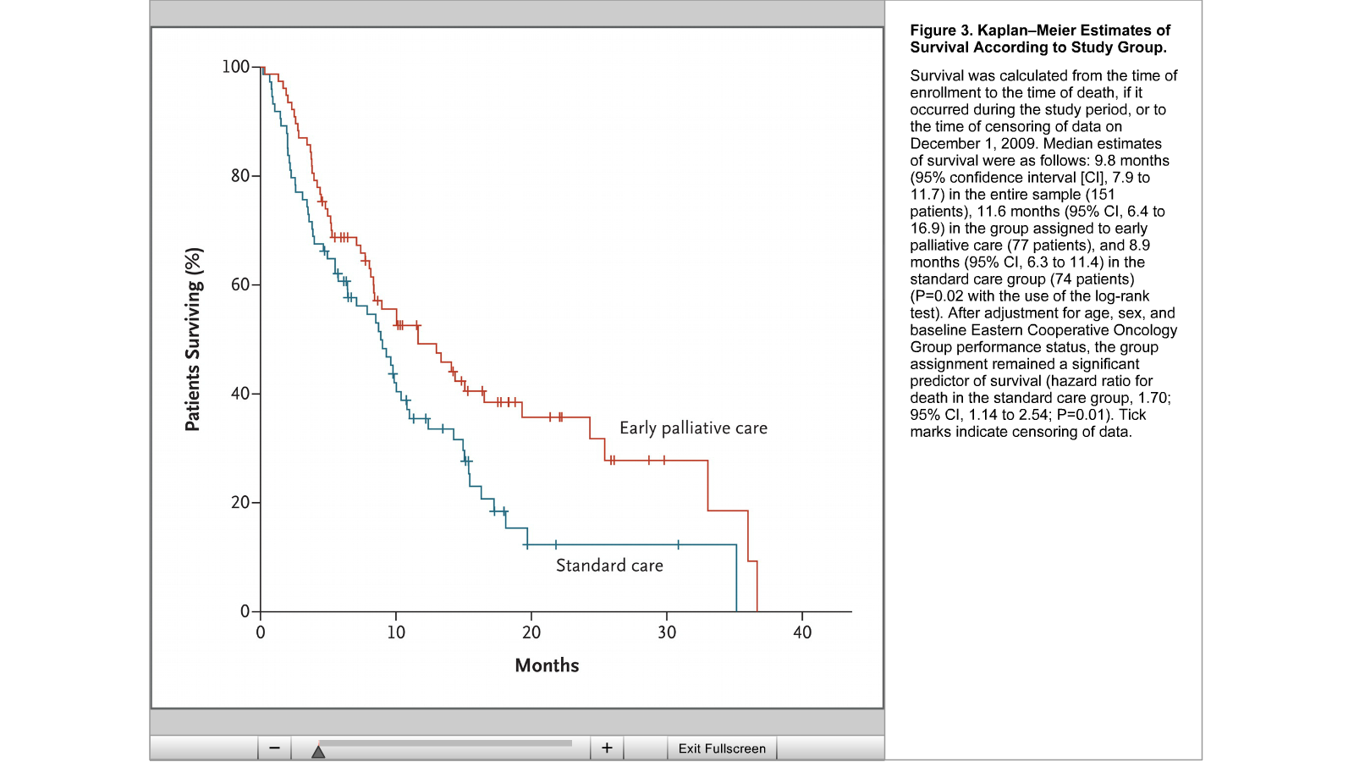
If it Were a Pill, it Would be Worth Millions
Median Estimates of Survival:
11.6 months early PC group
8.9 months in standard group

Slide 12
Palliative Care Has Many Benefits
Improved
Quality of life
Symptom control (i.e. pain, shortness of breath)
Spiritual wellbeing
Psychological symptoms
Satisfaction with care
Fewer hospitalizations
Fewer hospital days
Less burden on caregivers

Slide 13
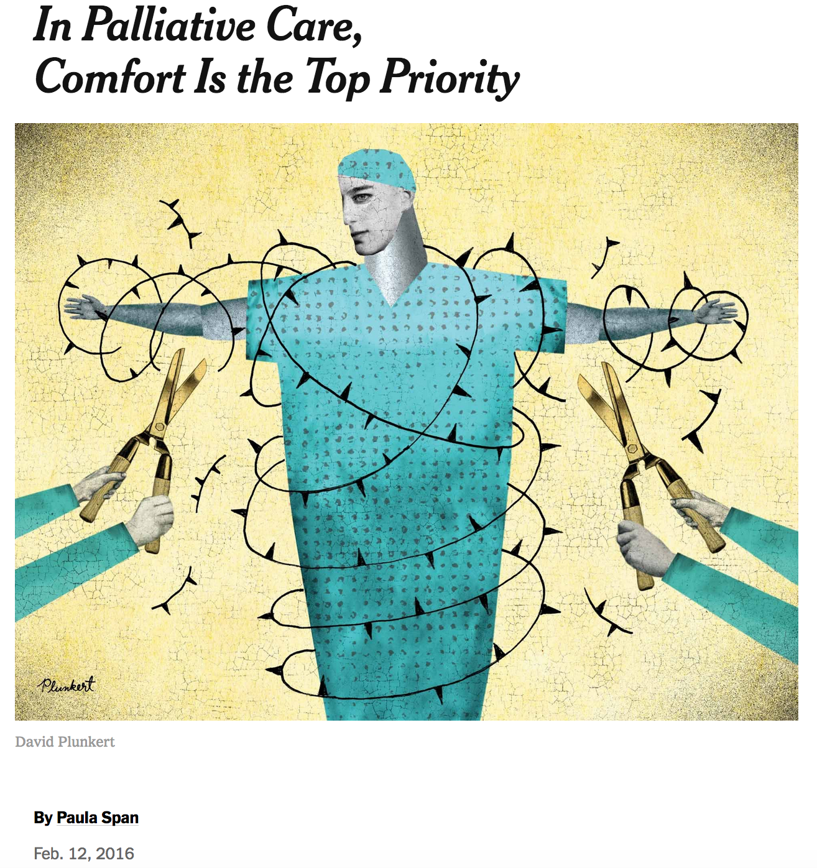
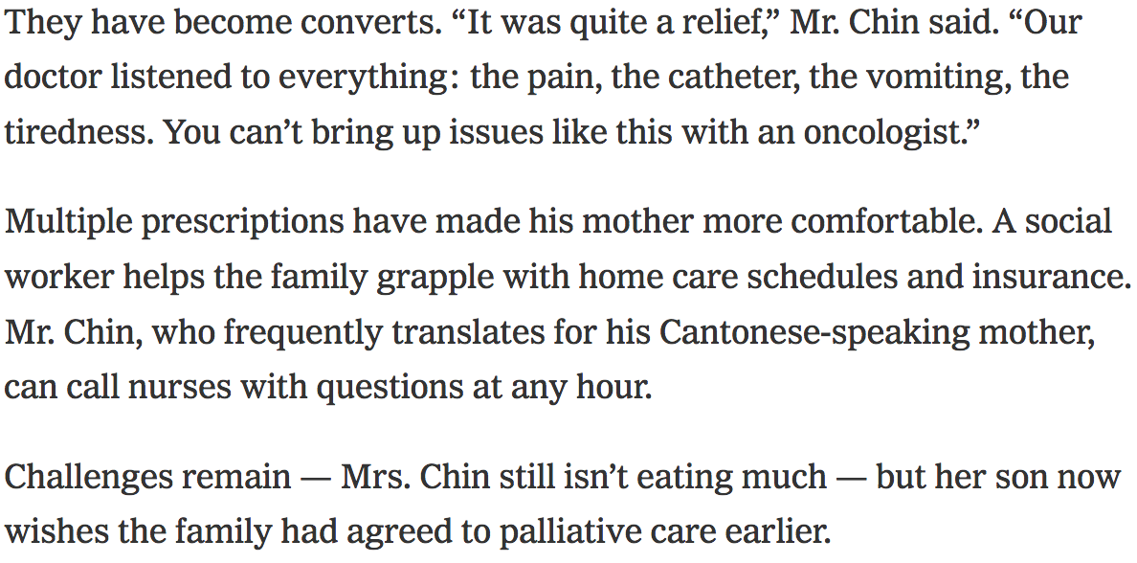
What it Looks Like in Real Life
“Our doctor listened to everything: the pain, the catheter, the vomiting, the tiredness.”
…but her son now wishes the family had agreed to palliative care earlier…

Slide 14
Palliative Care
Hospice

Slide 15
How to Get Palliative Care
Contact Stanford Palliative Care directly at:
www.med.stanford.edu/palliative-care
Or
Get assistance from Sukham at www.sukham.org
Sukhaminfo@gmail.com

Slide 16
Additional Resources
The Conversation Project
https://theconversationproject.org
Palliative Provider Directory
https://getpalliativecare.org/
Stanford Palliative Care Website
http://med.stanford.edu/palliative-care.html
Sukham
https://www.sukham.org/illness-palliative-hospice-care-end-of-life/
Palliative Care Always- 5 course series
https://www.coursera.org/specializat ions/palliative-care-always

Slide 17
www.med.stanford.edu/palliative-care www.sukham.org

