Slide 1
Pharmacology in Cystic Fibrosis
Denise Kwong, PharmD, BCPS
March 10, 2018

Slide 2
OBJECTIVES
Review pulmonary exacerbations and importance of treatment
Understand microbiology in cystic fibrosis and common pathogens in adults
Focus on Pseudomonas aeruginosa infections
Discuss pharmacokinetics of antibiotics and the importance of medication adherence
Review chronic medications for maintenance of lung health
Understand different respiratory therapies and sequence of administration

Slide 3
PULMONARY EXACERBATIONS
Characterized by:
↓ Lung function by 10%
Upper respiratory tract infection symptoms:
↑ cough, ↑ purulent sputum, shortness of breath, difficulty breathing
↓ exercise tolerance
↓ appetite and/or weight loss
Caused by:
Inflammation
Infection
Goal of treatment:
Return to previous pulmonary and functional status
Prolong time period to next pulmonary exacerbation
Repeat exacerbations have a NEGATIVE impact on lung function and lifespan
Budev MM, Mehta AC. Cystic Fibrosis. Cleveland Clinic: current Clinical Medicine. 2nd ed. Philadelphia: Elsevier; 2010. p. 1037-44.
Gibson RL, et al. Am J Respir Crit Care Med 2003; 168: 918-51.
Giusti R. Cystic Fibrosis. Conn’s Current Therapy. 1st ed. Philadelphia: Elsevier; 2012. p. 350-353.
Goss CH, Burns JL. Thorax 2007; 62: 360-67.
Notes:
-CF patients may have only mild bronchitic symptoms for long periods of time, but eventually, these periods of stability are interrupted by exacerbations of symptoms. These can include increased intensity of
-cough,
-tachypnea,
-SOB,
-decreased activity and appetite, and
-weight loss.
-Clinical efficacy measured by improved pulmonary function, ↓ sputum bacterial density, and improved quality of life measure
-Goal of treatment is to return patients to their previous pulmonary and functional status.
-In addition, for chronic P. aeruginosa infection, we want to prolong the time period to the next acute respiratory exacerbation as repeated exacerbations may have long-term negative impact on lung function and lifespan.
PATHOPHYS & MGMT OF INF 2003
BOPE & KELLERMAN
CLEVELAND CLINIC
EXACER IN CF 2007

Slide 4
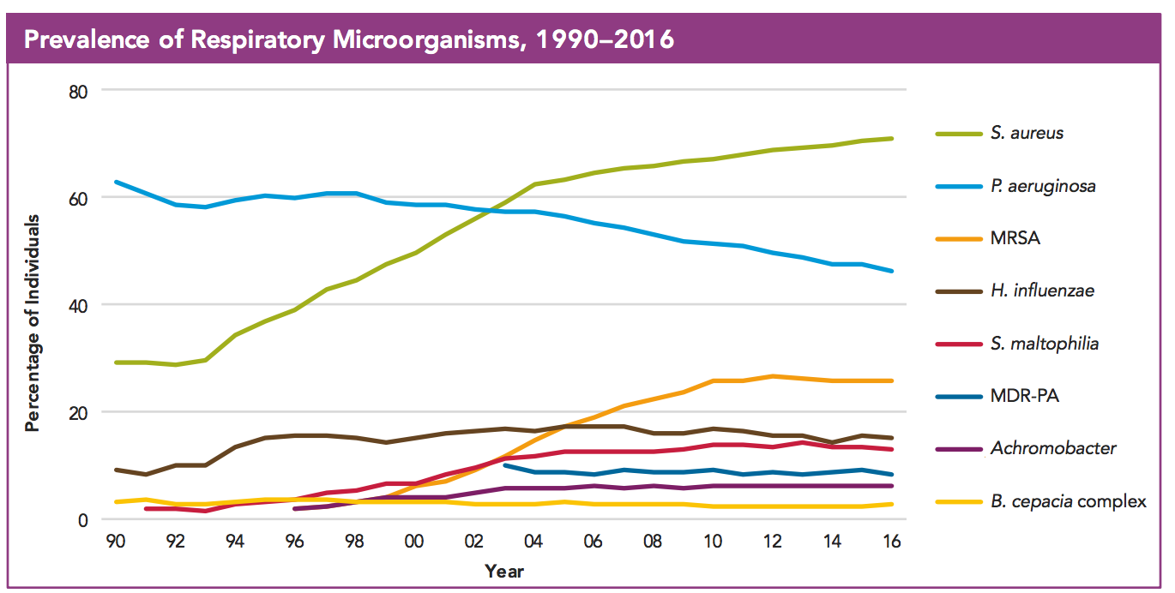
MICROBIOLOGY IN CYSTIC FIBROSIS
Cystic Fibrosis Foundation Patient Registry. 2016 Annual Data Report. Bethesda, Maryland.
Doring G, et al. Journal of Cystic Fibrosis 2012; 11: 461-79.
Giusti R. Cystic Fibrosis. Conn’s Current Therapy. 1st ed. Philadelphia: Elsevier; 2012. p. 350-353.
Notes:
- Decline in PA – maybe relate in part to widespread implementation of therapy to eradicate initial
Acquisition
MDR-PA remains the same – typically found in older adolescent/adult patients
Other bacteria most commonly believed to be pathogenic in CF include:
-Stenotrophomonas maltophilia
-Achromobacter xylosoxidans
-Burkholderia species
-Burkholderia cepacia is intrinsically resistant to a broad range of antibiotics and is associated with poorer lung function
CURRENT AND FUTURE
BOPE AND KELLERMAN
2016 ANNUAL REGISTRY

Slide 5
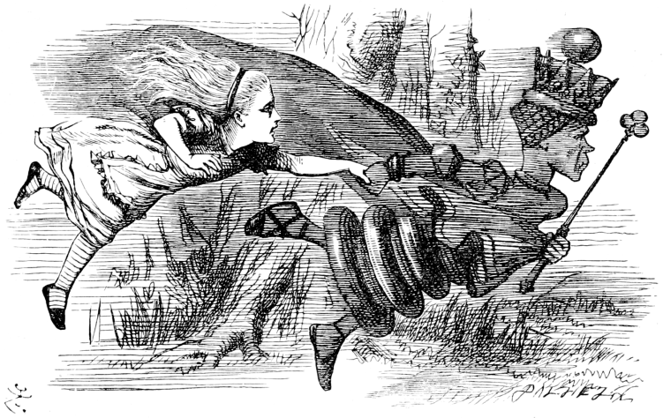
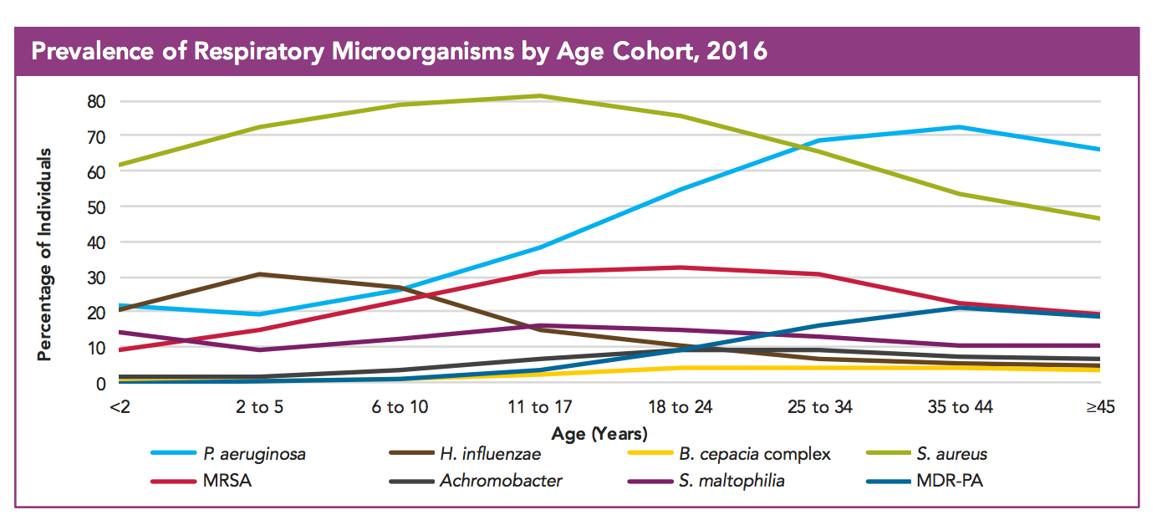
MICROBIOLOGY IN CYSTIC FIBROSIS
The Red Queen’s Race
“It takes all the running you can do, to keep in the same place” – Lewis Carole
Lewis Carole: Through the Looking Glass and What Alice Found There, Chapter 2, Image as depicted by John Tenniel
Cystic Fibrosis Foundation Patient Registry. 2016 Annual Data Report. Bethesda, Maryland.
Doring G, et al. Journal of Cystic Fibrosis 2012; 11: 461-79.
Giusti R. Cystic Fibrosis. Conn’s Current Therapy. 1st ed. Philadelphia: Elsevier; 2012. p. 350-353.
Notes:
"Well, in our country," said Alice, still panting a little, "you'd generally get to somewhere else—if you run very fast for a long time, as we've been doing."
"A slow sort of country!" said the Queen. "Now, here, you see, it takes all the running you can do, to keep in the same place. If you want to get somewhere else, you must run at least twice as fast as that!“
-So in taking a closer look at the microbiology in CF patients, you can see that Staphlococcus aureus and Haemophilus influenzae are common early colonizers
-As patients get older, PA becomes the predominant organism and is present in the sputum of 80% of adults
Other bacteria most commonly believed to be pathogenic in CF include:
-Stenotrophomonas maltophilia
-Achromobacter xylosoxidans
-Burkholderia species
-Burkholderia cepacia is intrinsically resistant to a broad range of antibiotics and is associated with poorer lung function
CURRENT AND FUTURE
BOPE AND KELLERMAN
2016 ANNUAL REGISTRY

Slide 6
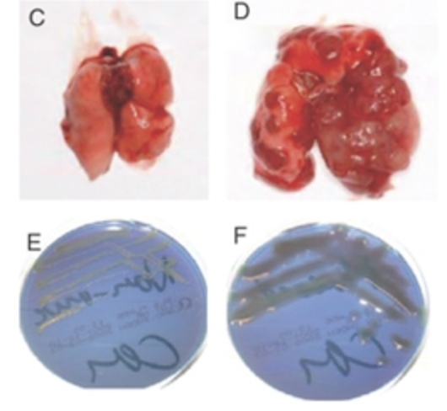
PSEUDOMONAS AERUGINOSA (PA)
Gram negative bacteria
Opportunistic pathogen
Mucoid form generates biofilm protecting bacteria from antibiotics
Pseudomonas correlated with:
Rapid decline in lung function
Decreased survival
May be colonized with multiple types of colonies
Surveillance monitoring every 3 months
Egan M. Chapter 395: Cystic Fibrosis. Nelson Textbook of Pediatrics. 19th ed. Philadelphia: Elsevier; 2011. p. 1481-97.
Giusti R. Cystic Fibrosis. Conn’s Current Therapy. 1st ed. Philadelphia: Elsevier; 2012. p. 350-353.
Moser, C. Novel experimental Pseudomonas aeruginosa lung infection model mimicking long-term host-pathogen interaction in cystic fibrosis. APMIS; 2009, Fig 3
Notes:
-Found in water reservoirs… like hot tubs…
-PA undergoes a mucoid transformation which interferes with the effectiveness of antibiotic therapy by generating a biofilm that provides a hypoxic environment thereby providing protection
-Acquisition of PA correlated with more rapid deterioration of lung function and increased mortality
-Aggressive antibiotic therapy is initiated when this bug is isolated to prevent chronic colonization of the airway
-May be present in several types of colonies, usually with different antibiotic sensitivities
-Periodic monitoring of the patient who has never been infected or who has had successful eradication should be done at least q3mos
BOPE AND KELLERMAN
EGAN

Slide 7
ANTIBIOTIC SELECTION
2009 Cystic Fibrosis Guidelines for Treatment of Pulmonary Exacerbations
“There is insufficient evidence to recommend the use of a single antibiotic as being equivalent to the use of more than one antibiotic class for treatment of Pseudomonas infection during an acute pulmonary exacerbation”
In practice we use 2 antibiotics to cover Pseudomonas aeruginosa
** Regimen based on recent culture sensitivities**
Try to pick different drug classes for different mechanisms of action
Intravenous (IV) antibiotics +/- Inhaled antibiotics
Doring G, et al. Journal of Cystic Fibrosis 2012; 11: 461-79.
Flume PA, et al. Am J Respir Crit Care Med 2009; 180: 802-8. Giusti R. Cystic Fibrosis. Conn’s Current Therapy. 1st ed. Philadelphia: Elsevier; 2012. p. 350-353.
Notes:
-In practice, you will see 2 IV antibiotics to cover PA. The regimen will be based on the most recent cultures if we have them.
-IV antibiotics are your standard treatment for a pulmonary exacerbation.
-You wouldn’t use inhaled antibiotics as monotherapy in this setting.
-Also, there is no evidence that using inhaled antibiotics during a course of IV antibiotics adds additional benefit.
-It is not always typically added on, but you may possibly see it in some more severe cases.
-If a patient is on a cycle of an inhaled antibiotic, then it may be continued while admitted.

Slide 8
ANTIBIOTICS EFFECTIVE AGAINST PSEUDOMONAS
β-lactams
Piperacillin/Tazobactam (Zosyn™)
Ceftazidime (Fortaz™)
Ceftazidime/Tazobactam (Avycaz™)
Cefepime (Maxipime™)
Ceftolozane/Tazobactam (Zerbaxa™)
Imipenem/cilastatin (Primaxin™)
Meropenem (Merrem™)
Doripenem (Doribax™)
Aztreonam (Azactam™)
Polymixins
Polymixin b (Aerosporin™)
Colistin (Coly-Mycin M™)
Aminoglycosides
Gentamicin
Tobramycin
Amikacin
Fluoroquinolones
Ciprofloxacin (Cipro™)
Levofloxacin (Levaquin™)
Double coverage combinations:
Two IV antibiotics with different MOA
β-lactam + Aminoglycoside
β-lactam + Colistin
β-lactam + Fluoroquinolone
Simon RH. Cystic fibrosis: Antibiotic therapy for lung disease. In: UpToDate, Hoppin, AG (Ed), UpToDate, Wellesley, MA, 2012.
Notes:
-For PA we have different antibiotics in different classes that can be used.
-Again, we want to make sure there is double coverage for PA with IV antibiotics with different mechanisms
-inevitably, even if you grow out one strain, CF patients usually have multiple colonies
-Combinations you may see are B-lactams with either an aminoglycoside, colistin, or a fluoroqinolone

Slide 9
HOW LONG TO TREAT?
Treat exacerbations until symptoms resolve and lung function recovers
Standard therapy:
Combination of two IV antibiotics for 14 – 21 days
Multi-drug resistant Pseudomonas aeruginosa may require longer therapy
Doring G, et al. Journal of Cystic Fibrosis 2012; 11: 461-79.
Gibson RL, et al. Am J Respir Crit Care Med 2003; 168: 918-51.
Notes:
-The standard therapy is for 14-21 days until symptoms resolve and lung function recovers.
-Typically, therapy should not be more than 3 wks, however if the patient has a multi-drug resistant PA, they may require a longer course

Slide 10
TIME VS CONCENTRATION DEPENDENT ANTIBIOTICS
Fluoroquinolones, Aminoglycosides
Beta-lactams, Macrolides
http://www.ashp.org/DocLibrary/MemberCenter/NPF/2011Pearls/Antibiotic-Pharmacokinetic-Monitoring.aspx
Notes:
Oxazolidiones (linezolid), and clindamycin also time dependent

Slide 11
ANTIBIOTIC DOSING AND MONITORING
Patient Adherence is the most important parameter
Time Dependent: Lower Doses + Frequent Dosing + Extended Infusion
Beta-Lactams (Piperacillin-Tazobactam, Cefepime, Meropenem, Aztreonam)
Concentration Dependent: Higher Doses + Infrequent Dosing
Aminoglycosides (Amikacin, Gentamicin, Tobramycin)
Bonus post-antibiotic effect
Therapeutic Drug Monitoring
Important to balance efficacy with toxicity
Drug levels usually timed for peaks and/or troughs
Peak: monitor efficacy
Trough: monitor toxicity
Most common toxicity = Kidney Damage
Look out for ↓ urine output, fluid retention (leg swelling), confusion, fatigue, nausea
Wu B., Sy S.K.B., Derendorf H. (2014) Principles of Applied Pharmacokinetic–Pharmacodynamic Modeling. In: Vinks A., Derendorf H., Mouton J. (eds) Fundamentals of Antimicrobial Pharmacokinetics and Pharmacodynamics. Springer, New York, NY
Notes:
Patient adherence = taking medications at the right time, correct frequency, and completing a full course

Slide 12
CHRONIC USE OF AZITHROMYCIN TO REDUCE EXACERBATIONS
Recommended for use in patients > 6 years old
High Evidence for patients WITH chronic PA colonization
Moderate Evidence for patients WITHOUT chronic PA colonization
Does NOT treat PA infection
Benefits:
↓ PA biofilm formation
Relative improvement of FEV1
Fewer courses of IV antibiotic
Fewer hospital days
Weight gain
AFB smear prior to starting, then check culture & smear every 6-12 months
Dose: ≥40 kg: 500 mg three times a week
Doring G, et al. Journal of Cystic Fibrosis 2012; 11: 461-79.
Flume PA. Am J Respir Crit Care Med 2007; 176: 957-69.
Yankaskas JR, et al. Chest 2004; 125: 1S-39S.
Mogayzel, P et al. Cystic Fibrosis Pulmonary Guidelines Chronic Medications. Am J Respir Crit Care Med. 2013; 680-689
Notes:
-Azithromycin has become an accepted therapy in CF patients with chronic PA infection and is recommended by the CFF.
- High Recommendation for pts colonized with PA (B evidence) , Moderate Recommendation for non -PA colonized pts (C evidence)
-It does not treat PA infection, but is thought to have some anti-inflammatory properties
-Some benefits seen in CF patients chronically infected with PA include:
-improved lung function
-decreased hospitalization rate
-weight gain
-Azithromycin should be included in those 6 or older who are also chronically infected with psuedomonas.
-An AFB smear test should be done prior to starting and intermittently checked if chronic azithromyin tx is used bc of slight risk of macrolide resistance developing if used as monotherapy and there is a nontuberculosis mycobacterial infection present

Slide 13
NO EVIDENCE FOR ANTI-INFLAMMATORY AGENTS IN ADULTS
Excessive inflammatory response in airways may be major cause of destruction
Inhaled corticosteroid:
No improvement in lung function
CFF does not recommend
Systemic corticosteroid:
Showed benefit of pulmonary function
Risks outweigh: cataracts, glucose intolerance, bone density decrease
CFF does not recommend
Ibuprofen:
Slowed progression of pulmonary disease in mildly affected patients
Recommended in 6-17 year old with FEV1 >60%
Mogayzel, P et al. Cystic Fibrosis Pulmonary Guidelines Chronic Medications. Am J Respir Crit Care Med. 2013; 680-689
Notes:
-Anti-inflammatory therapies are often used in the treatment of CF lung disease because the inflammatory response in CF airways is excessive
-It is thought that this excessive and persistent inflammation is a major cause of destruction of the airways, over time leading to bronchiectasis and severe obstructive airway disease
-Inhaled corticosteroids have not been found to improve lung function and the CFF does not recommend its use to improve lung function or reduce exacerbations
-PO steroids did show some benefit in terms of pulmonary function, but the risks outweigh any benefit. Patients were found to develop cataracts, glucose intolerance, growth retardation, bone density decrease. Therefore, PO corticosteroids are not recommended by the CFF.
-Now if the patient also had asthma in addition, then PO steroids may be useful for asthma exacerbations
-Studies looking at ibuprofen given at a high dose of 20-30 mg/kg divided into two doses (up to 1600mg BID) found that there was a slowing of the progression of pulmonary disease, but only in patients with mild disease. This was not the case for those with moderate-to-severe obstructive airways disease. – looking for peak plasma concentration of 50 -100 mcg/ml
-Therefore, in those with mild pulmonary disease, with an FEV1 >60% predicted, the CFF does recommend chronic use of ibuprofen to slow the loss of lung function
RECENT ADVANCES IN CF

Slide 14
RESPIRATORY THERAPIES

Slide 15
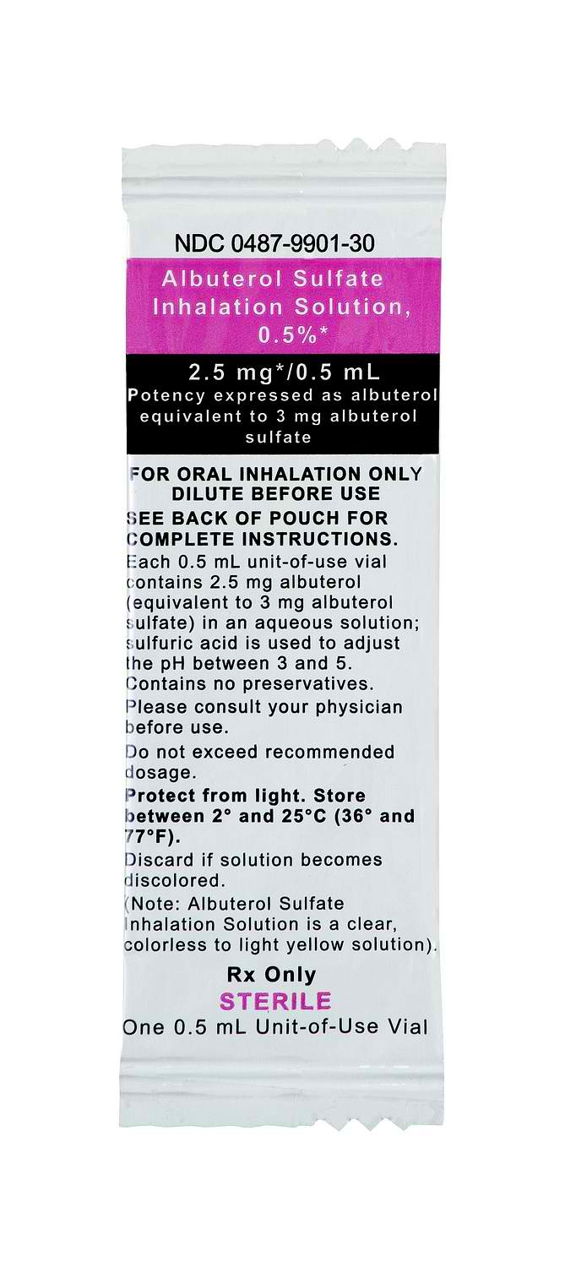
BRONCHODILATORS – B2 ADRENERGIC RECEPTOR AGONISTS
Relax bronchial smooth muscle -> bronchodilation
No long-term benefit with routine use
Used for symptom relief or prior to chest PT
Insufficient evidence to recommend for chronic use in > 6 year old
Giusti R. Cystic Fibrosis. Conn’s Current Therapy. 1st ed. Philadelphia: Elsevier; 2012. p. 350-353.
Flume PA. Am J Respir Crit Care Med 2007; 176: 957-69.
Yankaskas JR, et al. Chest 2004; 125: 1S-39S
Notes:
Airway hyperreactivity is present in 50-60% of CF patients
first deliver the -agonist aerosol to open the distal airways, then deliver hypertonic saline24 to hydrate the airways and improve ciliary transport, then follow with dornase alfa20 (rhDNase) to break down the thick tenacious secretions. Finally, perform airway clearance to remove the secretions, and then conclude with aerosolized antibiotics delivered to the “clean” lungs.
-No long-term benefit with routine use
-Used for symptom relief prior to chest PT to facilitate clearance of the airways
-the Cystic Fibrosis Foundation has insuffiencient evidence the chronic use of inhaled B2-agonists in those 6 years or older.
-the formulation most typically used is the albuterol nebulizer, which can be used prior to administering inhaled medications and also chest PT
BOPE AND KELLERMAN
MURRY AND NADEL’S
CHRONIC GUIDELINES 2007
CF ADULT CARE

Slide 16
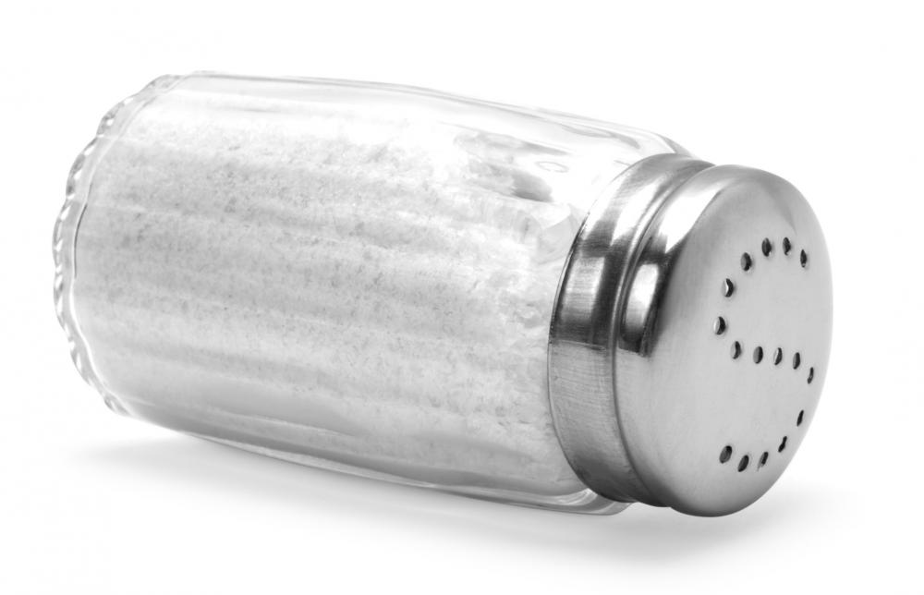
HYDRATION OF AIRWAY SURFACE FLUID
7% hypertonic saline (Hyper-sal®) increases hydration of airway surface fluid
Administered via nebulizer 2-4 times daily
Facilitate clearance of airway mucus
↑ pulmonary function
↓ frequency of pulmonary exacerbations
Egan M. Chapter 395: Cystic Fibrosis. Nelson Textbook of Pediatrics. 19th ed. Philadelphia: Elsevier; 2011. p. 1481-97.
Notes:
-Hypertonic saline the best known and widely used of its class to increase the hydration of airway surface fluid
-Many centers, in fact, now consider inhaled hypertonic saline as a standard of care
-It is administered usually twice daily via nebulizer
-it has been shown to improve mucocilliary clearance and lung function and is currently used in pediatric and adult patients with CF
-In patients who cannot tolerate 7% due to its side effects of cough and bronchospasm, the 3% hypertonic saline solution may be used
EGAN

Slide 17
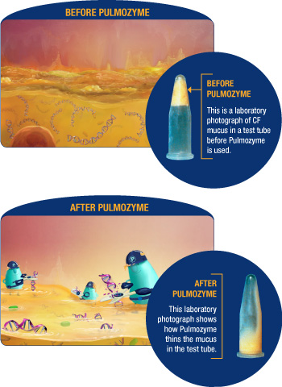
MUCOLYTICS
DNase or α-dornase (Pulmozyme®)
Nebulized mucolytic agent
Cleaves neutrophil-derived DNA contributing to thick secretions in airways
Found to:
↑lung function by 5%
↓ sputum viscosity
↓ risk of pulmonary exacerbations by 28%
Don’t mix with other nebulizers
medication gets deactivated
Side Effects: hoarseness and mild pharyngitis
Boucher RC, et al. Chapter 41: Cystic Fibrosis. Murray and Nadel’s Textbook of Respiratory Medicine. 5th ed. Philadelphia: Elsevier; 2010. p. 985-1022.
Giusti R. Cystic Fibrosis. Conn’s Current Therapy. 1st ed. Philadelphia: Elsevier; 2012. p. 350-353.
Yankaskas JR, et al. Chest 2004; 125: 1S-39S.
www.pulmozyme.com
Notes:
-Mucolytics - are another class of medications in our repertoire of CF treatment.
-Pulmozyme has shown good outcomes:
-Pulmonary function improvement
-Some improvement in sputum viscosity which also helps with airway clearance
-Decreased respiratory tract infections and pulmonary exacerbations
Found to:
↑lung function by 5%
↓ sputum viscosity
↓ risk of pulmonary exacerbations by 28%
-It may delay, but it will not prevent the progression of the disease
-Mucomyst is nebulized N-acetylcysteine
-It’s efficacy and safety have not been established, and it may irritate upper airways causing bronchoconstriction
BOPE AND KELLERMAN
MURRAY AND NADEL’S
CF ADULT CARE

Slide 18
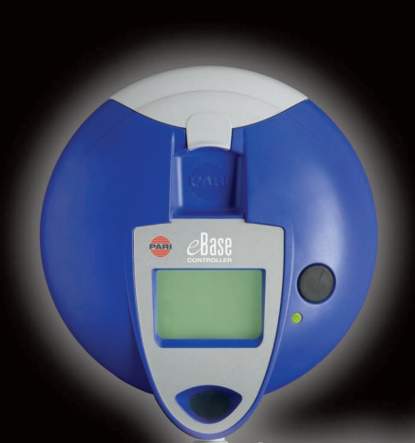
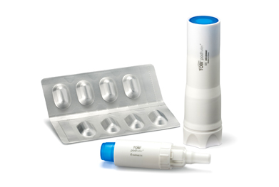
INHALED ANTIBIOTICS
Advantages:
↑ antibiotic concentration at site of infection
Enhanced bacterial killing
↓ need for IV antibiotics → ↓ toxicity
Cycled for 28 days on, then 28 days off
Nebulized Aztreonam (AZLI®, Cayston®) RECOMMENDED AGENT
Improves lung function, respiratory symptoms , ↑ QoL
Dose: 75mg nebulized three times daily with minimum 4 hours between doses
For ages 6 yrs or older
Nebulized Tobramycin inhalation solution/powder (TOBI®)
Improves lung function, ↑ QoL, ↓ hospitalizations
Dose: 300mg nebulized BID
Nebulized Colistin
Not FDA approved, but used
Doring G, et al. Journal of Cystic Fibrosis 2012; 11: 461-79.
Hewer SL. J R Soc Med 2012; 105: S19-S24.
Notes:
Inhaled Antibiotics are usually used for chronic suppression of bacterial infections.
CF foundation highly recommends tobi or aztreonam inhaled for moderate to severe CF (A evidence)
-There are many advantages to using inhaled antibiotics, such as
-Increased concentrations at the site of infection
-Enhanced bacterial killing
-It may also reduce the need for IV or prolonged oral therapy, thus reducing risk of toxicity
-It is usually cycled for 28 days on and then 28 days off
-Three formulations currently FDA approved.
-The Nebulized Tobramycin inhalation solution, brand name TOBI has shown to improve lung function, increase quality of life, and decrease hospitalizations.
- TOBI Podhaler: 112 mg (4 x 28 mg capsules) every 12 hours (do not administer doses <6 hours apart); administer in repeated cycles of 28 days on drug followed by 28 days off drug
-Nebulized aztreonam was approved in 2010 and it showed improvement in lung functions and respiratory symptoms - added to 2013 guidelines as standard treatment
-Nebulized colistin has been traditionally used, but it is not FDA approved

Slide 19
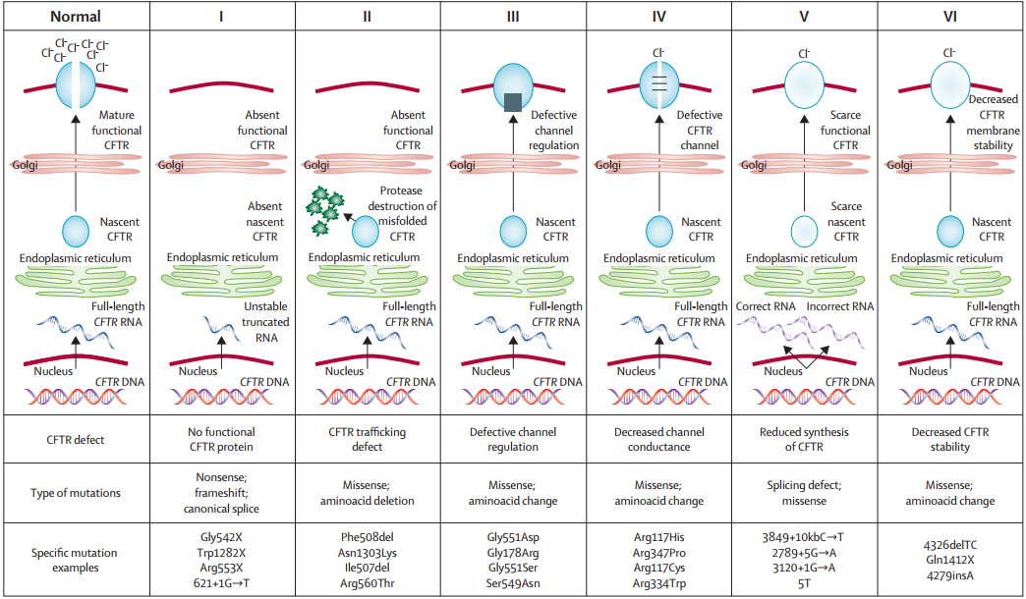
CFTR GENE MUTATION CLASSES
Most Prevalent
Elborn, S. Lancet 2016; 388: 2519-31.

Slide 20
ΔF508 mutation affects 70% of CF patients
G551D mutation affects 4-5% of CF patients
Gibson RL, et al. Am J Respir Crit Care Med 2003; 168: 918-51.
Lobo J, et al. Clin Chest Med 2012; 22: 307-28.
Notes:
-Most notable class 2 mutation is the ΔF508 mutation, which affects 70% of CF patients.
-G551D, a Class 3 mutation, affects a smaller number of patients at about 4-5%
-New therapies in development are looking to personalize the treatment and so their focus is honed in on some of these mutations, as we see with Ivacaftor
RECENT ADVANCES IN CF
PATHOPHYS AND MANAGEMENT 2003

Slide 21
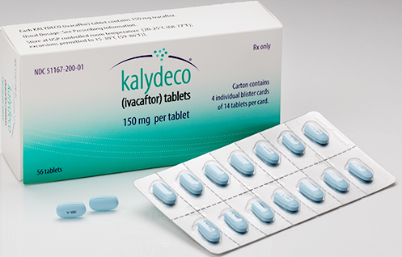
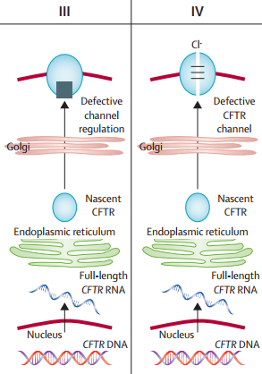
CFTR POTENTIATOR
Ivacaftor (Kalydeco®)
FDA approved in January 31, 2012
Facilitates Cl transport by potentiating CFTR channel and increasing probability of channel opening
Treatment of CF in patients 2 or older with one of the following mutations in CFTR gene: G551D, G1244E, G1349D, G178R, G551S, S1251N, S1255P, S549M or S549R, R117H
Dose: 150 mg PO BID with fat-containing food
Adverse Effects: abdominal pain, ↑ hepatic enzymes, HA, upper respiratory tract infection, nasal congestion, nausea, rash, rhinitis, dizziness, arthralgia
Gibson RL, et al. Am J Respir Crit Care Med 2003; 168: 918-51.
Kalydeco® [package insert]. Cambridge, MA: Vertex; 2012.
Notes:
-So the newest drug to be added to our repertoire of CF therapies is Ivacaftor
FIRST DRUG TO TREAT THE UNDERLYING CAUSE OF DISEASE
-not effective for patients who are homozygous for the F508del mutation in CFTR gene
-It was FDA approved in January of this year
-It’s MOA directed at the channel to increase the function of a correctly placed CFTR channel, thus increasing the opening time to increase Cl movement into the airway lumen
-has been shown to improve lung function (measured as predicted FEV1 10.5% imrovement within 2 weeks maintained 48 weeks), lower sweat chloride levels and help patients gain weight (2.7 kg) , reduction in pulmonary exacerbations
-It is approved for patients with certain mutations, must be genetically tested for this mutation prior to the start of it
Dose adjustments for hepatic function and DDI
-Ivacaftor is an adjunctive therapy to the standard CF care (~300,000/year)
-Adverse effects seen include:
-Ab pain
-increased LFTs
-hypoglycemia was noted
-and then also HA, nasal congestion, dizziness, arthralgia
-It is an oral tablet given twice daily and should be given with fat-containing food
-fat increases exposure 2.5 to 4 fold
KALYDECO should be taken with fat-containing food. Examples include eggs, butter, peanut butter, cheese pizza, whole-milk dairy products (such as whole milk, cheese, and yogurt), et
-It also requires dose adjustments in patients with moderate-to-severe hepatic impairment and when co-administered with strong CYP 3A4 inducers and inhibitors
PATHOPHYS AND MANAGEMENT 2003

Slide 22
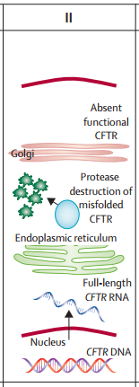
CFTR MODULATOR
Mechanism: Improves stability of F508del-CFTR
↑ processing and trafficking of mature protein to cell surface
Lumacaftor + Ivacaftor (Orkambi®) approved July 2015
Treatment of CF age 6 years and older w/ 2 copies of F508del mutation
Tezacaftor + Ivacaftor (Symdeko®) approved February 2018
Treatment of CF age 12 years and older w/ 2 copies of F508del mutation OR at least one mutation in CFTR gene responsive to therapy
Lobo J, et al. Clin Chest Med 2012; 22: 307-28.
Orkambi® [package insert]. Boston, MA: Vertex; 2015
Symdeko [package insert]. Boston, MA: Vertex: 2018.
Notes:
F508 del most common mutation
affect how many cftr at cell surface - too few at surface
proteins do not open enough

Slide 23
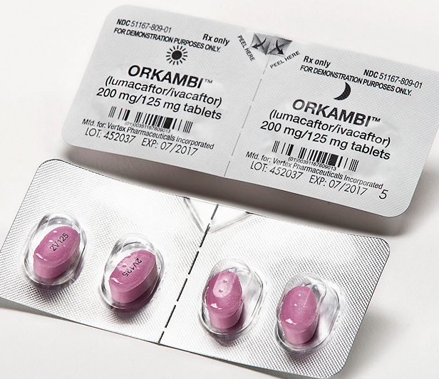
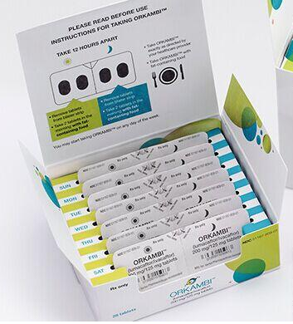
LUACAFTOR + IVACAFTOR (ORKAMBI®)
Each tablet contains lumacaftor 200 mg/ivacaftor 150 mg
Dose: 2 tablets orally every 12 hours with fat-containing food
Adverse Effects: chest discomfort, dyspnea, respiratory discomfort
Monitor for liver toxicity
Yellowing of skin and eyes, itching, abdominal pain, nausea, fatigue
Lobo J, et al. Clin Chest Med 2012; 22: 307-28.
Orkambi® [package insert]. Boston, MA: Vertex; 2015.
Notes:
Lumacaftor improves the conformational stability of F508del-CFTR, resulting in increased processing and trafficking of mature protein to the cell surface. Ivacaftor is a CFTR potentiator that facilitates increased chloride transport by potentiating the channel-open probability (or gating) of the CFTR protein at the cell surface. In vitro studies have demonstrated that both lumacaftor and ivacaftor act directly on the CFTR protein in primary human bronchial epithelial cultures and other cell lines harboring the F508del-CFTR mutation to increase the quantity, stability, and function of F508del-CFTR at the cell surface, resulting in increased chloride ion transport. In vitro responses do not necessarily correspond to in vivo pharmacodynamic response or clinical benefit.
lumacaftor is a strong inducer of CYP3A4
Dosage adjustment with concomitant medications: Coadministration of strong CYP3A inhibitors (eg, itraconazole): When initiating lumacaftor/ivacaftor in patients already maintained on a strong CYP3A inhibitor, reduce the initial dose to 1 tablet once daily. Following 1 week of therapy, increase to 2 tablets every 12 hours. If lumacaftor/ivacaftor therapy is interrupted for >1 week while taking strong CYP3A inhibitors, re-titration must occur. No dosage adjustment is required for patients already maintained on lumacaftor/ivacaftor who begin therapy with a CYP3A inhibitor.
Inform patients that ORKAMBI is best absorbed by the body when taken with fat-containing food. A typical CF diet will satisfy this requirement. Examples of fat-containing foods include eggs, avocados, nuts, butter, peanut butter, cheese pizza, whole-milk dairy products (such as whole milk, cheese, and yogurt), etc.

Slide 24
TEZACAFTOR + IVACAFTOR (SYMDEKO®)
Each tablet contains tezacaftor 100 mg/ivacaftor 150 mg
Dose: 1 tablets orally every 12 hours with fat-containing food
Adverse Effects: nausea, headache, sinus congestion, DIOS
Monitor for liver toxicity
Yellowing of skin and eyes, itching, abdominal pain, nausea, fatigue
Monitor for blurred vision (cataracts)
Symdeko [package insert]. Boston, MA: Vertex: 2018.

Slide 25
QUESTIONS?

