Slide 1
Navigating the World of Insurance Removing the Barriers
Anastasia Kaiser, MSW
Social Work Clinician for Adult Cystic Fibrosis Center

Slide 2
Outline
Insurance Options:
Private
GHPP
MediCal/Medicare
Covered California
SSI/SSDI
Updates
Helpful CF Specific Resources

Slide 3
Insurance Options: Private Insurance
Private insurance through employer’s health plan
Available through self, spouse, or parent (until age 26)
At age 26, steps can be taken to stay on parents insurance plan
Meet with HR
CF TT on forms stating disability and need
Disability criteria can vary
Definition of disability subject to review by treatment team
Many Options!
HMO, PPO, POS, EPO

Slide 4
Insurance Options: Genetically Handicapped Persons Program (GHPP)
California based health care program to help people with specific genetic diseases
Covers: Clinic visits, hospital stays, prescriptions, medical equipment, and lung transplant surgery
Application requirements:
CF genotype
Social Security Number
Proof of CA residency (utility bill, proof of registration to vote in CA…)
Income verification, tax statements from previous year
Follow this link: http://www.dhcs.ca.gov/services/ghpp/Pages/Apply.aspx
Source: www.dhcs.ca.gov

Slide 5
Insurance Options: MediCal and/or Medicare with Disability
Becomes an option after applying for, and receiving, Social Security Disability Insurance (SSDI)
Benefits to people who can’t work because they have a medical condition that’s expected to last at least one year or result in death
After 24 consecutive months getting SSDI benefits you will be enrolled automatically into Medicare or MediCal
This can be in addition to existing insurance plan
5 month waiting period for benefits to begin (30 months out from becoming disabled)
Income determines which insurance plan you are assigned
Source: www.socialsecurity.gov

Slide 6
Insurance Options: MediCal (through income)
MediCal (State level program for Medicaid)
Free or low-cost health coverage for children and adults with limited income and resources
Provides essential health benefits
MediCal is offered at free or lowest cost, as opposed to Covered CA plans
Managed MediCal Plan vs. “Straight” MediCal
Managed (ex: Health Plan of San Mateo, Santa Clara Family Health Plan)
Keeps networks of health providers specific to county
“Straight” MediCal
Allows you to be seen by any provider who accepts MediCal
Being on MediCal or getting a Managed Plan is determined by your county of residence
Source: www.coveredca.com, www.disabilityrightsca.org

Slide 7
Insurance Options: Covered California
Created by the Affordable Care Act (ACA)
ObamaCare
The California version of healthcare.gov
Not an individual insurance plan, but instead an
Insurance plan store (marketplace)
Provides insurance options for individuals who are ineligible for MediCal/Medicaid and do not have an employer insurance option
To apply:
http://www.coveredca.com/faqs/ or call a representative at 1-800-300-1506.
(Stanford contact Kevin Woods—650-724-5750)

Slide 8
Insurance Options: Covered California
For Hospital Coverage:
HealthNet EPO/HMO/HSP
HealthNet PPO- must be purchased via HealthNet or with a licensed insurance agent
Valley Health Plan HMO
All other plans are considered “Out of Network”
For Physician Coverage:
HealthNet EPO/HMO/HSP : (HMO/HSP: PCP selection is limited to physicians in Santa Clara County)
Valley Health Plan HMO (specialist services only)
HealthNet PPO- must be purchased via HealthNet or with a licensed insurance agent
Source: www.stanfordhealthcare.org

Slide 9
This information is not meant to be legal advice
Meeting one of the medical criteria is not a guarantee of benefits
Might still be eligible if you can show condition is medical equivalent to one of the listed criteria

Slide 10
SSI and SSDI: Comparison
SSI
“Supplemental Security Income”
Financial need based
To Qualify:
Making no or low income
Less than 2k in assets
(less than 3k if married)
SSDI
“Social Security Disability Insurance”
Dependent on how many taxable work credits made from working
Ex: worked full time in minimum wage job for 5 of the last 10 years will likely qualify

Slide 11
Update: SSI/SSDI 2017 Criteria
SSI and SSDI- both use same medical criteria
Social Security looks at medical records within the twelve months prior to the filing of an application. Under the new rules a person may be eligible in six other ways:
1. Three hospital stays in the year prior to applying for benefits, at least 30 days apart; OR
2. Treatment for a spontaneous collapsed lung requiring chest tube placement; OR
3. Respiratory failure requiring ventilation or noninvasive ventilation with BiPAP or a combination, for a continuous period of at least 48 hours or a continuous period of a least 72 hours if following surgery; OR
4. Embolization for hemoptysis; OR
5. FEV1 <50% twice in last year, 30 days apart (approximate)
The SSA is also taking into consideration altitude of living, height and weight for this. This is a recent change, coming into effect in October 2016.
Source: http://www.cfroundtable.com/2016/09/19/breaking-news-an-analysis-of-the-new-social-security-rules-for-cystic-fibrosis/

Slide 12
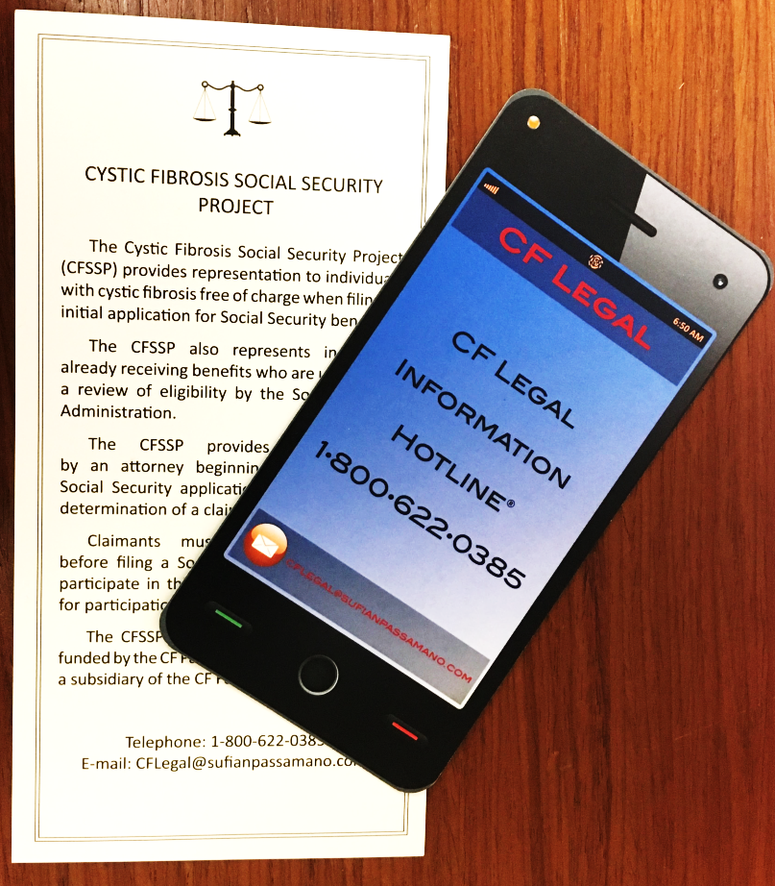
CF Legal Information Hotline
Provides free confidential information to individuals with CF and caregivers
SSI eligibility and benefits
CF Social Security Project
MediCal/Medicare/Private Health Insurance
Education
Employment
Sponsored by the CF Foundation
1-800-622-0385
CFLegal@sufianpassamano.com

Slide 13
Financial assistance to eligible individuals to cover coinsurance, copayments, health care premiums and deductibles for certain medications and therapies
Specific to CF: vitamins, supplements, hypertonic saline solution, nebulizers paired with treatments, and certain handsets
Money is loaded onto a Visa card for your convenience
Maximum award is $15,000
How to apply:
Apply online: https://www.healthwellfoundation.org/patients/apply/
Call hotline: 1-800-675-8416. Monday–Friday 9 a.m. – 5 p.m. EASTERN STANDARD TIME.

Slide 14
Personalized service to help you with insurance, financial, legal and other issues you are facing
One-on-one work with a dedicated CF Foundation case manager
Compass is available to anyone with CF, their family and their care team, regardless of income or insurance status.
Free and confidential ☺
1-844-COMPASS (844-266-7277)
Monday - Friday, 8:30 a.m. - 5:30 p.m. EST
Email: compass@cff.org

Slide 15
Stanford’s Financial Assistance and Financial Counseling
If all else fails…
Feel free to consult with Financial Counseling Department
Insurance questions specifically related to getting care at SHC
Billing related concerns or questions
650-498-2900, Option 2 to speak with a counselor
Financial Assistance Application
Evaluation to see if SHC can help with payment plan or bill forgiveness
Proof of income
Completed application
https://mfaa.uscbinc.com/

