Slide 1


The Orkambi Revolution
Hype, Hate or Health?
CF Ed Day 2017
Richard B. Moss, MD
Center for Excellence in Pulmonary Biology
Department of Pediatrics
Stanford University

Slide 2
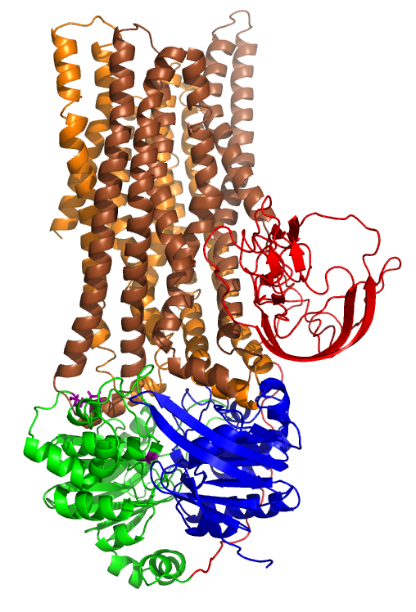
Cystic Fibrosis Transmembrane Regulator (CFTR) Protein
~90% of CF individuals have at least one F508del allele
~50% have 2 copies (homozygous); ~40% have one copy (heterozygous)
F508del-CFTR has a protein-folding defect that
  Inhibits trafficking
  Enhances degradation
  Reduces CFTR membrane channel function
Little to no functional F508del-CFTR reaches the cell surface
Extracellular
Intracellular
Cl⁻
R domain
cAMP/PKA
regulation
F508del
NBD1
ATP binding / hydrolysis
NBD2
ATP binding / hydrolysis

Slide 3
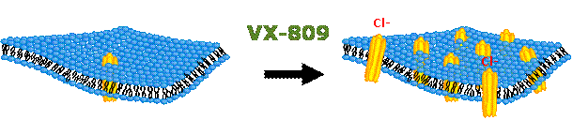
CFTR Correctors
CFTR correctors aim to increase the delivery and amount of functional CFTR protein to the cell surface, resulting in improved ion transport
ER
ER
Lumacaftor resulted from a high-throughput screening and medicinal chemistry optimization program to generate F508del-CFTR corrector compounds

Slide 4
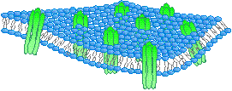
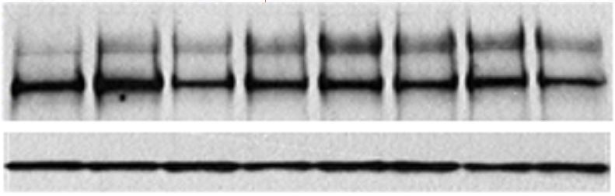
Lumacaftor (VX-809) Effect on F508del-CFTR Maturation and Chloride Secretion In Cell Culture
CFTR Maturation
Cl– Secretion
Plasma Membrane
VX-809 conc.
18
15
12
9
6
3
0
C-
B-
Golgi
0.8
0.7
0.6
0.5
0.4
% Non-CF-HBE CI- transport
ER
C/C+B Ratio
-9 -8 -7 -6 -5 -4
VX-809 (Log M)
Ussing chamber studies with HBE from F508del homozygous CF donors (n=7)
-9 -8 -7 -6 -5 -4
VX-809 (Log M)
Western blot showing B- to C-band conversion with cultured HBE from F508del homozygous CF donors
Notes:
J. Riordan Antibody

Slide 5
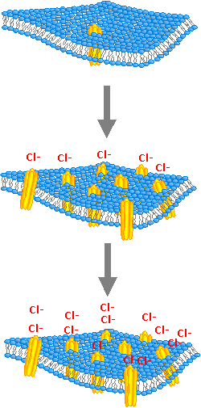
Combination Approach: CFTR Potentiator Ivacaftor (Kalydeco) Doubled the Activity of CFTR Corrector Lumacaftor (VX-809)
F508del-CFTR
40
30
20
10
0
VX-809
+
Ivacaftor
CFTR corrector
F508del-CFTR Activity
(% wt-CFTR)
VX-809
alone
CFTR potentiator
-9 -8 -7 -6 -5 -4
Log M [VX-809]

Slide 6
Orkambi (lumacaftor-ivacaftor) Combination Trial for F508del Homozygous CF
Key eligibility criteria:
  Age ≥12 years, confirmed CF diagnosis
  Homozygous for F508del-CFTR
  Percent predicted FEV₁ ≥40 to ≤90 at screening
Notes:
Two Phase 3, randomized, double-blind, placebo-controlled, parallel-group study. Patients who completed TRAFFIC/TRANSPORT were able to enter the PROGRESS rollover study
Combined lumacaftor (600 mg qd or 400 mg q12h) with ivacaftor (250 mg q12h) or matched placebo for 24 weeks
Conducted at 185 sites in North America, Europe, and Australia
N=1108

Slide 7
Outcome Measures
Primary endpoint:
  Absolute change from baseline in percent predicted FEV₁ at Week 24, as assessed by the average absolute change at Weeks 16 and 24

Slide 8
Percent Predicted FEV₁
(Pooled TRAFFIC & TRANSPORT)
Absolute Change from Baseline in Percent Predicted FEV₁
6
4
2
0
-2
Placebo
LUM 600 mg qd / IVA 250 mg q 12h
LUM 400 mg q12h / IVA 250 mg q12h
*
*
*
*
*
*
*
*
*
*
Absolute Change in Percent Predicted FEV₁
(% points) (LSMean ± 95% CI)
BL Day 15 Wk 4 Wk 8 Wk 16 Wk 24
*P<0.025
Visit
Absolute change from baseline at Week 24 in percent predicted FEV₁ (percentage points)* | Treatment Difference vs Placebo (P-value)
LUM 600 mg qd + IVA 250 mg q12h | 3.3 (P<0.0001)
LUM 400 mg q12h + IVA 250 mg q12h | 2.8 (P<0.0001)

Slide 9
Outcome Measures
Secondary outcome measures included:
  Relative change in percent predicted FEV₁
  BMI
  CFQ-R, respiratory domain
  Threshold analysis, ≥5% increase in relative change in percent predicted FEV₁
  Pulmonary exacerbations
  Safety

Slide 10
Body Mass Index
Absolute Change from Baseline in BMI
0.6
0.4
0.2
0.0
Placebo
LUM 600 mg qd / IVA 250 mg q 12h
LUM 400 mg q12h / IVA 250 mg q12h
*
*
*
*
*
Absolute Change in BMI (kg/m2)
(LS Mean ± 95% CI)
BL Day 15 Wk 4 Wk 8 Wk 16 Wk 24
*P<0.025
Visit
Absolute change from baseline at Week 24 in BMI (kg/m2) | Treatment Difference (P-value)
LUM 600 mg qd + IVA 250 mg q12h | 0.28 (p<0.0001)
LUM 400 mg q12h + IVA 250 mg q12h | 0.24 (p=0.0004)

Slide 11
Respiratory Quality of Life
Absolute Change from Baseline
in CFQ-R Respiratory Domain
9
6
3
0
-3
Placebo
LUM 600 mg qd / IVA 250 mg q 12h
LUM 400 mg q12h / IVA 250 mg q12h
*
*
*
*
*
*
*
Absolute Change in CFQ-R Respiratory
Domain (score) (LS Mean ± 95% CI)
BL Day 15 Wk 4 Wk 8 Wk 16 Wk 24
*P<0.025
Visit
Absolute change from baseline at Week 24 in CFQ-R respiratory domain | Treatment Difference (P-value)
LUM 600 mg qd + IVA 250 mg q12h | 3.1 (p=0.0071)
LUM 400 mg q12h + IVA 250 mg q12h | 2.2 (p=0.0512)

Slide 12
Percentage of Patients Achieving Relative FEV1 Change Thresholds of at Least 5%
Pooled
Average relative change from baseline in percent predicted FEV₁ at Weeks 16 and 24
46*
39*
27*
24†
* P<0.0001
† P<0.0003

Slide 13
Pulmonary Exacerbations
Time-to-First Pulmonary Exacerbation
1.0
0.9
0.8
0.7
0.6
0.5
Proportion of Event-free Patients
Placebo
LUM 600 mg qd / IVA 250 mg q 12h
LUM 400 mg q12h / IVA 250 mg q12h
0.1
0.0
BL Day 15 Wk 4 Wk6 Wk8 Wk 10 Wk 12 Wk 14 Wk 16 Wk 18 Wk 20 Wk 22 Wk 24
Study Week
Group | Number of Events (rate/ 48 weeks) | Rate Ratio vs Placebo
Placebo | 251 (1.14) | --
LUM 600 mg qd + IVA 250 mg q12h | 173 (0.80) | 0.70, P=0.0014
LUM 400 mg q12h + IVA 250 mg q12h | 152 (0.70) | 0.61, P<0.0001

Slide 14
More Severe Pulmonary Exacerbations
Through Week 24
Events requiring hospitalization
Events requiring IV antibiotics
-45%
P<0.0001
-56%
P<0.0001
-39%
P=0.0028
-61%
P<0.0001

Slide 15
Safety
Adverse Events
 | Placebo | LUM 600 qd/ IVA 250 q12h | LUM 400 q12h/ IVA 250 q12h
Number of patients who experienced any adverse event | 355 (96%) | 356 (97%) | 351 (95%)
Number of patients who discontinued treatment due to adverse events
Number of patients who experienced a serious adverse event | 106 (29%) | 84 (23%) | 64 (17%)
Most Common Adverse Events: - Infective pulmonary exacerbation - Cough - Headache - Sputum increased | 182 (49%) 148 (40%) 58 (16%) 70 (19%) | 145 (39%) 121 (33%) 58 (16%) 55 (15%) | 132 (36%) 104 (28%) 58 (16%) 54 (15%)
Adverse events that occurred more Frequently in active arms: Dyspnea Respiration abnormal
6 (1.6%) 14 (3.8%) 17 (4.6%)
29 (7.8%) 55 (15%) 48 (13%)
22 (5.9%) 40 (11%) 32 (8.7%)
Notes:
Incidence of adverse events was similar in lumacator-ivacaftor and placebo groups
Rate of discontinuation of therapy because of adverse events: 4.2% for lumacaftor-ivacaftor and 1.6% for placebo

Slide 16
Safety Data In Relation Baseline Lung Function
Orkambi was generally well tolerated by patients across a spectrum of lung function impairment
The incidence of some respiratory adverse events was higher with Orkambi than with placebo in all subgroups:
Baseline ppFEV₁ levels <40:
Cough (40% vs 25%), dyspnea (26% vs 14%), abnormal respiration (8% vs 4%)
Baseline ppFEV₁ levels ≥40:
Dyspnea (13% vs 7%), abnormal respiration (10% vs 6%)
Baseline ppFEV₁ levels <70:
Dyspnea (17% vs 11%), abnormal respiration (10% vs 8%)
Baseline ppFEV₁ levels ≥70:
Dyspnea (7% vs 3%), abnormal respiration (9% vs 2%)

Slide 17
PROGRESS Study Design
1030 (97.6%) patients rolled over into PROGRESS
850 (82.6%) patients completed Week 72 and 411 patients (39.9%) completed Week 96
Notes:
Unplanned interim analysis of efficacy outcomes at Week 72 of PROGRESS
Analysis of safety at 96 weeks of PROGRESS (planned analysis)
Patients randomized to placebo in TRAFFIC and TRANSPORT were randomized (1:1) to 1 of 2 active treatment arms in PROGRESS
This presentation will focus on the LUM/IVA 400/250 mg q12h data

Slide 18
PROGRESS Key Outcome Measures
Primary endpoint:
  Long-term safety and tolerability of LUM/IVA based on AEs, clinical laboratory values, ECG, vital signs and pulse oximetry
Key secondary outcome measures:
  Absolute change from TRAFFIC/TRANSPORT baseline in ppFEV₁ and BMI, and the number of PEx events
Notes:
Secondary outcome measures included
Absolute change in ppFEV₁ from baseline
Relative change in ppFEV₁ from baseline
Absolute change in CFQ-R respiratory domain score from baseline
Absolute change in BMI from baseline
Number of pulmonary exacerbations starting from previous study
Absolute change in BMI z-score and weight from baseline
Time to first pulmonary exacerbation

Slide 19
No New Safety Signals Observed With an Additional 96 Weeks of Treatment
Most common serious AEs in LUM 400 mg q12h/IVA patients
  33% infective PEx of CF
  3% hemoptysis
  3% DIOS
  <2% all other serious AEs
As previously reported, 3 deaths occurred; none were considered
treatment-related (2 infective PEx of CF and 1 DIOS)
Respiratory AEs seen in 38% of placebo → LUM 400 mg q12h/IVA patients
  Mostly associated with initiation of active treatment (median time-to-onset: 2 days)
AST/ALT elevations ≥3x ULN in 9% of LUM 400 mg q12h/IVA patients
  No patients with concomitant bilirubin elevation
Modest blood pressure increase observed with active treatment
Mean Change From TRAFFIC/TRANSPORT Baseline at Extension Week 96 (SE) | Placebo → LUM 400 mg q12h/IVA | LUM 400 mg q12h/IVA
Systolic blood pressure, mmHg | 5.1 (1.5) | 5.9 (0.8)
Diastolic blood pressure, mmHg | 4.1 (1.2) | 4.4 (0.8)
ALT, alanine transaminase; AST, aspartate transaminase; DIOS, distal intestinal obstruction syndrome; SE, standard error; ULN, upper limit of normal..
Konstan M et al, Lancet Respir Med 2017;5:107-118
ir

Slide 20
PROGRESS Summary of
Treatment-Emergent Adverse Events
Parameter, n (%) | TRAFFIC/TRANSPORT* |  | PROGRESS*
 | Placebo (n=370) | LUM 400 mg q12h/ IVA 250 mg q12h (n=369) | LUM 400 mg q12h/ IVA 250 mg q12h (n=340) | Placebo→ LUM 400 mg q12h/ IVA 250 mg q12h (n=176)
LUM/IVA exposure period, wk | - | 0-24 | 24-120 | 0-96
Patients reporting any TEAE | 355 (95.9) | 351 (95.1) | 333 (97.9) | 176 (100.0)
Patients discontinued due to a TEAE | 6 (1.6) | 17 (4.6) | 18 (5.3) | 18 (10.2)
Patients reporting a serious TEAE | 106 (28.6) | 64 (17.3) | 143 (42.1) | 89 (50.6)
The safety profile of Orkambi in PROGRESS through Week 96
(up to 120 weeks of treatment) was consistent with that reported in TRAFFIC/TRANSPORT

Slide 21
Change in FEV₁ Sustained With Up to 120 Weeks of Treatment
LUM 400 mg q12h/IVA (n=369)
Placebo (n=371)
TRAFFIC/TRANSPORT
PROGRESS
Placebo→LUM 400 mg q12h/IVA (n=176)
Absolute Change From Baseline in ppFEV₁ (% points), LS Mean (95% CI)
LUM/IVA initiated
BL
Day 15
Week 4
Week 8
Week 16
Week 24
Ext. Day 15
Ext. Wk 8
Ext. Wk 16
Ext. Wk 24
Ext. Wk 36
Ext. Wk 48
Ext. Wk 60
Ext. Wk 72
Ext. Wk 84
Ext. Wk 96
Visit
 | TRAFFIC/TRANSPORT Week 24 |  | PROGRESS Ext. Week 72 (Main Efficacy Analysis) |  | PROGRESS Ext. Week 96 (Sensitivity Analysis)
Absolute Change From Baselineª in ppFEV₁ (Wang-Hankinson) | Placebo | LUM/IVA | Placebo → LUM/IVA | LUM/IVA | Placebo → LUM/IVA | LUM/IVA
LS mean (95% CI), percentage points | -0.4 (-1.2, 0.4) P=0.3494 | 2.2 (1.3, 3.0) P<0.0001 | 1.5 (0.2, 2.9) P=0.0254 | 0.5 (-0.4, 1.5) P=0.2806 | 0.8 (-0.8, 2.3) P=0.3495 | 0.5 (-0.7, 1.6) P=0.4231
Data in figures are based on 96-week sensitivity analyses.
ªFor the placebo and LUM/IVA groups, baseline from TRAFFIC/TRANSPORT was used; for the placebo → LUM/IVA group, baseline from PROGRESS was used. All P values are within treatment group. BL, baseline; CI, confidence interval; Ext., extension; LS, least squares; SE, standard error. Konstan M et al, Lancet Respir Med 2017;5:107-118.

Slide 22
Continued Improvement in BMI With Up to 120 Weeks of Treatment
LUM 400 mg q12h/IVA (n=369)
Placebo (n=371)
TRAFFIC/TRANSPORT
PROGRESS
Placebo→LUM 400 mg q12h/IVA (n=176)
Absolute Change From Baseline in BMI (kg/m²), LS Mean (95% CI)
LUM/IVA initiated
BL
Day 15
Week 8
Week 16
Week 24
Ext. Day 15
Week 4
Ext. Wk 8
Ext. Wk 16
Ext. Wk 24
Ext. Wk 36
Ext. Wk 48
Ext. Wk 60
Ext. Wk 72
Ext. Wk 84
Ext. Wk 96
Visit
 | TRAFFIC/TRANSPORT Week 24 |  | PROGRESS Ext. Week 72 (Main Efficacy Analysis) |  | PROGRESS Ext. Week 96 (Sensitivity Analysis)
Absolute Change from Baselineª in BMI | Placebo | LUM/IVA | Placebo → LUM/IVA | LUM/IVA | Placebo → LUM/IVA | LUM/IVA
LS mean (95% CI), kg/m² | 0.13 (0.04, 0.23) P=0.0066 | 0.37 (0.28, 0.47) P<0.0001 | 0.62 (0.45, 0.79) P<0.0001 | 0.69 (0.56, 0.81) P<0.0001 | 0.76 (0.56, 0.97) P<0.0001 | 0.96 (0.81, 1.11) P<0.0001
Data in figures are based on 96-week sensitivity analyses.
ªFor the placebo and LUM/IVA groups, baseline from TRAFFIC/TRANSPORT was used; for the placebo → LUM/IVA group, baseline from PROGRESS was used. All P values are within treatment group. BL, baseline; CI, confidence interval; Ext., extension; LS, least squares. Konstan M et al, Lancet Respir Med 2017;5:107-118.

Slide 23
Pulmonary Exacerbation Rate Remained Low With Up to 120 Weeks of Treatment
TRAFFIC/ TRANSPORT
TRAFFIC/TRANSPORT placebo
LUM 400 mg q12h/IVA
Placebo → LUM 400 mg q12h/IVA
PROGRESS
TRAFFIC/ TRANSPORT
Event Rate per Patient-Year (48 Weeks)
TRAFFIC/ TRANSPORT
PROGRESS
PROGRESS
Pulmonary Exacerbations
Pulmonary Exacerbations Requiring Hospitalization
Pulmonary Exacerbations Requiring IV
Antibiotic Use
TRAFFIC/TRANSPORT results estimated from 24 weeks of observation.
PROGRESS LUM/IVA group calculated from patients who received up to 120 weeks of LUM/IVA, including during TRAFFIC/TRANSPORT.
PROGRESS placebo → LUM/IVA group calculated from patients who received up to 96 weeks of LUM/IVA only, not including TRAFFIC/TRANSPORT events. Konstan M et al, Lancet Respir Med 2017;5:107-118.
Notes:
Ad Hoc Table 4.2.5.25.1 (T-AH-ISE-CE-PE-COUNT)
Table 14.2.6.1a
Ad Hoc Table 4.2.5.25.2 (T-AH-ISE-CE-PE-HOSP-COUNT)
Table 14.2.6.3a
Ad Hoc Table 4.2.5.25.3
Table 14.2.6.4a

Slide 24
Lung Function Decline Analysis
ORKAMBI Patients (F508del Homozygous)
Control Patients (F508del Homozygous)
Patients who received ORKAMBI in the Extension Study
N=516
CFFPR patients homozygous for F508del with confirmed CF diagnosis (2012 or earlier); 12+ years old in 2012; valid entries for sex, race, birth year; no transplant through end of 2012; no pregnancy in 2012; ≥1 stable encounterª in 2012 with nutritional and spirometry data
N=5093
Patients with ≥3 PFT records spanning ≥6 months starting 30 days after initiation on ORKAMBI
N=461
Controls matched to patients who received ORKAMBI
N=1640
Up to 1:5
Matching
Cohort treated with ORKAMBI included in analysis
N=439
Matched controls with ≥3 PFT records spanning ≥6 months before death, transplant, or pregnancy through 2014 N=1448
Orkambi patients on FDA-approved 400/250 LUM/IVA b.i.d dose
19 Orkambi patients had no identified CFFPR match, so not included; 47% were matched to 5 controls

Slide 25
Orkambi Associated With a Slower Annual Rate of Lung Function Decline Than Matched Controls
Slope: -1.33/year
2.38
Difference
of 0.97 percentage points/year, representing
42% reduction
in the rate of decline (P<0.001)
3.35
4.31
Slope: -2.29/year
GLI equations. Postbaseline data limited to 2 years. To avoid inclusion of acute lung function improvement with LUM/IVA, visits ≤21 days of treatment initiation were excluded
Konstan M et al, Lancet Respir Med 2017 Feb;5(2):107-118.

Slide 26
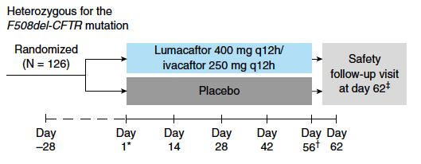
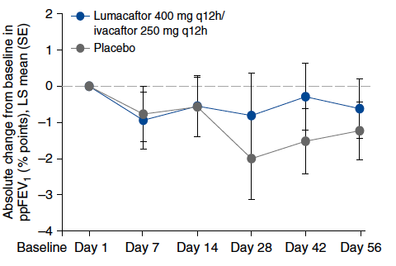
Orkambi Trial in F508del Heterozygous CF
Not Effective
or Approved
Rowe S et al, Ann ATS 2017;14::213

Slide 27
Initial Real World Orkambi Reports at the 2016 N Am CF Conference
G Sawicki/CFFPR: 6 mo (July-Dec 2015) uptake 42%. Less if >30yr, fewer visits, higher FEV1, less iv Abx; more if private insurance
Adults
D Ahmad, Drexel (Phila): n=20, d/c rate 10%, after 6 restarts
J Tolle, Vanderbilt (Nashville): n=25 (9 adolesc), d/c rate 29% including 1 acute
respiratory failure
M Anstead, U Kentucky (Lexington): n=29, d/c rate 17%
S Walker, Emory (Atlanta): n=54, d/c rate 15%. Rx rate 52%; of no rx - lost to
follow up 39%, declined 16%
J Wang, UCLA: n=28, d/c rate 36%, mostly in ppFEV1<40
Adolescents
T Ong, U Washington (Seattle): n=15 d/c rate 6.6%

Slide 28
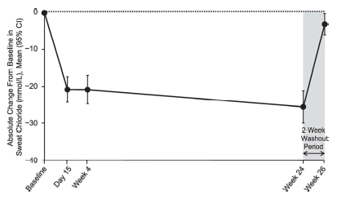
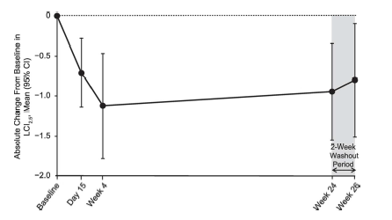
Orkambi in 6-11 Year Olds: USA Trial
Open-label 24 week safety study
n=58. 2 TEAE discontinuations (1 LFT, 1 rash - resolved). Dyspnea 1,
respiration abnormal 1, wheeze 1 - mild, no interruptions.
FEV1pp +2.5 (-0.2 to 5.2) from baseline, p=0.067
BMI z-score +0.15 (0.08 to 0.22), p<0.0001
Sweat chloride -24.8 (-29.1 to -20.5) mmol/L, p<0.0001
CFQ-R respiratory domain +5.4 (1.4 to 9.4), p=0.0085
LCI_{2.5} -0.88 (-1.4 to -0.37), p=0.0018
Based on this phase 3 safety study, on 28 Sept 2016 FDA approved Orkambi for F508del homozygous patients 6-11 years of age
Age-based dosing: lumacaftor 200 mg/ivacaftor 250 mg bid

Slide 29
Orkambi in 6-11 Year Olds: EU Trial
Randomized 24 week double-blind placebo-controlled efficacy trial.
Lumacaftor 200 mg/ivacaftor 250 mg bid
Orkambi n = 102, placebo = 101, baseline ppFEV 89.8, LCI_{2.5} 10.28
Primary endpoint: LCI_{2.5} treatment effect -1.09, p<0.0001
Secondary endpoints:
ppFEV1 treatment effect +2.4, p=0.018
Sweat chloride treatment effect -20.8 mmol/L, p<0.0001
BMI treatment effect +0.11kg/m², p=0.25
CFQR-resp domain treatment effect +2.5, p=0.062
Safety
TEAE discontinuations: LUM/IVA = 3, placebo = 2
Basis for Marketing Authorization Application (MAA) line extension to the European Medicines Agency early 2017

Slide 30
Clinical Experience: Selection
Typical patient
  Age: ≥6 years
  Sex: both
  Genotype: F508 homozygous
  Lung function: Cautious initiation if FEV₁ low for age group, no rigid upper boundary
  We participate in other sponsored protocols of Orkambi and other CFTR modulators (mono- and combo- therapy)
  Uptake in Adult Center slower; adult issues include sicker patients, more complications/concomitant meds, lifestyle considerations

Slide 31
Clinical Experience: Initiation
Precautions
  Respiratory – acute sensation of dyspnea, sometimes wheeze
  (9-20% in trials). Discontinuations due to side effects total 5-10%
  Nausea, abdominal pain, vomiting (10-15% in trials)
  Baseline and follow-up blood pressure (4-5 mm Hg increase in trials)
  Monitoring for liver toxicity (no increase over placebo in trials)
    Baseline liver function tests; repeat at 1, 3, 6, 12 months, then annually
  Check for potential drug-drug interactions
    Azoles for fungal infection
    Oral contraceptives

Slide 32
Conclusion
• Orkambi is a breakthrough fundamental treatment of CF
FDA-approved from age 6 up for F508del homozygous CF (~50%)
Ineffective for F508del heterozygous CF (~40%)
Side effects limit use in 5-20% patients (higher in older/sicker subgroups)
Lung function efficacy is generally modest, in line with predictions from cell culture models
Reduced exacerbation and rate of decline effects are more striking, and cannot be predicted from acute or medium-term lung function effects
More potent CFTR modulator combination therapy is on the way; may also offer fewer side effects

