Slide 1
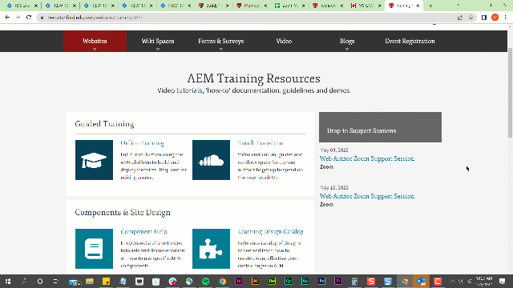
Clear Local Chrome Storage
Open the Google Chrome Console by pressing F12. Or go to browser options > More tools > Developer tools.
Click Application in the console’s top menu.
Click Local Storage in the console’s left menu.
Select SHC related URL(s), right-click Clear.

