Slide 1
Deconstructing Pod-Based Systems’ Advertisements
Print-Outs
© Stanford University

Slide 6
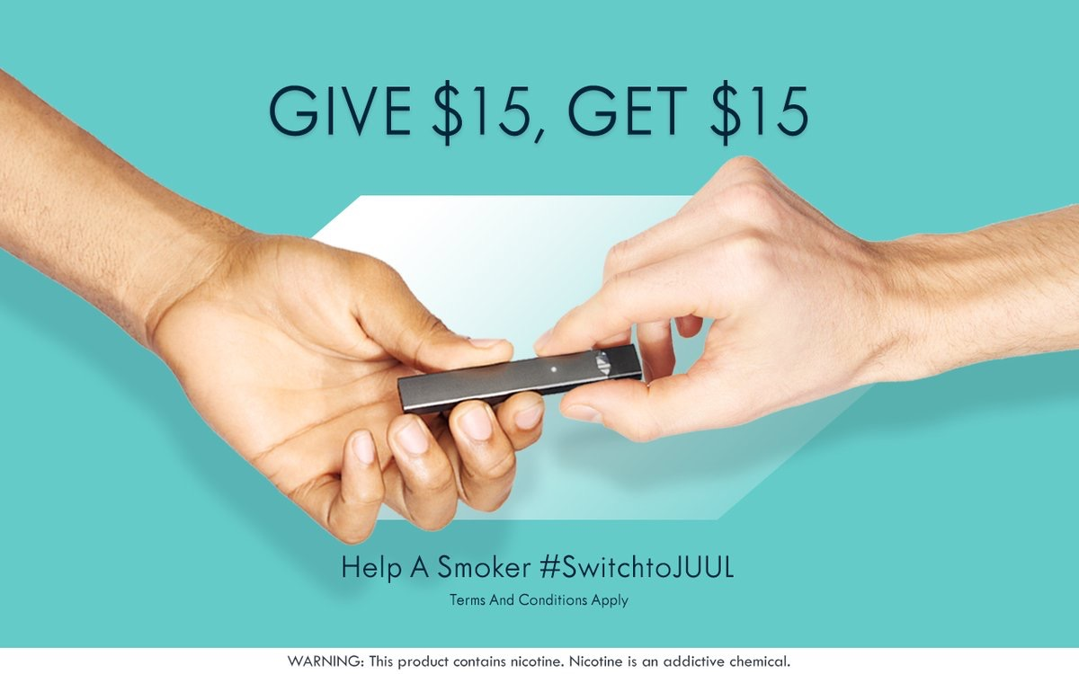

Slide 7
Notes:
http://www.styleitholmes.com/advertising/

