Slide 1
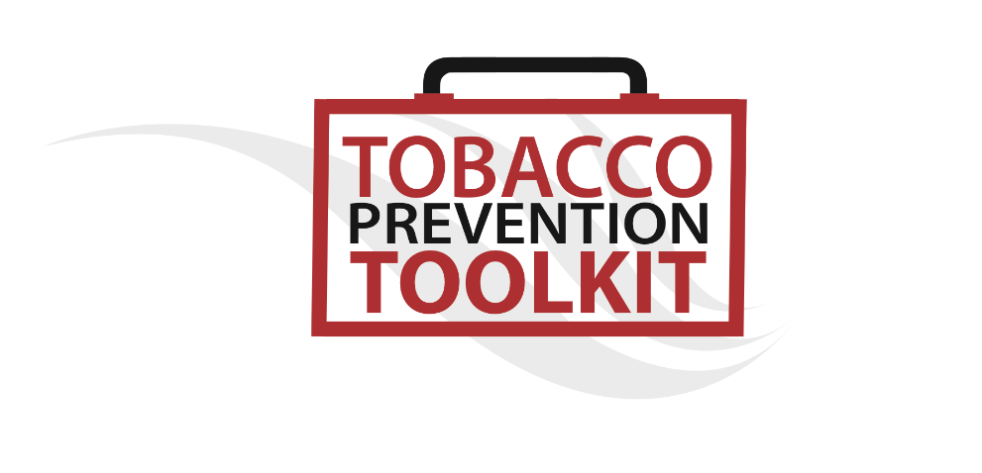

Smokeless Tobacco 101
© Stanford University

Slide 2
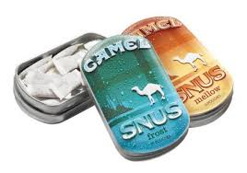
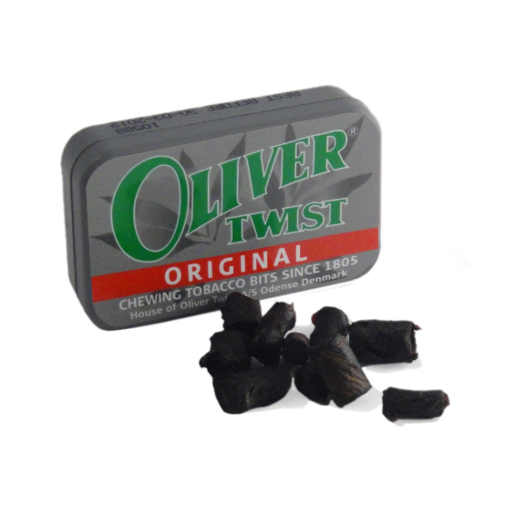
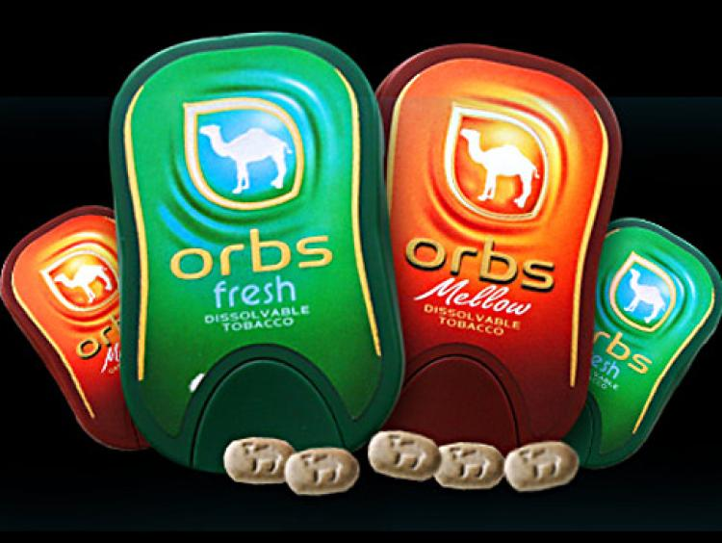
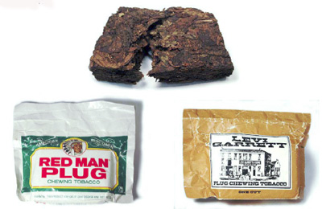
In this presentation
→What is Smokeless tobacco?
→Smokeless Tobacco Products
→Smokeless Tobacco History
→Health Risks
Image Credit: via thenounproject.com
Notes:
Teacher Talking Points:
In this presentation, we will discuss:
(Click) What is smokeless tobacco?
(Click) Then, we will explore the various existing smokeless tobacco products.
(Click) We will also cover some smokeless tobacco history.
(Click) Lastly, we will also talk about the health risks associated with using smokeless tobacco.

Slide 3
What is Smokeless Tobacco?
→ Smokeless tobacco is not smoked.
Chewing Tobacco
Oral Tobacco
Spit/Spitting Tobacco
Dip
Chew
Snus
Notes:
Teacher Talking Points:
So, what is smokeless tobacco? (Click) Smokeless tobacco is not smoked.
Users chew or suck on (dip) tobacco leaves, releasing nicotine which is absorbed in the mouth’s lining.
It can be spit or swallowed depending on the product.
Smokeless tobacco is also known as (click) chewing tobacco, (click) oral tobacco, (click) spit or spitting tobacco, (click) dip, (click) chew, and (click) snus.

Slide 4
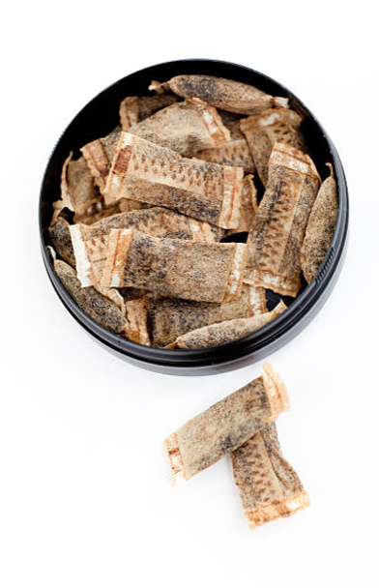
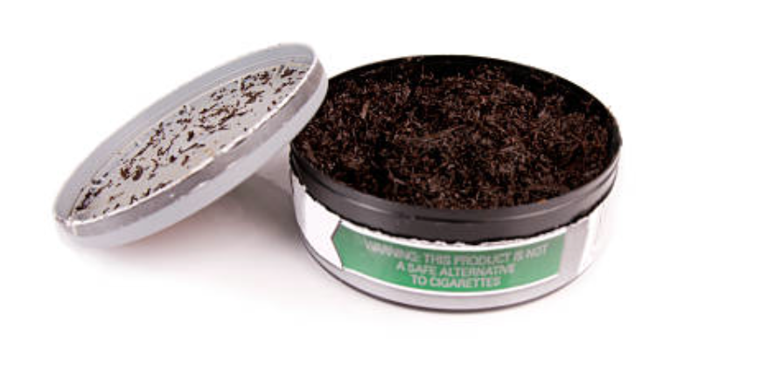
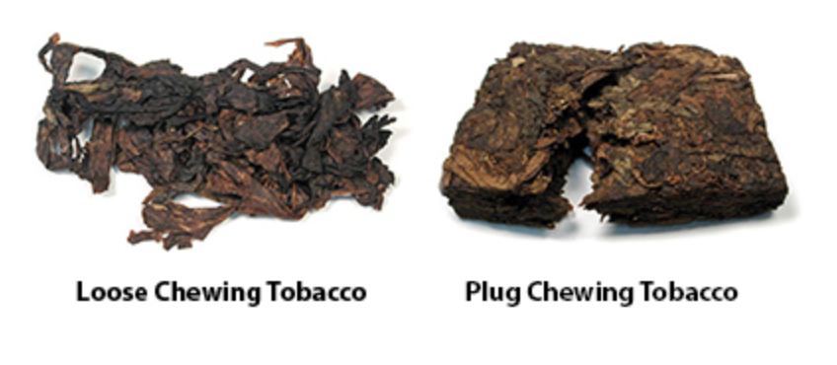
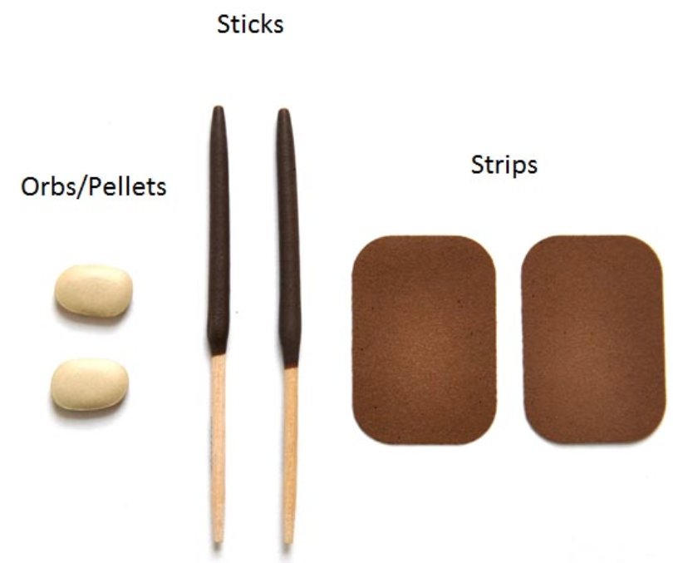
Smokeless Tobacco Products
There are many different types of smokeless tobacco used around the world. Here are just a few examples:
NOPE!
Oral Moist Snuff (“dip”)
Snus
Chewing Tobacco
Dissolvables
Notes:
Teacher Talking Points:
There are many different types of smokeless tobacco used around the world. Here are just a few examples:
(Click) Oral Moist Snuff (“dip”)
Smokeless tobacco is not smoked or burned. It can be chewed or sucked on, and can be spit out or swallowed depending on the product itself.
One of the most popular smokeless tobacco products used in the U.S. is Oral Moist Snuff, also know as “dip.”
Snuff is a finely ground tobacco product, typically placed between the cheek and gums or upper lip, it needs to be manually crushed for the nicotine to be released.
(Click) Chewing Tobacco
Another smokeless tobacco product that users can chew or suck on is known as Chewing Tobacco, or simply chew.
A portion of the tobacco is placed between the cheek and gum or the upper lip teeth.
It is sold in the form of bricks, twists, or loose-leaf.
Loose-leaf tobacco is usually sweetened, and sometimes includes flavoring through other additives.
The common chewing tobacco products sold include Red Man, Oliver Twist, and Levi Garrett.
(Click) Snus
Snus is a smokeless tobacco product that comes in the form of a teabag, which is “parked” in the cheek.
It was first seen in Sweden. Unlike U.S. snus, Swedish and European snus is pasteurized, a process that kills germs.
It also contains low levels of nitrosamine, which is a chemical compound that is generally carcinogenic.
(Click) Dissolvable (lozenges, sticks, strips, orbs)
Tobacco products that slowly dissolve over time.
It is finely grounded tobacco held within a solid chemical shell that melts in saliva.
Resemble small mints, toothpicks, dissolvable breath strips, etc.
Products Image #3, 4: http://www.istockphoto.com/photos/chewing-tobacco?phrase=chewing%20tobacco&excludenudity=true&sort=best
Image #1, 2: https://www.cdc.gov/tobacco/data_statistics/fact_sheets/smokeless/products_marketing/index.htm

Slide 5



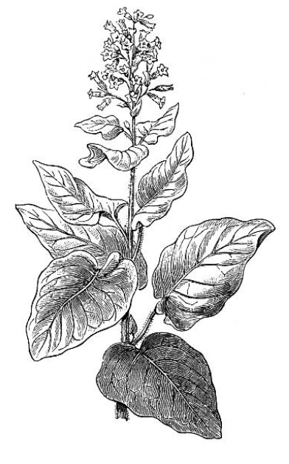
Smokeless Tobacco & USA History
Then…
Spittoon
Notes:
Teacher Talking Points:
American inhabitants chewed tobacco in religious and political ceremonies as early as 1 BCE (click).
Tobacco was used as a currency in 17th and 18th centuries in US colonies (click).
By the 18th century, smokeless tobacco was extremely popular and was considered an “American Habit.” Spittoons were even in congress for legislators to use (click).
During the 19th century spitting tobacco became socially unacceptable and illegal in public places due the risk of spread germs and diseases.
Pictures from: http://www.istockphoto.com/photos/-tobacco-?excludenudity=true&page=1&phrase=%20tobacco%20&sort=best

Slide 6
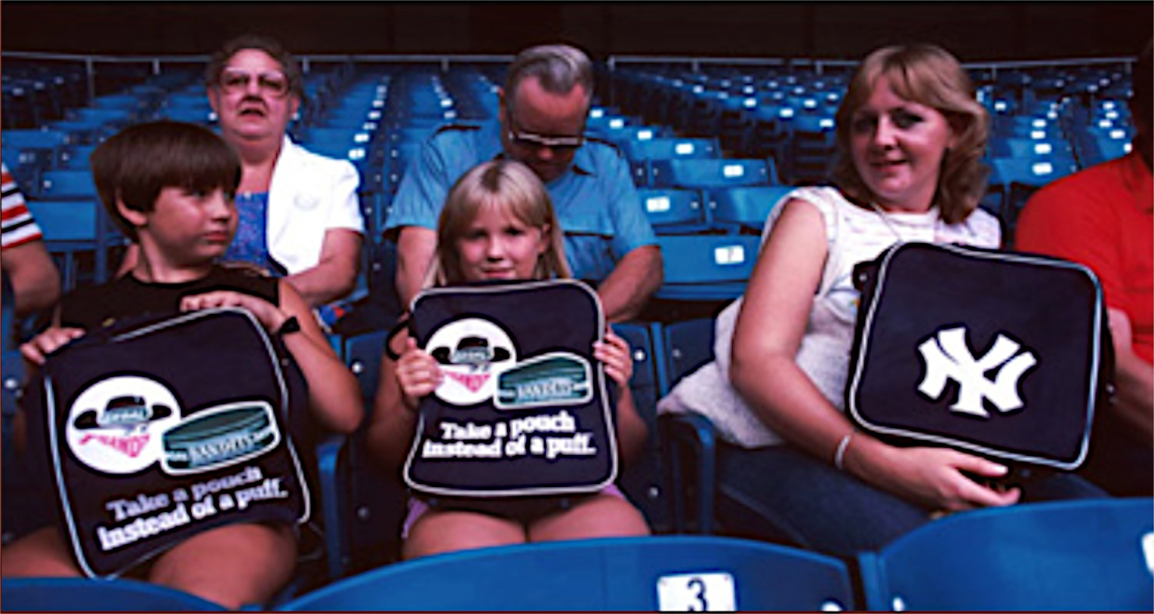
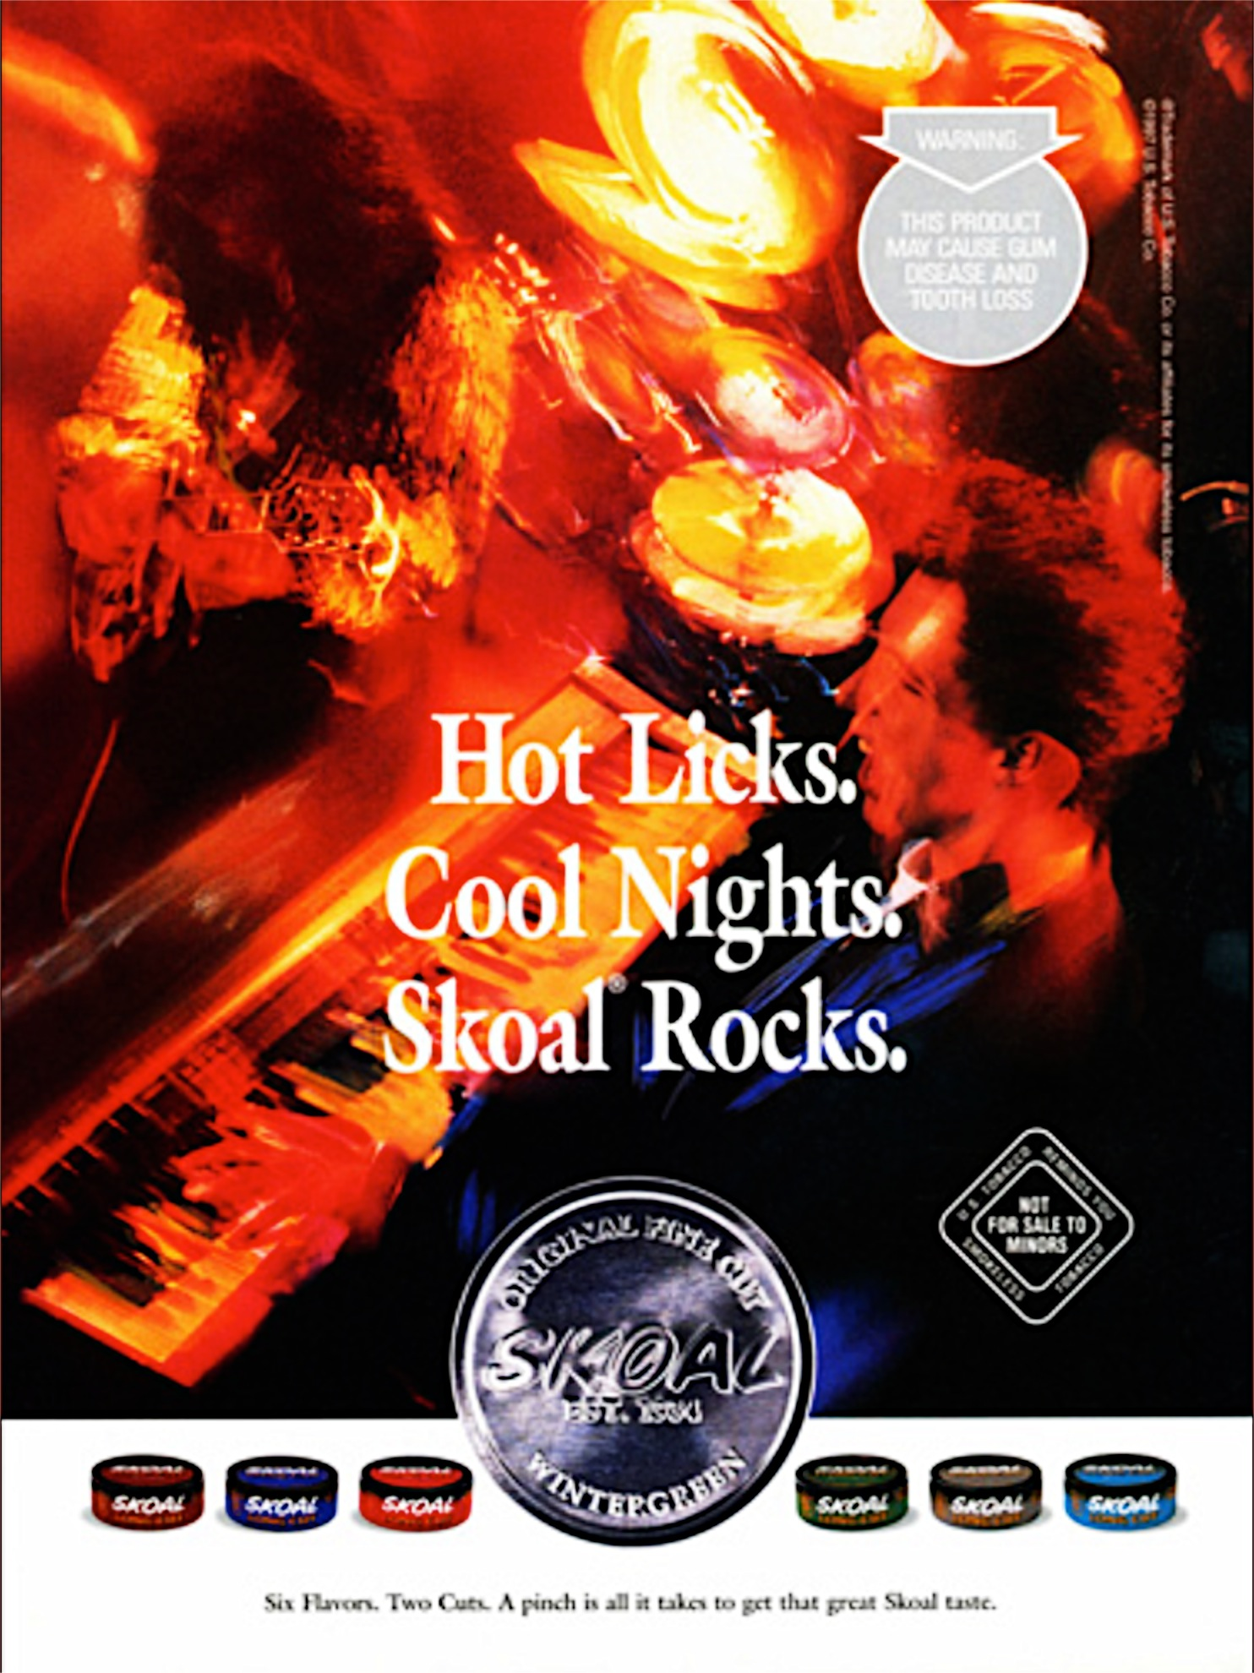
NOW…
“Cherry Skoal is for somebody who likes the taste of candy, if you know what I mean”
-Skoal Representative commenting on addition of Candy Flavor
Notes:
Teacher Talking Points:
In the 20th century smokeless tobacco made a come back with the increasing number of young men using. Up until then, it was more typical old men to use.
By the late 1990’s and early 2000’s clean air acts outlawed smoking in public places.
Some of the factors contributing to the growth of smokeless tobacco market included availability of flavors, attractive pricing, and availability to use anywhere!
Representatives understood the appeal of flavors to adolescents (click), as well as marketing sociability, masculinity, and individuality towards young men (click).
However in 2016, Major League Baseball (MLB) bannned smokeless tobacco for entering players and fans.

Slide 7
The Smokeless Tobacco Landscape is Changing...
The people who use smokeless is changing
Older men using chew → Younger men using dip
The way ST is marketed is changing
*Major U.S. brands owned by cigarette companies
*A way around smoke-free spaces
*Claims of being a safer alternative to smoking
The products themselves changing
Flavors, nicotine, brands, & price... a dip for every taste
Notes:
Teacher Talking Points:
As time passes, tobacco companies have created new products to cater to every type of consumer. Considering who is going to replace the older smokers, the Big Tobacco has made sure to maintain customers to make money off their products.
Firstly, the people who use smokeless is changing. (Click) Older men are now using chew, while the younger men are using dip.
Secondly, the way smokeless tobacco is marketed is no longer the same. (Click) Due to the growing variety of products and consumers, many major US brands owned by cigarette companies are also producing other tobacco products.
Many of these products cater to the demands and restrictions placed by the law, as well as the changing mindsets of the public.
Smokeless tobacco is a way around smoke-free environment restrictions and they are being advertised as such.
Many consumers see these tobacco products as having different health effects because they come in different forms, so they are being marketed as a safer alternative to smoking.
And lastly, the products themselves are no longer the same. There are more options now than there were a decade ago.(click). The new products entering the market may also appeal to young people due to the various flavors being introduced like cherry, vanilla, apple, and many more. Flavors, nicotine, brands, and pricing; there is something being marketed for everyone’s specific preference.

Slide 8
Smokeless Tobacco Advertisement
In 2014, US Tobacco Companies spent
$600 Million promoting smokeless tobacco.
Why do you think Camel uses the phrase “Boldly Go Everywhere” & “Experience Cleaner Tobacco Environment” to promote snus?
Notes:
Teacher Talking Points:
In 2014, US tobacco companies spent $600 million promoting smokeless tobacco.
(Click) Based on the history that you just learned, why do you think Camel uses the phrase “Boldly Go Everywhere” & “Experience Cleaner Tobacco Environment” to promote snus.
Picture(s) From:
http://tobacco.stanford.edu/tobacco_main/images_mari.php?token2=fm_mari_st652.php&token1=fm_mari_ing5870.php&theme_file=fm_mari_mt069.php&theme_name=Chewing%20Advertising%20Themes&subtheme_name=Snus

Slide 9
      Think Pair Share:
      Make a hypothesis about whether or not you think using smokeless tobacco only impacts your mouth/oral region?
Notes:
Teacher Talking Points:
Now, turn to a partner, and answer the following question, “Make a hypothesis about whether or not you think using smokeless tobacco only impacts your mouth/oral region?”
Make sure to justify your answer.

Slide 10
Smokeless Tobacco Health Effects
Oral cancers
Oral wounds, ulcers, and tumors
Destroyed oral tissue
Gum infection
Tooth discoloration
Enamel erosion
Shrinking gums
Tooth decays
Notes:
Teacher Talking Points:
Smokeless tobacco causes many adverse health effects in the mouth due to users’ having to chew and suck on the tobacco.
Some of the oral conditions include:
(Click) Oral cancers, including the area immediately behind the mouth, known as the pharynx (pharyngeal cancer).
(Click) Mucosal lesions, which are membranes that line various cavities that suffer from injuries, through wounds, ulcers, and tumors, etc.
(Click) Gingival keratosis, tissue destruction associated with teeth.
(Click) Periodontal disease, serious damage to the gums which could destroy jawbone.
(Click) Tooth discoloration
(Click) Enamel erosion, the tooth’s enamel destroyed by acids.
(Click) Gingival recession, exposure to tooth’s root due to diminishing/receding gum line.
(Click) Dental caries, such as tooth decays and cavities caused by bacteria.
Although the more serious adverse health effects of smokeless tobacco use may be delayed for many years, the early onset of smokeless tobacco use among young people provides time to build nicotine addiction and time for long term exposure to the high concentration of cacingoens in smokeless tobacco.

Slide 11
Smokeless Tobacco Health Effects
Smokeless tobacco can impact your entire body.
Pancreatic Cancer
Stomach Cancer
High Blood Pressure
Cardiovascular Disease
Notes:
Teacher Talking Points:
(Click) Smokeless tobacco may cause many other adverse health effects other than in the mouth, including: (click) abdominal related issues (pancreatic cancer; the pancreas is a gland that helps with digestion and maintaining proper blood sugar level) and (click) stomach cancer; (click) abnormally high blood pressure (hypertension); (click) and diseases related to the heart and blood vessels (cardiovascular).
According to the Surgeon General data of 2003, frequent users were 3 times more likely to acquire cancer of the buccal area of the oral cavity than less frequent users and 4 times more likely to have throat cancer.
Those who started using smokeless tobacco before the age of 14 years were 20 times more likely to develop throat cancer.

Slide 12
Misconceptions smokeless tobacco use:
“Cigarettes, it goes into your body and through your lungs and into everything like that… chewing tobacco just stays in my mouth.”
(current-user, age 16)
“I haven’t had any health problems with [ST] since I have been chewing… I know that if I did have a health problem, that would probably motivate me to quit.”
(current-user, age 16)
“The group I hang out with, like boots, blue jeans… they’re like cowboys, like country kids—[ST] is really accepted. It’s just like a thing that happens. No one even takes a second look at it.”
(current-user, age 17)
“[My parents] think [ST is] gross, but they also think that I’m old enough to make my own decisions.”
(current-user, age 17)
Notes:
Teacher Talking Points:
Many young people have misconceptions about smokeless tobacco
(Click) Some young people not understand the oral health risks and might not fully understand the Only high awareness of oral health risks, outweigh potential dangers; an independent choice, especially risk relatively to cigarettes.
(Click) Additionally, many users view health risks as distant and avoidable, if not less harmful than use of other drugs.
(Click) Others view it as a part of the community tradition and culture, a way of life!
(Click) Lastly, family influence can alter the choice to use. From the family having strong anti-tobacco expectations, to reinforced acceptance, or superficially disapproving yet permissive and reluctantly accepting.
All of these experiences come from youth whom a current smokeless tobacco users.

Slide 13
      Think, Pair, Share:
      WARNING: This product can cause mouth cancer.
    WARNING: This product can cause gum disease and tooth loss.
    WARNING: This product is not a safe alternative to cigarettes.
    WARNING: Smokeless tobacco is addictive.
Do you think these 4 warning labels are a good representation of the health effects caused by smokeless tobacco?
Notes:
Teacher Talking Points:
The US government requires tobacco companies to have 1 of the 4 warning labels listed below on each smokeless tobacco package or advertisement. (click)
Warning: This product can cause mouth cancer.
Warning: This product can cause gum disease and tooth loss.
Warning: This product is not a safe alternative to cigarettes.
Warning: Smokeless tobacco is addictive.
(Click) Do you think that these 4 warning labels are a good representation of the health effects caused by smokeless tobacco?

Slide 14
Resources
CDC – Smokeless Tobacco: Products and Marketing
https://www.cdc.gov/tobacco/data_statistics/fact_sheets/smokeless/products_marketing/index.htm
CDC – Smokeless Tobacco: Health Effects
https://www.cdc.gov/tobacco/data_statistics/fact_sheets/smokeless/health_effects/index.htm
NCBI—Smokeless Tobacco Use by Baseball Players entering the Professional Ranks
https://www.ncbi.nlm.nih.gov/pmc/articles/PMC164901/pdf/attr_38_02_0126.pdf
SRITA: “Chewing Tobacco” Advertisements
http://tobacco.stanford.edu/tobacco_main/subtheme_mari.php?token=fm_mari_mt069.php
Notes:
Other images:
https://commons.wikimedia.org/wiki/File:Shisha-edit.png
http://www.istockphoto.com/photos/chewing-tobacco?excludenudity=true&page=2&phrase=chewing%20tobacco&sort=best

