Slide 1
What a Waste! Impact of Cigarettes and E-cigarettes on the Environment

Slide 2
Topics
Cigarettes and the environment
Parts of an e-cigarette and where they are disposed of
E-waste and the environment

Slide 3
I will Learn...
3. Proper disposal methods for e-cigs and vapes
Where each part of an e-cigarette goes after disposal
2. How e-waste affects our environment and our community

Slide 4
Warm Up!
How many e-cigs do you see in the picture?
Notes:
Talking Points:
As a warmup: how many e-cigs do you see in the picture?
Let’s count how many e-cigs you see hidden in this picture.

Slide 5
Notes:
Talking Points:
Total 10: 2 pink Ezzy, 1 blue Puff Bar, 1 Suorin air plus, 1 yellow Puff Bar, 2 JUULs, 2 cigarettes, 1 white brandless vape.
The purpose of this activity is to start our discussion on e-cigarette and cigarette trash and how it’s everywhere.

Slide 6
Notes:
Talking Points:
What is the most littered plastic item found in US beaches and waterways?

Slide 7
Notes:
Talking points:
1. The answer is cigarette butts!
2. Ask students: What do you think about that? (pause for responses).
3. The most commonly found piece of trash on beaches isn’t plastic bags or straws.
4. Littered cigarette butts oozes toxic chemicals such as arsenic (used to kill rats) and lead, to name a few, into the environment and can contaminate water.
5. The toxic exposure from cigarettes can poison fish as well as animals who eat cigarette butts
6. Cigarettes are not biodegradable. The plastic fibers, called cellulose acetate, in cigarette butts are non-biodegradable, meaning they won’t organically break down from living organisms.
REFERENCES:
https://truthinitiative.org/research-resources/harmful-effects-tobacco/tobacco-and-environment
“cigarette butts are the most frequently littered item in U.S. beaches and waterways and second most littered item globally.”
Eco watch
https://www.ecowatch.com/cigarette-butts-litter-2635534590.html
National Geographic
https://www.nationalgeographic.com/environment/article/cigarettes-story-of-plastic

Slide 8
THE ENVIRONMENT
Where do cigarettes, e-cigarettes, and cannabis vapes go?
How should they be disposed?
Notes:
Talking points:
1. So let’s talk about the environment.
2. Ask students: How are people disposing of cigarettes? (pause for responses). How about e-cigarettes (including nicotine, non-nicotine, and cannabis e-cigarettes)? (pause for responses).
3. We will find out what happens when these products are improperly disposed of.
4. We will also find out how they should be disposed.

Slide 9
Where do cigarettes go?
Notes:
Talking points:
1. Where do cigarettes go?

Slide 10
Cigarette butts are made from
microplastic fibers.
Small animals
Cigarettes contain toxic chemicals like nicotine, arsenic, and more.
Waterways
Large animals
Notes:
Talking points:
1. The cigarette butt is non-biodegradable because it's made of over 15,000 microplastic fibers.
2. Cigarettes also have toxic chemicals like nicotine and other heavy metals, which can go into the waterways.
3. Small animals can be killed by cigarettes.
4. Large animals might eat cigarettes thinking they are food.
References:
https://www.undo.org/little-big-lie?gclid=Cj0KCQjw_7KXBhCoARIsAPdPTfgY2TK5ZgfHzX8SfdD7HPnlHeGF9cB_mPi62fZS6GuMKlCkXryY5AcaAiebEALw_wcB
https://truthinitiative.org/research-resources/harmful-effects-tobacco/toxic-plastic-problem-e-cigarette-waste-and-environment
Image by <a href="https://pixabay.com/users/422737-422737/?utm_source=link-attribution&amp;utm_medium=referral&amp;utm_campaign=image&amp;utm_content=488400">Hebi B.</a> from <a href="https://pixabay.com//?utm_source=link-attribution&amp;utm_medium=referral&amp;utm_campaign=image&amp;utm_content=488400">Pixabay</a>

Slide 11
Where do e-cigarettes go?
Notes:
Talking points:
Where do e-cigarettes go?

Slide 12
Notes:
Talking Points:
E-cigarettes affect the environment in three main ways.
Reference:
https://miro.medium.com/max/1274/0*yZF8TzGKaWDHr1lP.jpg
https://d3nevzfk7ii3be.cloudfront.net/igi/QQw3hNFg2y4FZ4Ib.medium

Slide 13
the battery
E-cigs have a battery inside them, usually made from lithium-ion, making them E-WASTE
When thrown in the regular trash, the e-cig (with the battery) is crushed
This can cause the battery to explode, meaning dangerous fires
Littered e-cigs’ battery slowly deteriorates, and other components go into water
Notes:
Talking points:
1. The first way it affects the environment is through the battery.
2. E-cigarettes, including nicotine, non-nicotine, and cannabis vapes, have a battery which is used to vaporize the liquid for a person to vape.
This battery is often made from dangerous metals like lithium-ion, which can explode when processed in trash plants.
3. If left outside, the battery slowly deteriorates and the heavy metals go into the water, which is toxic for the environment.
4. E-cigarettes qualify as e-waste, and have to be trashed like other electronic devices.

Slide 14
the pod
Nicotine is a toxic chemical and can be lethal to small children or animals
Along with nicotine, there are also heavy metals like lead, tin and nickel
Discarded e-cigs can cause nicotine poisoning in children and animals
e-cigs are both a hazardous waste and e-waste
Notes:
Talking points:
1. The second way that e-cigarettes affect the environment is through the nicotine pods. Nicotine is a toxic chemical and lethal to small children or animals if they come in contact.
2. Pods (even if vaped as much as possible) contain trace levels of nicotine and other heavy metals which can directly hurt animals and children or can soak into the soil and nearby water sources.
3. Along with nicotine, there are also heavy metals like lead, tin, and nickel that are toxic.
4. Discarded e-cigarettes that come in contact with children or animals can cause accidental nicotine poisoning.
5. Due to the nicotine and other heavy metals, e-cigarettes are considered hazardous waste. They are also considered e-waste.
5. THC, the chemical in cannabis vapes, is not a hazard like nicotine, however, it is considered as a toxin under California standards. Also, they may contain solvents and other contaminants.
Reference:
https://www.publichealthlawcenter.org/sites/default/files/inline-files/What-a-Waste-Legally-Disposing-of-E-Cigarettes-and-Nicotine-Products.pdf
https://www.ozonesmoke.com/media/catalog/product/cache/2e5dd8b74949a298dd2cd2cebdc06e35/j/u/juul-pods-classic-menthol.jpg

Slide 15
The Plastic
E-cigarettes contain large amounts of plastic.
Plastics break down into microplastics, which can infiltrate the ocean, food, and other nature.
Notes:
Talking Points:
1. The third way is the effect of e-cigarettes on the environment is from the plastic pieces. This effect is much like any other plastic product you might buy.
Plastic can take centuries to decompose.
2. As they breakdown, the plastics turn into microplastics which are small enough to make their way into ocean ecosystems and food that we ingest.
References:
https://truthinitiative.org/research-resources/harmful-effects-tobacco/toxic-plastic-problem-e-cigarette-waste-and-environment

Slide 16
The confusion about disposal
E-cigarette companies have purposefully marketed their products so that consumers think they are “clean” or “green.”
Even government websites are unclear on how to classify e-cigarettes.
So where and how do you dispose
e-cigarettes?
A California bill called for tobacco companies to make products with recyclable materials but did not become law.
Notes:
Talking Points:
1. There is confusion about how to dispose e-cigarettes.
2. E-cigarette companies have purposefully marketed their products so that consumers (users) think they are “clean” or “green.”
3. Even government websites are unclear on how to classify e-cigarettes. Some label pods as hazardous waste, some as biohazard waste.
4. In California, there was a bill that called for tobacco companies to make products with recyclable materials but did not become law.
5. So where and how should people dispose of e-cigarettes?

Slide 17
Disposing e-cigarettes
In California, look up household hazard waste product program. https://calrecycle.ca.gov/homehazwaste/directory/
or check with your local county household waste removal program outside of California.

Slide 18
Photovoice Garbology
Project
Video
Notes:
Talking Points:
1. Let’s watch a video on a garbology project using photovoice created by peer health educators.
2. As a class, we will be doing a similar project.

Slide 19
Photovoice Garbology
Video
Think -Pair -Share
What do you see here?
Which was your favorite photo?
What was happening in that photo?
How does this relate to our lives?
Why does this problem exist?
Notes:
Talking Points:
Let's reflect on what we saw in the video.
In groups of two (think-pair-share), discuss and answer the questions on the slide.
Afterwards, we will do a share out.
(Teacher note: give students about 5-7 minutes, then open to discussion for 2-3 minutes).
Reference:
https://www.pathwaysrtc.pdx.edu/pdf/proj5-photovoice.pdf

Slide 20
“The best way to avoid contaminating the environment with vape waste is to avoid using them altogether.” – Boulder County, Vape Aware
Notes:
Talking Points:
Given what we have discovered, one way for us to protect the environment is to not smoke cigarettes or use any e-cigarettes products including nicotine and cannabis.

Slide 21
QUITTING Resources
Text "DITCHVAPE" to 887-09
KICK IT California: www.nobutts.org
Teen.smokefree.gov or 1-800-QUIT-NOW
Text "Start My Quit" to 36072 (mylifemyquit.com)
Notes:
Talking Points:
If you or someone you know smokes cigarettes or uses vapes, consider quitting.
Here are some quitting resources.

Slide 22
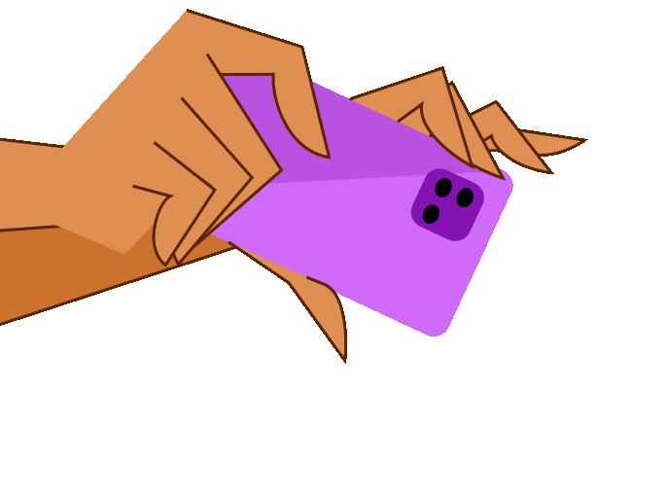
Photovoice
Project Activity & Assignment
During the next week, you will take photos around your neighborhood, school, and home where you are exposed to tobacco, e-cigarettes, and/or cannabis vapes.
Your photos can include images of advertisements, trash, or waste from these products.
Select 5-10 of your photos and develop a report that displays your photos. Include a 2-3 sentence description of why you took that photo and how it is related to your personal feelings about tobacco, e-cigarettes, and/or cannabis vapes.
Notes:
Talking Points:
(Read slide with instructions on photovoice assignment).
(Teacher Note: suggest assigning this on a Thursday with a Mon due date for students to have enough time to gather their photos).

Slide 23
KEY TAKeAwAYs
Cigarettes and e-cigarettes are not biodegradable and do harm the environment
Properly disposing of cigarettes and e-cigs help protect the environment
Quitting the use of cigarettes and e-cigs, or never starting in the first place, reduces harm to the environment.
You can help protect our environment in many ways!
Notes:
Talking Points:
Let's review our key Takeaways.
(Read off slides)

Slide 24
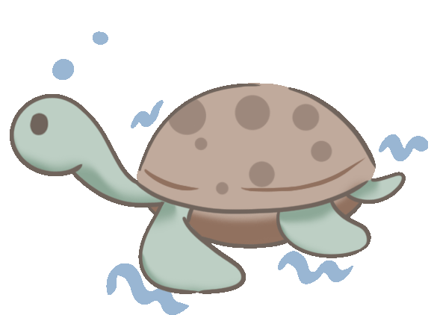
Kahoot!

