Slide 1
How to Complete a Subaward Requisition
For use after November 26, 2017

Slide 2
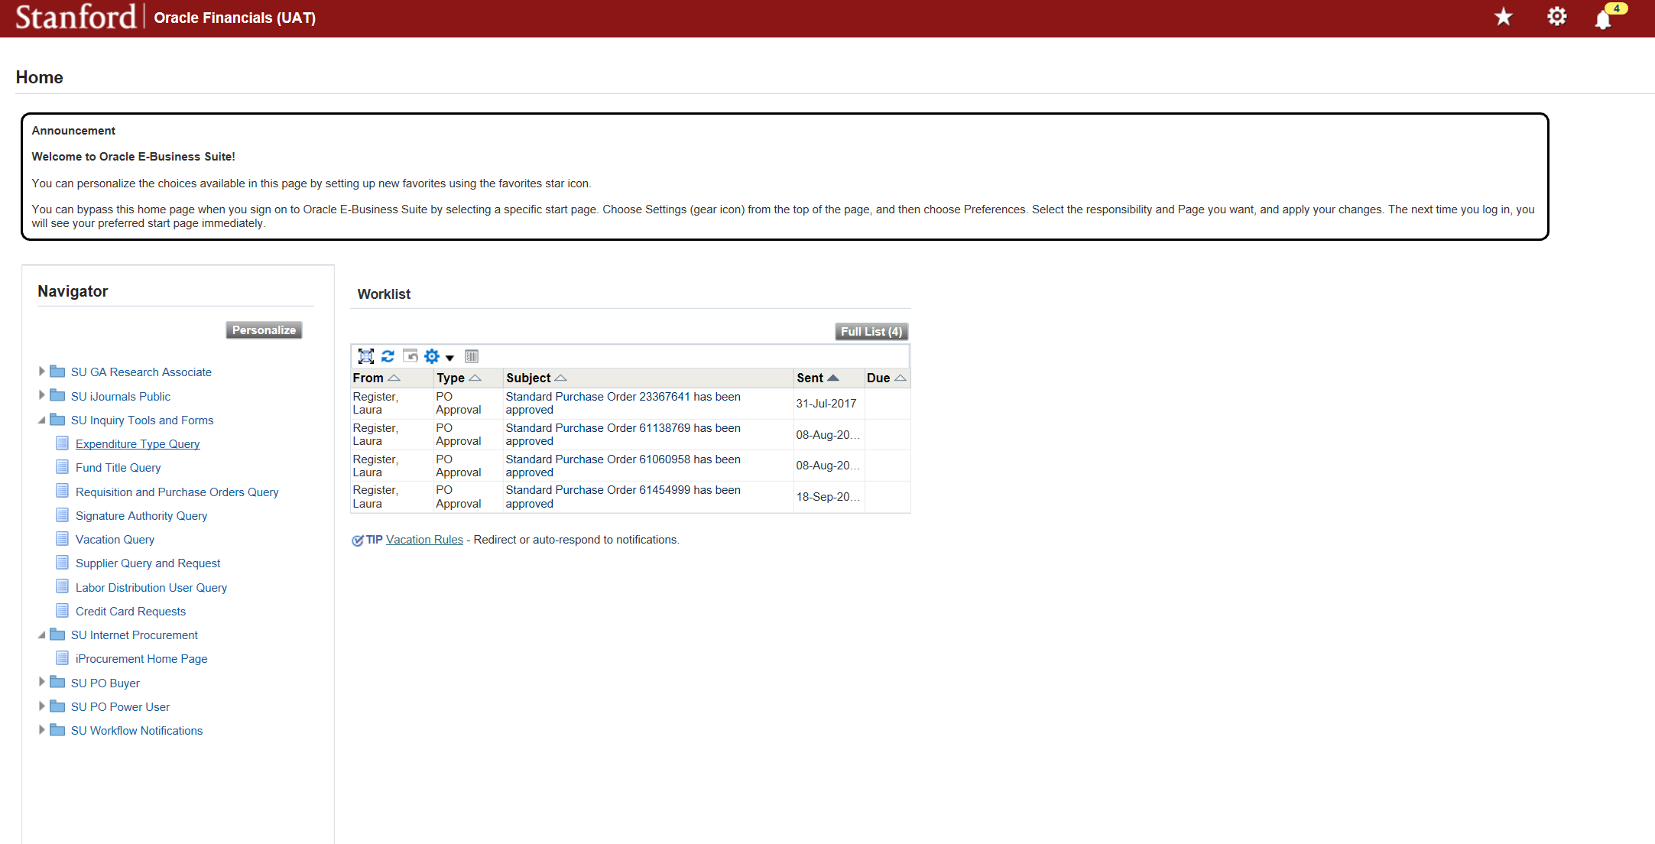
New Subaward
Select “SU Internet Procurement” to enter the requisition portal

Slide 3
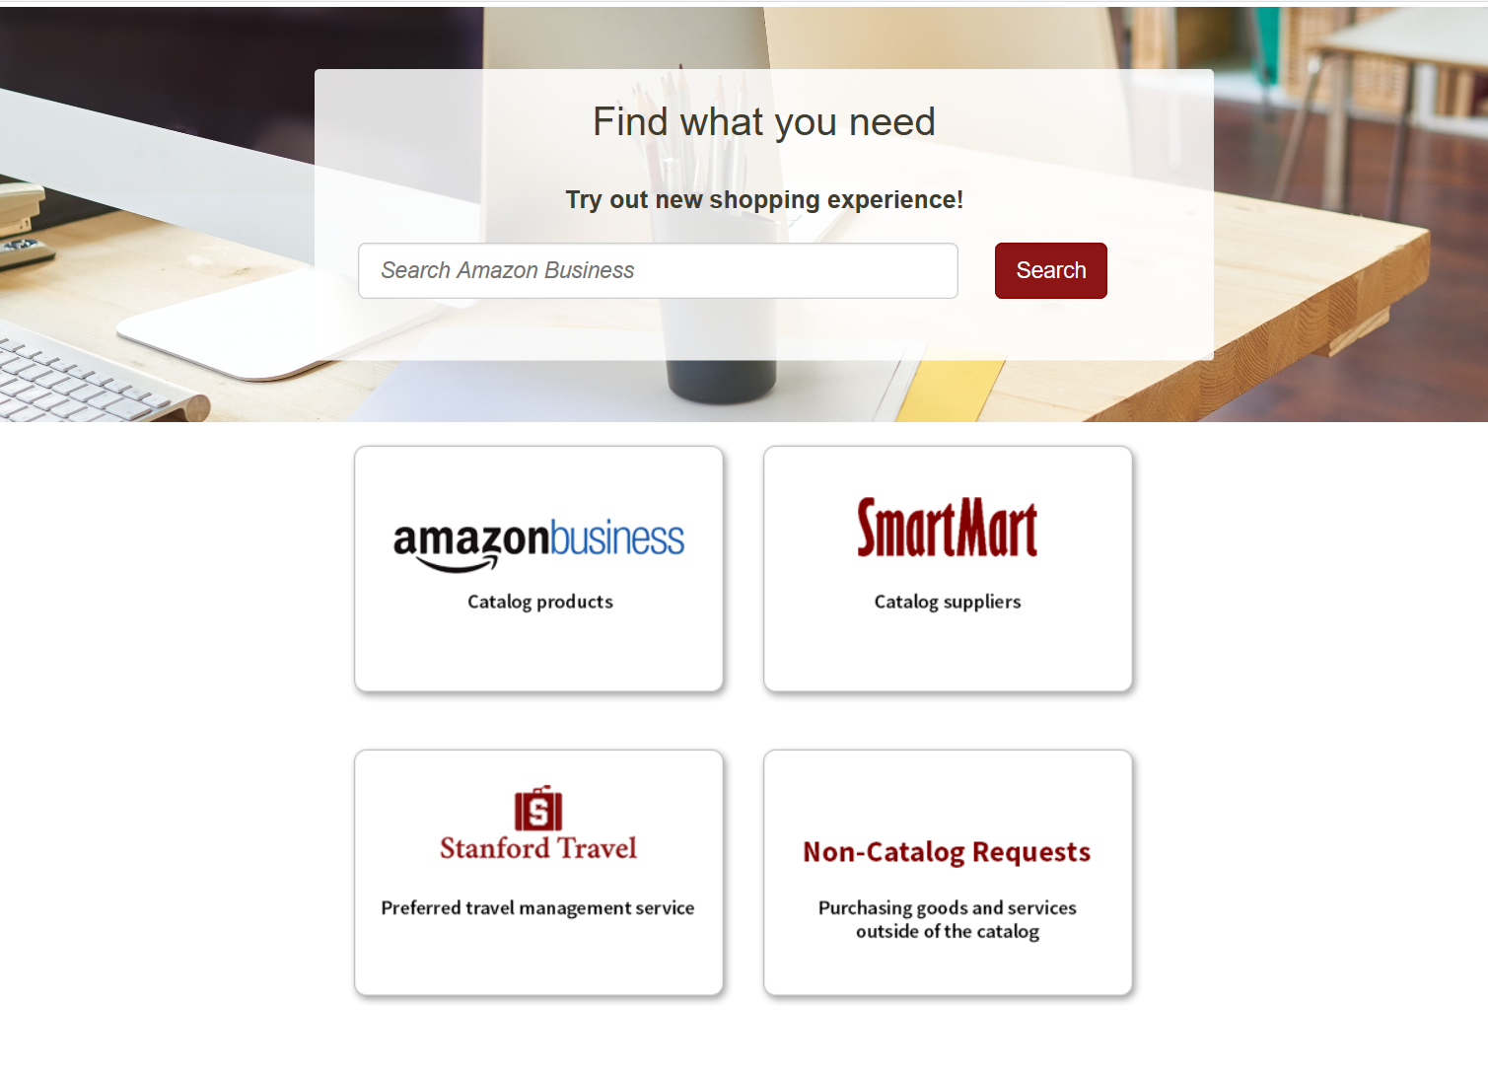
New Subaward
To initiate a new Subaward Requisition, select “Non Catalog Requests”

Slide 4
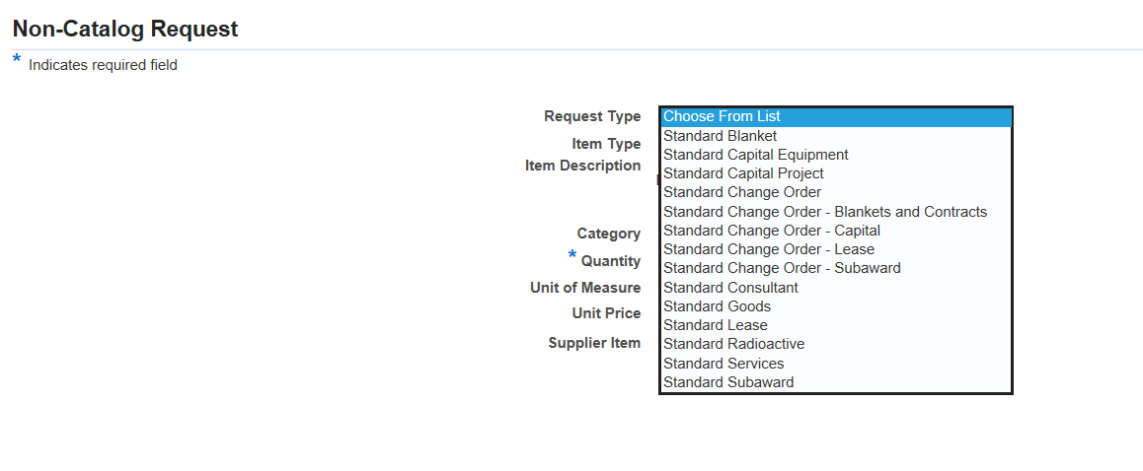
New Subaward
From the drop down menu, select “Standard Subaward” for new subawards

Slide 5
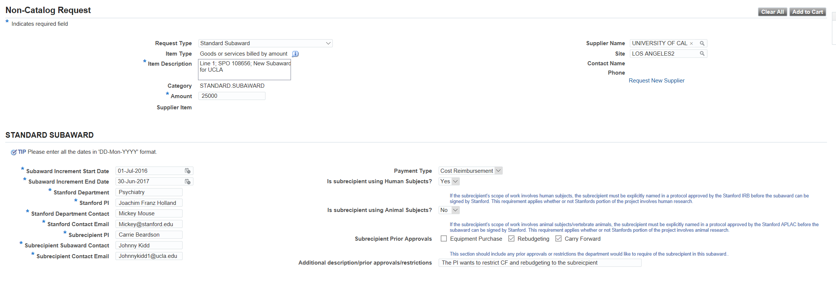
New Subaward
Complete all the fields for the first line and then select “Add to Cart”
If there will be multiple lines for expenditure types, make sure the item description is not the same for both. We recommend putting “Line 1” and “Line 2” at the front of the descriptions
Only “Request New Supplier” if you cannot find the supplier at all. If you need a site added to an existing supplier, then you will need to request it in the “Supplier Query and Request”, not in the requisition
The amount field should be the amount subject to IDC (54710) first, then the amount not subject to IDC (54720) second
Subaward start and end dates should be within Stanford’s period of performance from the sponsor and should not exceed one year at a time
Payment type should be based on the budget.
Prior approvals should be specific to the subrecipient and can be more restrictive than the prime if closer monitoring or more reporting is needed
Use the additional description to notify the contract officer of any additional requirements they should include in the contract

Slide 6
Update the Item Description and Amount for the second line and select “Add to Cart” again.
Update “Item Description” so it isn’t the same as the prior line
Update the amount to the non-IDC amount
You should see the first line amount in your cart

Slide 7
Check that the Shopping Cart shows both lines, then select “View Cart and Checkout”

Slide 8
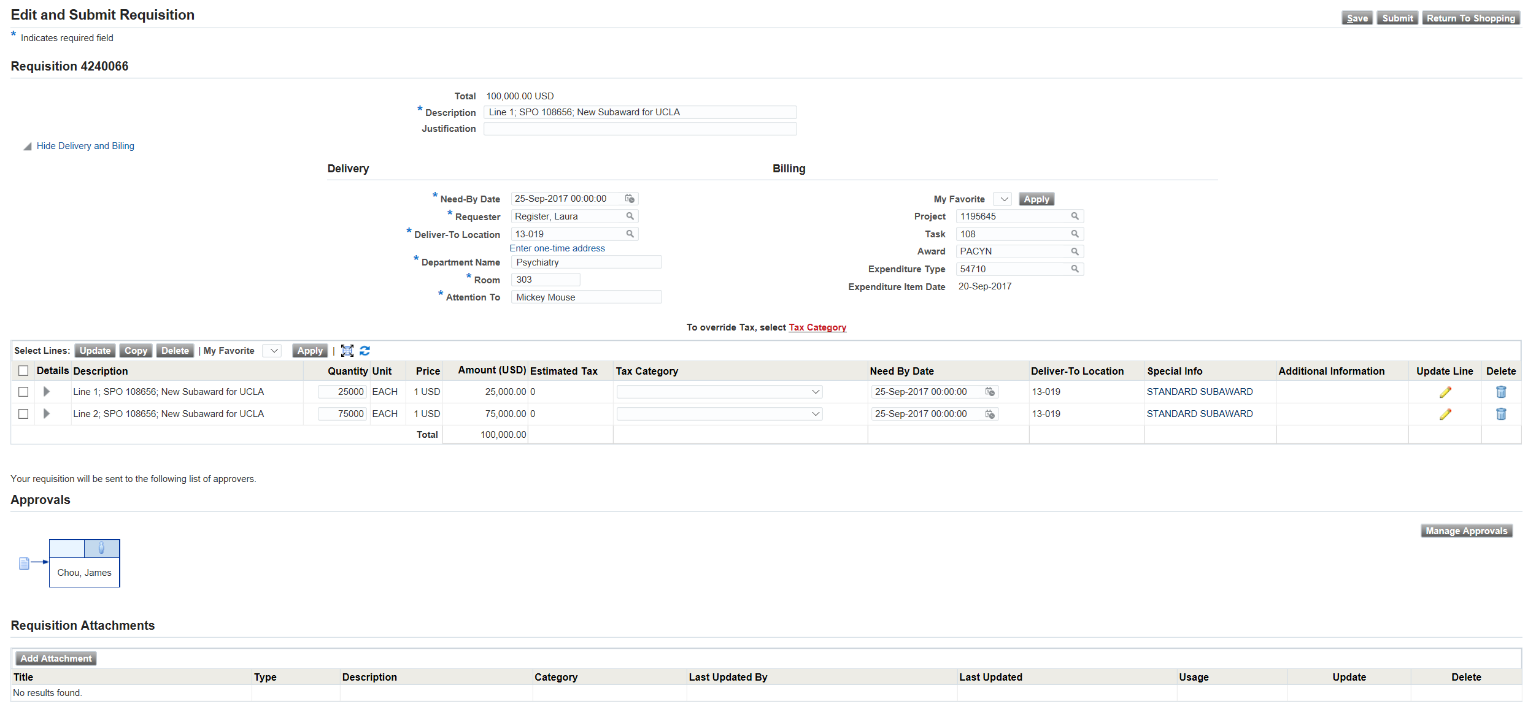
Complete Delivery and Billing information and select “Apply”
Update the expenditure type for line 2 (See next page for more details)
Check that IDC and non-IDC amounts are correct
Add any additional approvers
Upload attachments.
Complete the PTAE for the subaward and put the first expenditure type (54710) then select “Apply”
Select the second line and then select “Update” to update the Expenditure Type for line 2. If you do not update, both lines will be the ET selected in Billing. See next page for more details.
1
2
Confirm the first line is correct for the amount to be applied to IDC and the remainder is correct for non-IDC
3
4
For new subawards you should attach the SOW, Budget (that matches the dollar amount on the requisition), Budget Justification, and Form #33
Select “Manage Approvers to add additional approvers. Do not add OSR approvers, the requisition wil automatically route to them
5

Slide 9
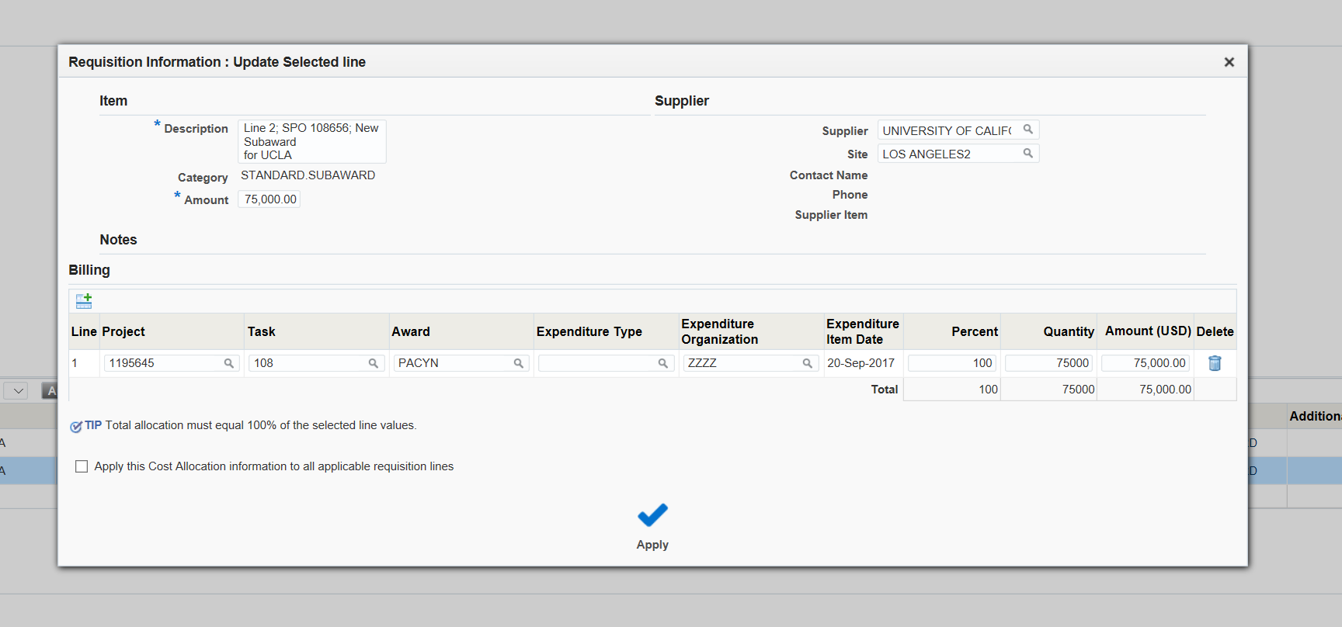
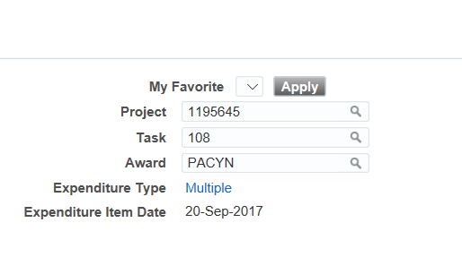
Updating the expenditure type
2
Select “Update”
1
Select the line you want to update the expenditure type for
Once applied, the Expenditure Type field on the main page will show “Multiple”. This will only apply if you have multiple lines with more than one expenditure type.
Enter the expenditure type: 54710 for IDC and 54720 for non-IDC
3
5
4
select “Apply”
Once completed, return to prior page to complete the remaining steps

Slide 10
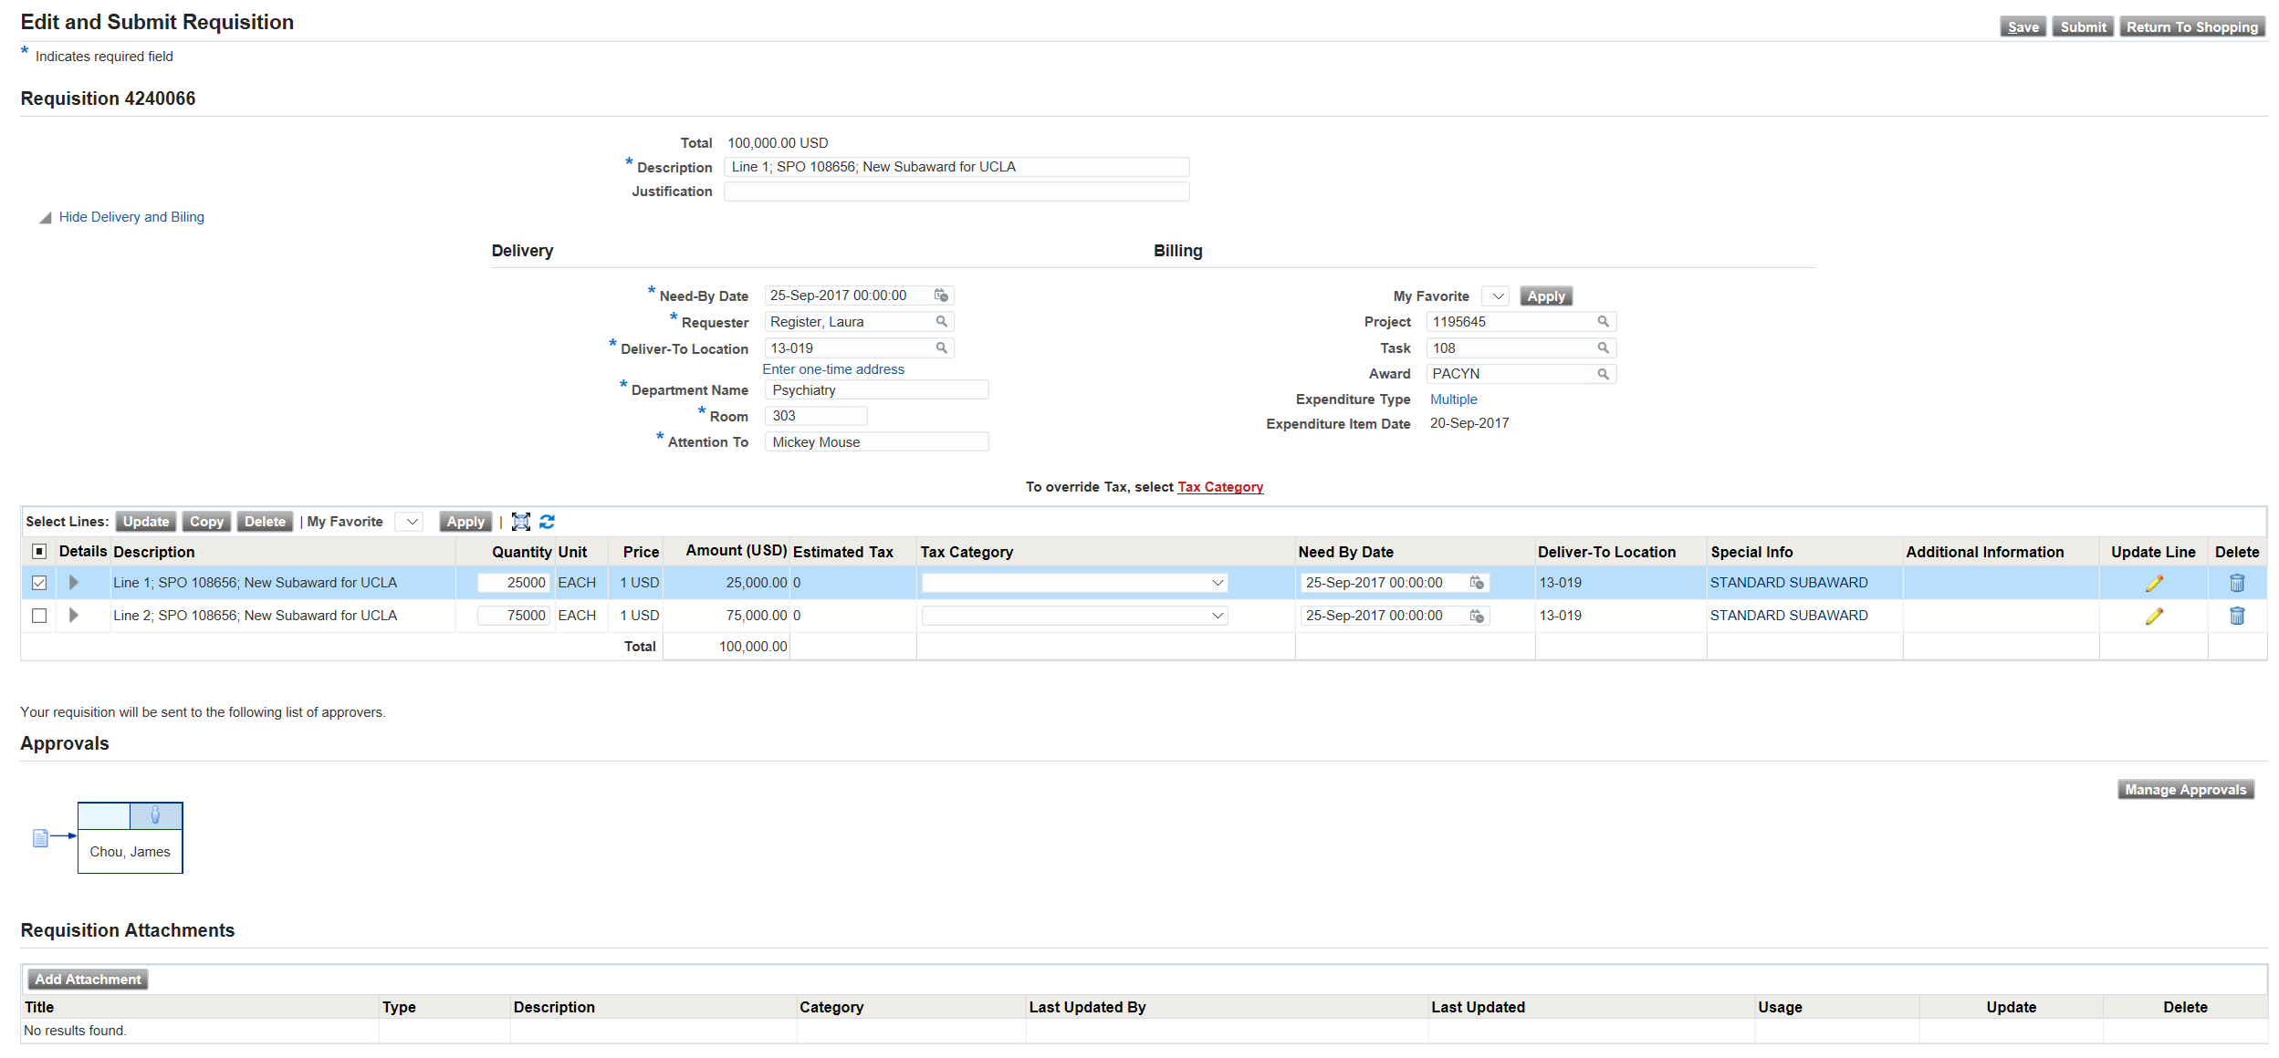
Before you submit, check to make sure everything is correct and all your attachments are uploaded. An accurate requisition with all the documents a contract officer needs to draft the agreement will help speed up the contracting process.
Once you have verified everything is correct, select “Submit” to route the requisition for approval.

Slide 11
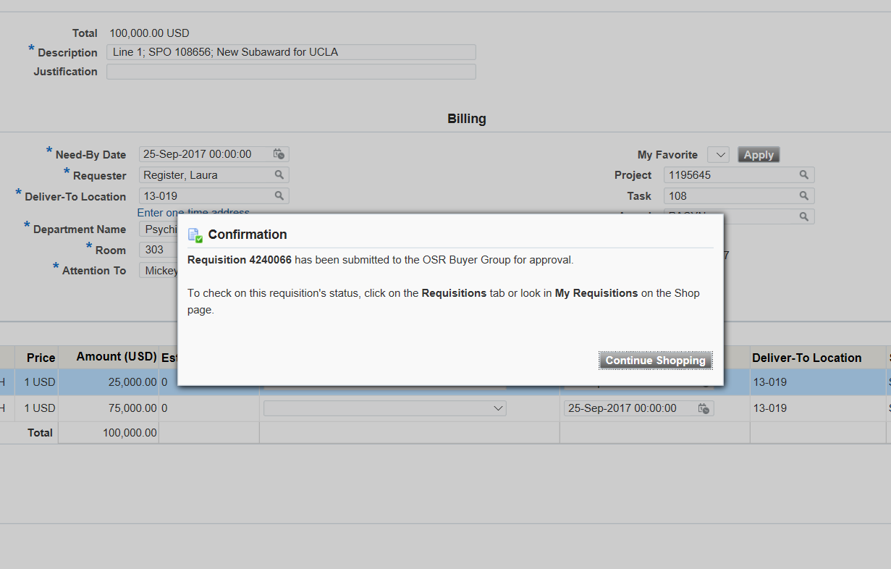
Once submitted you can track the requisition routing in iProcurement until it is approved. Once approved, you will receive a SeRA email to track the process of the contract negotiation. Please note that requisition approval is separate from approval of the PO, which will not occur until the agreement has been fully executed and finalized.

Slide 12
Subaward Amendment
Select “SU Internet Procurement” to enter the requisition portal

Slide 13
Subaward Amendment
To initiate a Subaward Change Order Requisition, select “Non Catalog Requests”

Slide 14
Subaward Amendment
From the drop down menu, select “Standard Change Order - Subaward” for subaward amendments

Slide 15
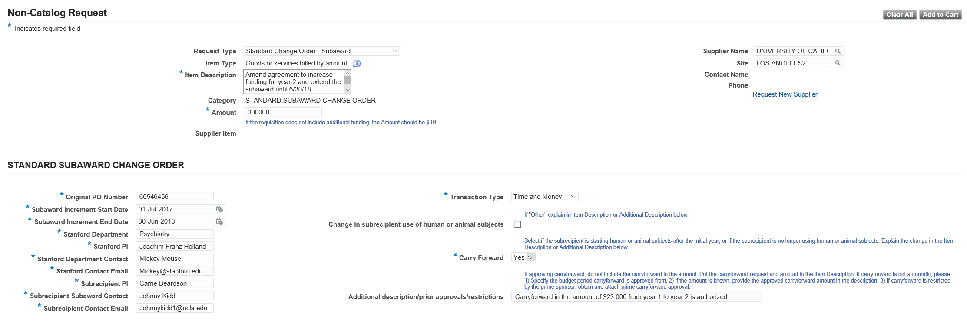
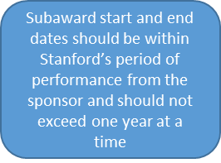
Subaward Amendment
Complete all the fields for the and then select “Add to Cart”
Include a basic summary of your change order request
The amount should include only additional funding. Carryforward amouns should be noted in the description, but not added to the amount.
Input original PO number for the subaward you are amending
Use the dropdown to identify what actions you are requesting
Note in the additional description if there have been any changes or anything you want to bring to the attention of the contract officer

Slide 16
Subaward Amendment
Confirm the total amount in your shopping cart and select “View Cart and Checkout”
You should see the first line amount in your cart

Slide 17
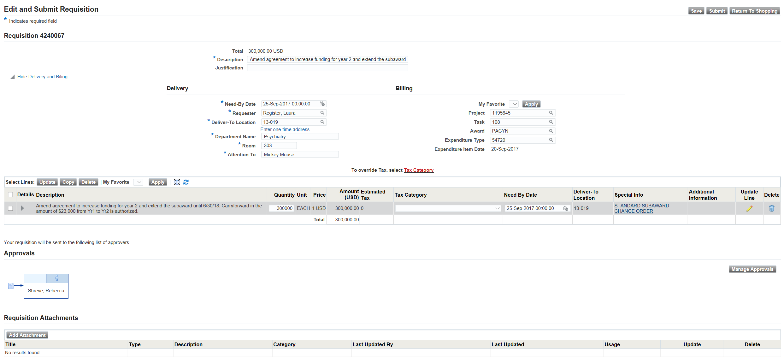
Complete Delivery and Billing information and select “Apply”
Add any additional approvers
Upload attachments.
Subaward Amendment
1
Complete the PTAE for the subaward and put the expenditure type (54720 if you have hit the first $25k threshold for federal awards) then select “Apply”
For subaward amendments you should attach the Budget that matches the dollar amount on the requisition (if it has changed from the proposal), Sponsor Carryforward Approval (if requesting), and a Revised SOW (if the scope has changed).
Select “Manage Approvers to add additional approvers. Do not add OSR approvers, the requisition wil automatically route to them
2
3

Slide 18
Before you submit, check to make sure everything is correct and all your attachments are uploaded. An accurate requisition with all the documents a contract officer needs to draft the amendment will help speed up the contracting process.
Subaward Amendment
Once you have verified everything is correct, select “Submit” to route the requisition for approval.

Slide 19
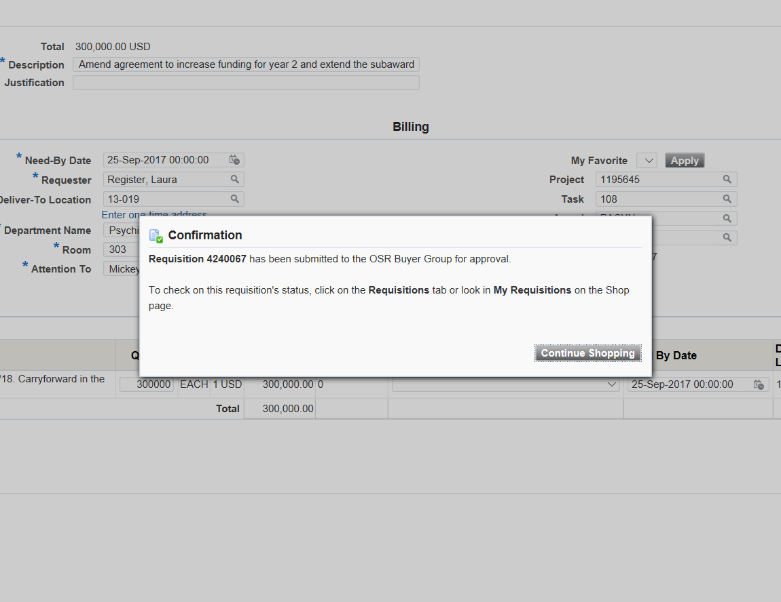
Once submitted you can track the requisition routing in iProcurement until it is approved. Once approved, you will receive a SeRA email to track the process of the contract negotiation. Please note that requisition approval is separate from approval of the PO, which will not occur until the agreement has been fully executed and finalized.
Subaward Amendment

Slide 20
Additional Tips
You can access your worklist from this page, or by selecting this icon
Fund title query will let you look up your award and all the tasks under that award, as well as start and end dates
Requisition and Purchase order query will allow you to see the status of your requisition and PO, upload invoices, check PO commitments, remaining funding, PTA’s, invoice status, and invoice payments
Supplier Query and Request will allow you to look up suppliers and sites, determine if they’re active, request reactivation of suppliers and sites, and add a new supplier or site.

