Slide 1
Nancy Piro, PhD – No conflicts of interest to disclose
Kim Walker, PhD - No conflicts of interest to disclose

Slide 2
SES:096 Voice of the Director: Your experience on what works and doesn’t work with CCC meetings
Nancy Piro, PhD
Education Specialist/Program Manager
Stanford University Medical Center
Kim Walker, PhD
Instructional Designer
School of Medicine, Stanford University

Slide 3
Session Overview
Introduction and background on multi-institution survey
Report on survey results from Program Directors at multiple institutions on the CCC process and outcomes
Emergent themes on directors’ experiences and their roles in the CCC
Quantitative outcomes
Qualitative outcomes
What directors tell us was ineffective in the CCC process
Best practices for coordinators supporting a successful CCC
Action planning for implementation of best practices

Slide 4
Objectives & Session Focus
This session will focus on understanding and discussing the results from a multi-institution survey on CCC practices from the Program Directors’ perspective.
At the conclusion, participants will be able to:
Review their own practices in light of the survey outcomes
Identify best practices that best suit their program or institution needs
Develop and take home an action plan enabled by these best practices to better facilitate the work of their CCCs

Slide 5
Background
Notes:
Milestones
As the ACGME began to move toward continuous accreditation, specialty groups developed outcomes-based milestones as a framework for determining resident and fellow performance within the six ACGME Core Competencies.
Why Milestones? First and foremost, the Milestones are designed to help all residencies and fellowships produce highly competent physicians to meet the health care needs of the public.
Milestones serve important purposes in program accreditation
Allow for continuous monitoring of programs and lengthening of site visit cycles
Public Accountability – report at a national level on aggregate competency outcomes by specialty
Community of practice for evaluation and research, with focus on continuous improvement of graduate medical education

Slide 6
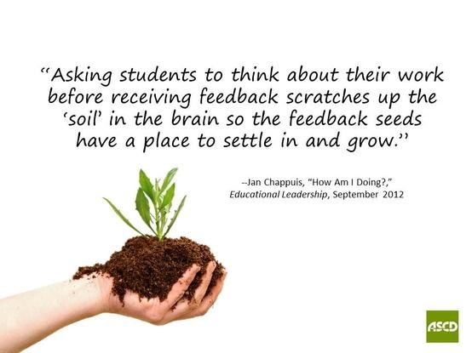
Milestones
Notes:
For educational (residency/fellowship) programs, the Milestones:
Provide a rich descriptive, developmental framework for clinical competency committees
Guide curriculum development of the residency or fellowship
Support better assessment practices
Enhance opportunities for early identification of struggling residents and fellows
For residents and fellows, the Milestones:
Provide more explicit and transparent expectations of performance
Support better self-directed assessment and learning
Facilitate better feedback for professional development
For educational (residency/fellowship) programs, the Milestones:
Provide a rich descriptive, developmental framework for clinical competency committees
Guide curriculum development of the residency or fellowship
Support better assessment practices
Enhance opportunities for early identification of struggling residents and fellows
For residents and fellows, the Milestones:
Provide more explicit and transparent expectations of performance
Support better self-directed assessment and learning
Facilitate better feedback for professional development

Slide 7
Clinical Competency Committee
How the CCC does its work is decided by the Program Director
Notes:
Subcommittees
Assigning residents to faculty members for pre-review
Pre-review work will vary
Some CCCs meet more than twice a year
This outlines the minimum responsibilities that the ACGME requires of the CCC. The review process is left up to the individual committee to decide. The CCC can decide to have some members pre-review the information for each resident and then present them to the group as a whole. The process of pre-review is thought to be helpful in large programs. The CCC may also choose to have the entire committee review every resident. When and how often the CCC meets is also flexible, but the expectation is that the CCC should review every resident for progression on every set of milestones every six months. If there is not enough information at a given time to determine if a resident has made progress on a particular set of milestones (e.g., the resident was on a six-month leave of absence), the committee should just record that there was no change in the milestone level instead of assigning a lower or higher milestone level simply because time has passed.
The CCC reviews all of the residents, gives advice, and makes recommendations for milestone levels. Milestones designations are formative rather than summative. The program director still makes the final determination about each resident’s ability to practice independently (summative).

Slide 8
TEMPLATE
Notes:
ACGME requirements:
While the PD has the ultimate control and say of how the CCC operates, it is important to have the policy follow the ACGME requirements and other decisions explicitly addressed.

Slide 9
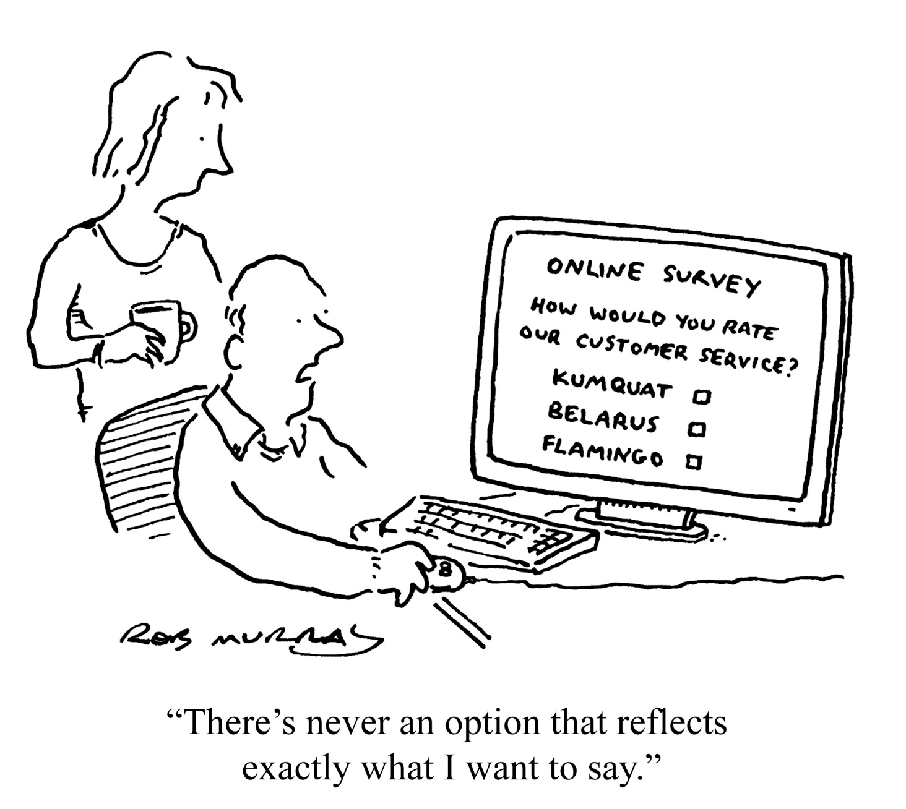
Survey Idea – from Inspiration to Implementation
Notes:
Discussion of approach to the survey with equal balance of quantitative and qualitative options to give them a chance to say exactly what they want to!

Slide 10
Survey – Fun Facts
What:
A 14 Question* web-based survey with both quantitative and open ended questions was developed to assess the program director and coordinator experience so far with respect to CCCs.
When and To Whom:
Between November 12, 2014 and January 15, 2015, the survey link was distributed to a wide sample of directors and coordinators (both within Stanford and across the country to the 15 largest institutions, and to PC networks in OB/GYN, Anesthesia, and Surgery)
Analytic Methods Used – Both Qualitative and Quantitative Analyses were used.
Response: 135 Program Directors and 325 Program Coordinators responded to our survey by January 15, 2015
* Questions detailed on the following slide
Notes:
We will be focusing on the program directors survey results, but will also touch on the highlights and perspectives from the coordinators. Interestingly, for the mirror questions between the two surveys, there was similar responses/alignment.

Slide 11
Survey Questions
What's your program?
Are you a voting member of your CCC?
During your CCC meeting, how much time (on the average) per resident was spent on the milestone assessments?
What actions has your program taken to better align your training program with your milestones (e.g., changed curriculum, added didactics, linked current evals to milestones, used spreadsheets to aggregate evaluation data, added new evaluation tools)?
What data was used in your CCC meeting for trainee assessment?
What data was more valuable in your overall milestone assessments?
Please describe any aspects of the milestone evaluation process that you thought were particularly beneficial.

Slide 12
Survey Questions (2)
Please describe any aspects of the CCC process that were particularly cumbersome.
To what extent do milestone evaluations provide for a more thorough semi-annual evaluation?
To what extent do milestone evaluations increase our documentation of trainee strengths?
Milestone evaluations increase our documentation of trainee weaknesses/areas for improvement.
The CCC process for trainee milestone evaluations is worth the time/effort.
If not worth the time and effort, why not?
Lastly, what did we miss? Are there any other areas of concern or suggestions?

Slide 13
How to Apply to Your Institution
CURRENT PRACTICE (Starting State) | POSSIBLE PRACTICE (End State)
CCC Membership and Size
Faculty Pre-work
Alignment of Milestones
Evaluation Tools
CCC Process
Challenges

Slide 14
Q1. Distribution of Programs Surveyed – 60 programs responded
Notes:
Other (1 response):
Developmental-behavioral pediatrics
Pediatric anesthesiology
Pediatric critical care medicine
Pediatric endocrinology
Pediatric gastroenterology
Pediatric pulmonology
Pediatric rheumatology
Pediatric surgery
Pediatric urology
Pediatrics/Anesthesiology (components individually accredited)
Allergy and immunology
Clinical cardiac electrophysiology
Critical care medicine
Dermatology
Diagnostic Radiology/Nuclear Medicine (components individually accredited)
Gastroenterology
Geriatric psychiatry
Hematology
Neurological surgery
Neurology
Neuropathology
Oncology
Plastic Hand Surgery
Sports medicine
Thoracic surgery
Other (2 response):
Child neurology
Endocrinology, diabetes, and metabolism
Geriatric medicine
Hospice and palliative medicine (multidisciplinary)
Neuroradiology
Ophthalmology
Pediatric hematology/oncology
Pediatric radiology
Plastic surgery - integrated
Psychiatry
Pulmonary disease and critical care medicine
Radiation oncology
Radiology-diagnostic
Rheumatology
Selective pathology-Surgical Pathology
Sleep medicine (multidisciplinary)
Surgery
Vascular and interventional radiology

Slide 15
Q2. PDs - voting member of your Clinical Competency Committee (CCC)?
Notes:
Why would a PD want to be a voting member: size of program, they work closely with trainees and have a good grasp of their levels of competency
Why would a PD not want to be a voting member? Mediator role between the committee and the trainee; unduly influenced; not much time spent working directly with the trainees (larger program size).

Slide 16
PC Survey: Who is on your program's CCC?
Notes:
Nancy – who might be able to contribute to discussion?
Don’t need to be voting members but can contribute their personal observations and assessments.
Mentors
Coordinators
Nursing staff

Slide 17
Q3. How much time (on the average) per resident was spent on the milestone assessments?

Slide 18
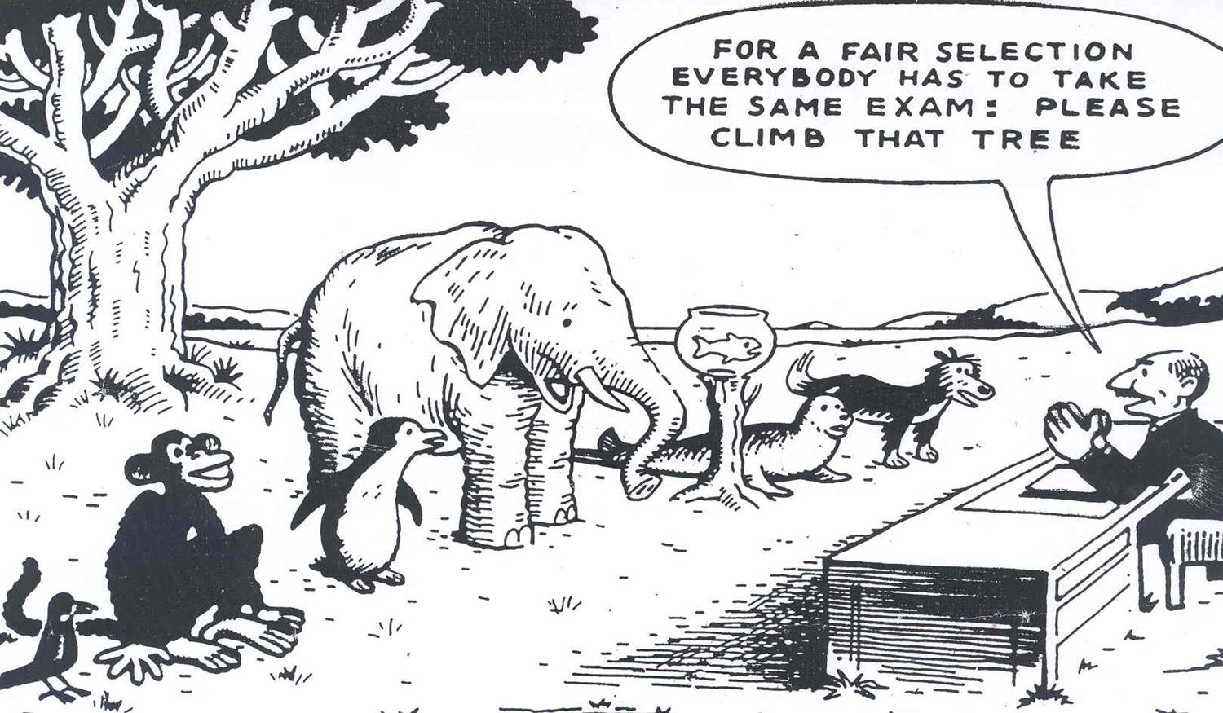
Q4. Alignment of milestones with training: Emergent Themes
New forms of evaluation (n=82) New curriculum/didactics (n=26)
Notes:
“changed curriculum by adding some learning activities, changed end of rotation evaluations, started a resident portfolio for organization and reflection”
“Linked evals to milestones. Added new evaluation tools. Used spreadsheets to aggregate evaluation data. Created new direct observation tools.”
“Evals linked to milestones Clinical competency exams (annual osce's) linked to milestones.”
“linked evals to milestones spread milestones out over several rotation evaluations added eMetrics as a surgical skills evaluation tool”
“Added training, linked evaluations to milestones, started field notes, changed curriculum, added new evaluation tools”

Slide 19
Q4. Alignment of milestones with training: Emergent Themes
New direct observation tools
“Started surgical skill evaluations”
“Created a computer based tool to provide instant feedback and document milestone progress.”
“…ramped up eval tools over time (mini CEX, tech skills assessment)…”
Notes:
Milestones need to be directly observable – patient care; communication, interpersonal skills. Can’t be inferred. Need specific tools focused on the exact

Slide 20
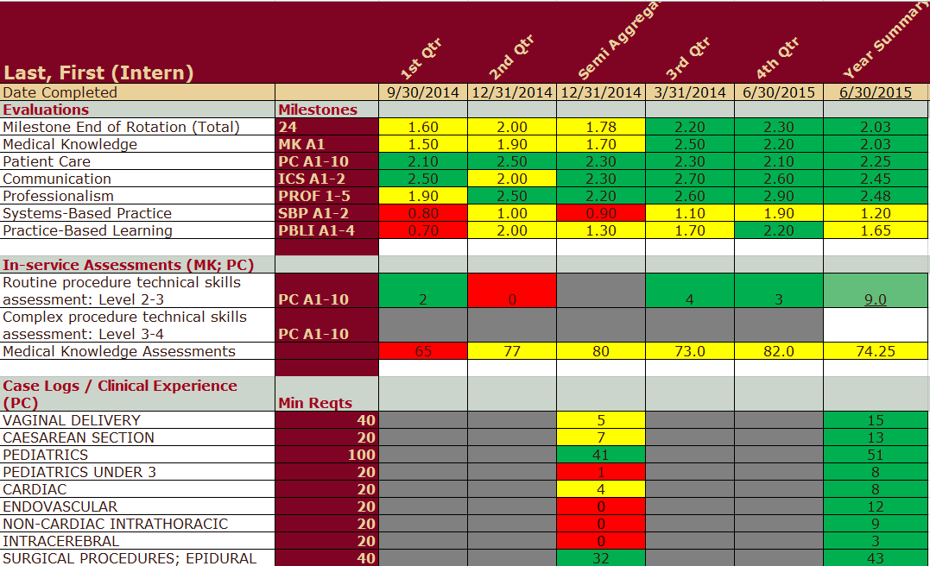
Q4. Alignment of milestones with training: Emergent Themes
Dashboard Spreadsheets
“Spread sheets, color coded resident measures such as conference attendance”
“created spreadsheet to make sure our evaluation tools capture all the milestones”
Notes:
“Spread sheets, color coded resident measures such as conference attendance”
“created spreadsheet to make sure our evaluation tools capture all the milestones”

Slide 21
Q5. Data used in CCC meetings for trainee assessment

Slide 22
Data included in the CCC Review: Overall Emergent Themes
Aggregate milestone evaluation scores
Board scores
Conference Attendance
Continuity clinic chart review
Curriculum Vitae
Didactic attendance
Duty Hour Summary
Duty Hour reporting compliance
Evaluation completion rate
In service exam scores
Learning modules completion
Medical records outstanding OP reports
Medical student evaluations
Mock oral results
Narrative evaluation comments
Peer Evaluations
Presentations
Previous evaluation
Procedure logs
Research projects
Self assessment scores
Spider diagrams with comparison data
Continuity clinic attendance
Notes:
Kim –
So many sources of possible data can be used in the evaluation.
Milestones try to capture so many aspects of the trainees learning experience.
This is a list created by all the organizations across the country that participated – helpful to see what others are using that you might want to incorporate

Slide 23
Q6. What data was more valuable in your overall milestone assessments?
Notes:
Only 1 out of 8 believe quantitative more valuable. Pre-milestones, quantitative was much the deciding factor on overall assessment with the CCC meeting process.
In some of our CCC meting experiences, the richness of comments really drives the overall assessment: storytelling around particular experiences and observations – little time spent looking at aggregate scores
Yet, there is importance in both types (7 out of 8 thought either qualitative by itself was most valuable or a combination of both qualitative and quantitative)

Slide 24
Q7. Beneficial aspects of the milestone evaluation process
Committee-based review and discussion
“Group discussion to clarify our own thinking and understanding of the Milestones and their meaning”
Notes:
“Group discussion to clarify our own thinking and understanding of the Milestones and their meaning; recognition of deficits in our teaching”

Slide 25
Q7. Beneficial aspects of the milestone evaluation process
Committee-based review and discussion
“…recognition of deficits in our teaching”
Notes:
“Group discussion to clarify our own thinking and understanding of the Milestones and their meaning; recognition of deficits in our teaching”
“Makes everyone in CCC really focus on the issues (i.e., can't waffle) Multiple opinions strengthen the rigor of the process.”
“I think sitting down with a group of committed educators who can discuss a resident's performance and in some cases have actually called evaluators to clarify milestones provides a much more comprehensive look at an individual resident's performance.”

Slide 26
Q7. Beneficial aspects of the milestone evaluation process
Committee-based review and discussion
“Multiple opinions strengthen the rigor of the process.”
Notes:
“Makes everyone in CCC really focus on the issues (i.e., can't waffle) Multiple opinions strengthen the rigor of the process.”
“I think sitting down with a group of committed educators who can discuss a resident's performance and in some cases have actually called evaluators to clarify milestones provides a much more comprehensive look at an individual resident's performance.”

Slide 27
Q7. Beneficial aspects of the milestone evaluation process
Committee-based review and discussion
“…provides a much more comprehensive look at an individual resident's performance.”
Notes:
“Makes everyone in CCC really focus on the issues (i.e., can't waffle) Multiple opinions strengthen the rigor of the process.”
“I think sitting down with a group of committed educators who can discuss a resident's performance and in some cases have actually called evaluators to clarify milestones provides a much more comprehensive look at an individual resident's performance.”

Slide 28
Q7. Beneficial aspects of the milestone evaluation process
More objective and focused reviews
“
“common language”
“more detailed evaluation”
“more objective evidence”
Notes:
“Milestones have given the entire faculty a common language.”
“more objective evidence of resident performance”
“Providing some objectivity to professionalism Providing structure to discussions of resident progress”
“The whole milestone process let to a more detailed evaluation of each resident. Previously, the evals were based more on general impression of each attending.”

Slide 29
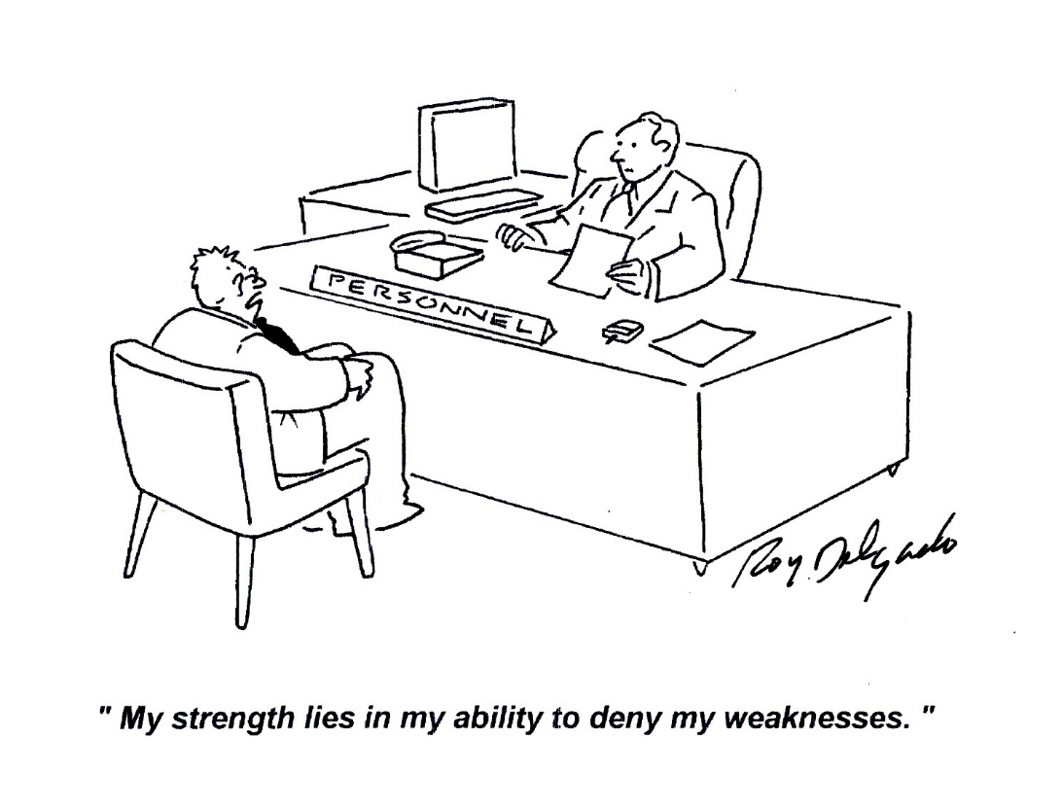
Q7. Beneficial aspects of the milestone evaluation process
Identification of trainee strengths and areas for improvement
Notes:
“unpacks areas where residents are struggling-helps better define them”
“The structure made it easier to see strengths/weaknesses of each resident.”
“We focused on performance that was better or worse than expected at that training level”

Slide 30
Q7. Beneficial aspects of the milestone evaluation process
Identification of gaps in education (curriculum)
Notes:
Systems based practice:
“Program assessment of weaknesses in the curriculum that did not address some milestones, i.e. Cost assessments.”
“Group discussion to clarify our own thinking and understanding of the Milestones and their meaning; recognition of deficits in our teaching”
“made gaps in curriculum and, in particular, gaps in evaluation including faculty competence easy to identify and demonstrate a need for resources to improve”
“Some of the milestones brought to light aspects of training that we had previously not focused on.”

Slide 31
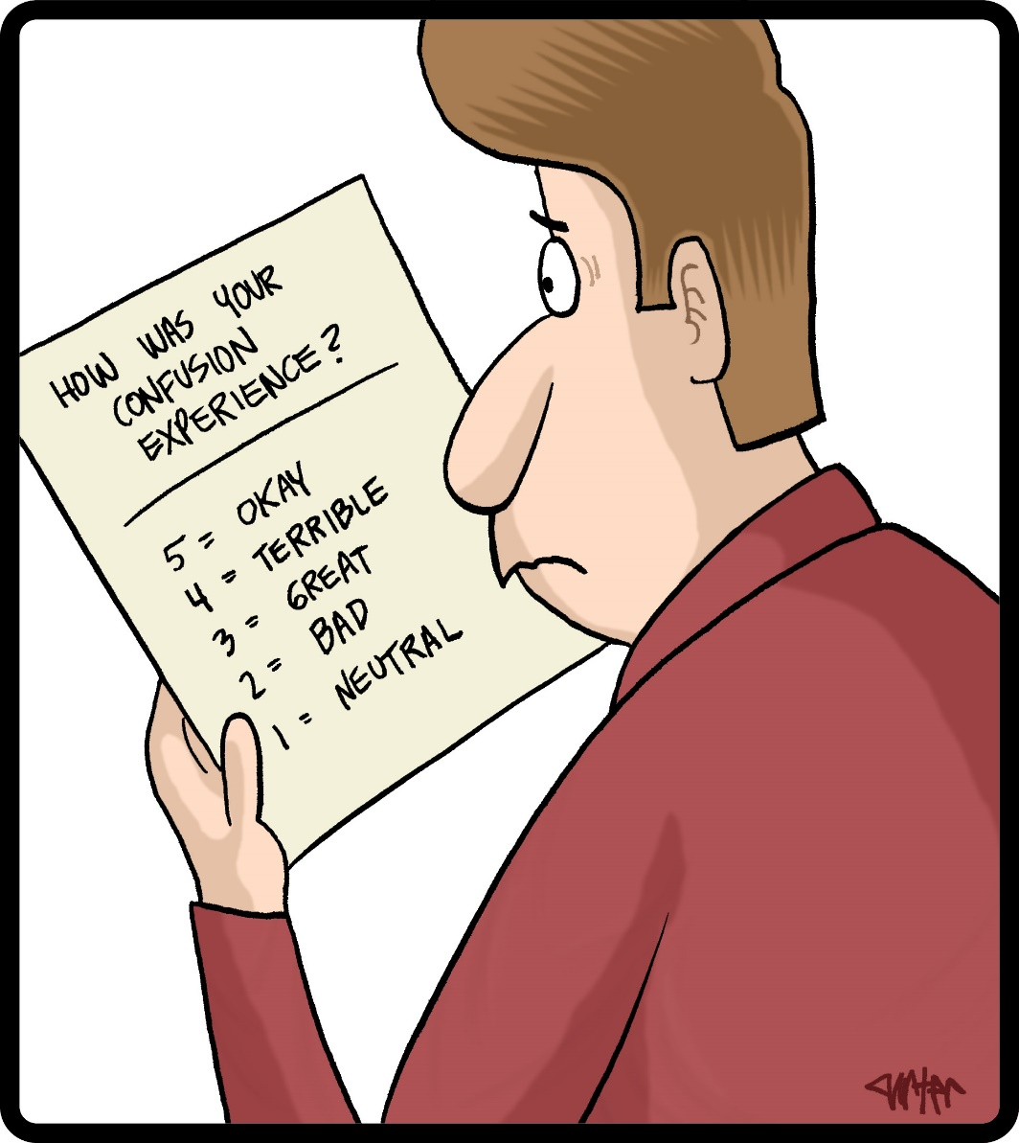
Q8. Cumbersome aspects: Emergent Themes
Milestone interpretation
“contrived”
“nebulous”
“uncalibrated”
"what are they really getting at here?"
Notes:
“Milestone vocabulary unclear; sometimes we asked, "what are they really getting at here?"; some topics did not seem relevant or interpretable for my trainees; no questions or milestones related to knowledge (only ability to find information on the Internet)”
“Milestones seem contrived for most clinical activity.”
“It is very difficult at times to assign a proper milestone level because the descriptions associated with the levels in some milestones are not that different from one level to another.”
“Many milestones are nebulous and uncalibrated; no guidelines for scores with respect to level of residency training.”

Slide 32
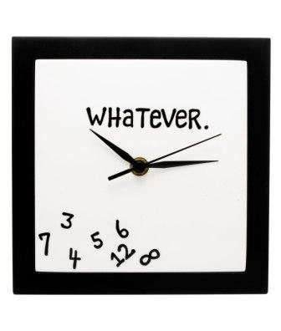
Q8. Cumbersome aspects: Emergent Themes
Time Consuming
Notes:
The CCC process & number of milestones evaluations which need to be done per resident is completely impractical for large programs. This is a classic example of an idea which sounds good in theory but is a mess in practicality.
milestones are long and our meetings are MUCH longer-lots of grumbling from CCC members!!!
Commitment of time in already difficult understaffed situation
the huge administrative burden of collecting and sortint the data. our prgram is large >150 trainees.
Process does not scale well; ideal for a small group of trainees but quickly becomes overwhelming for a large program.
So what are some things that programs can do to address the time issue: changes in process, milestones by resident (focusing on one milestone at a time for all residents); resident-faculty assignment (all PG1s); subcomittees by PGY levels;

Slide 33
Q8. Cumbersome aspects: Emergent Themes
Acquisition of sufficient data
Another 50 milestone evals due tomorrow?!
I can’t take it anymore!!!
Notes:
Acquisition of sufficient data
Getting sufficient data for all residents.
Death by click ... Evaluation fatigue is overwhelming. By the time people get through all the clicks they are do fatigued that meaningful comments are sparse.
number of junior residents who had not done rotations for whom several of the milestones could not be assessed.

Slide 34
Q9. Milestone evaluations provide for a more thorough semi-annual evaluation.
Notes:
70/30 split in agreement; Think back to old semi-annual process that it all fell on your lap and responsibility to aggregate data and come to some meaningful conclusions with very limited data from evaluators. Can provide more targeted feedback based on direct observations across a key sample of faculty.

Slide 35
Q10. Milestone evaluations increase our documentation of trainee strengths.
Notes:
67 to 33, two to one split

Slide 36
Q11. Milestone evaluations increase our documentation of trainee weaknesses/areas for improvement
Notes:
70/30 more than 2 to 1 split;
Anecdotally, some residents interviewed in house have stated how much they appreciate the milestone feedback.

Slide 37
Q12. The CCC process for trainee milestone evaluations is worth the time/effort.

Slide 38
Q12. Why not worth the time: Emergent Themes
“already doing it in other ways”
“CCC does not tell me more about my residents than I already know.”
Notes:
“Isn't really adding anything to what we were doing in old system.”
“already doing it in other ways and this just adds another meeting for me as PD”
“CCC does not tell me more about my residents than I already know. No one has ever told the PDs how this data will be used. What is the hypothesis we are testing? None of these many forms answers the question : Is this resident a safe and competent neurosurgeon which should be the goal of any evaluation.”
“I didn't see anything in the milestones not already reflected in current evaluations, and it all adds up to needless extra time for program directors without any evidence that I can see that this will improve fellow training. The milestones data don't directly link with any meaningful measures that impact fellow progression from one year to the next. The milestones are way too generic to be all that meaningful in any one specialty. The milestones are poorly scaled for fellowships to use- levels 1 and 2 are below the level of first year fellows which compresses the scoring and makes it very hard to distinguish year to year progression.”

Slide 39
Q12. Why not worth the time: Emergent Themes
Cumbersome and Esoteric Milestones
Notes:
“Cumbersome verbiage in milestones leads to misinterpretation by many faculty. No one is sure what to do with the numeric scores, as there are no defined thresholds or criteria for advancement, remediation or graduation.”
“We already had a CCC committee that functioned very well to assess each resident. Many of the milestones are so esoteric that it is hard to provide an objective assessment of the milestone. We know which residents are doing well and which ones are not based on our evaluation process. The detail in the milestones was cumbersome and didn't add anything. No foundation – no piloting / no research / no tests for validity / no evals developed”
“If we were to do an accurate assessment of each resident for each milestone we would need a validated test such as surgical simulator, written test, observation. These tests would have to be affordable reproducible, and easy to administer. we don't have these test so we using subjective qualitative evaluations which are really just a "repackaging" of what we were doing already. I believe the milestone project is the right step forward but hard to implement well.”

Slide 40
Q12. Why not worth the time: Emergent Themes
No prior research, testing for validity
Notes:
“Designed and implemented before ever tested for validity in this context or utility to the groups compelled to use it.”
“there is no evidence that any of the MANY ridiculous measures that the RRC continues to invent (core competencies, core curriculum) etc, in any way produces better physicians and I think the cumbersome paperwork, etc DECREASES the time we actually can spend TEACHING the residents.”
“It's completely unstudied at this point. We have no data to support whether it improves how we evaluate trainees, or even whether that improved evaluation leads to improved training for them.”

Slide 41
Q12. Why not worth the time: Emergent Themes
PDs need educational mission support.
Notes:
…Trainees are likely to get the impression that having a long CV/portfolio and filling all the dots for whatever is required = being a good physician. What they need is practice being a physician and good mentoring - direct observation with direct feedback afterwards, not more complicated and elaborate evaluations. Changing the name (to milestones) does not change what we teach, what we need to teach or what the best methods for teaching is! …
“…rotation evaluations are getting extremely burdensome for faculty to cover milestones plus all of the areas of technical expertise, and I am not convinced we will end up with a better program graduate at the end of the road. Academic faculty at institutions that place an emphasis on publications and grants for promotion are being turned off to investing in training the next generation because of these burdens. In fact, I will likely step down as program director because the role is becoming too burdensome in view of the scope of my other activities.”
“The ACGME (and the entire education community from kindergarten to post graduate education) seems to think that evaluations = education. If we want to do a better job of educating we need to reward educations for educating and clinical work (not for research/publications) AND we need to give them time to educate, not require more and more paperwork… The increased administrative burden is resulting in some of the best educators dropping out of the education process.”
“The faculty deserve DOE for education, given the increased requirements especially during transition and implementation.”

Slide 42
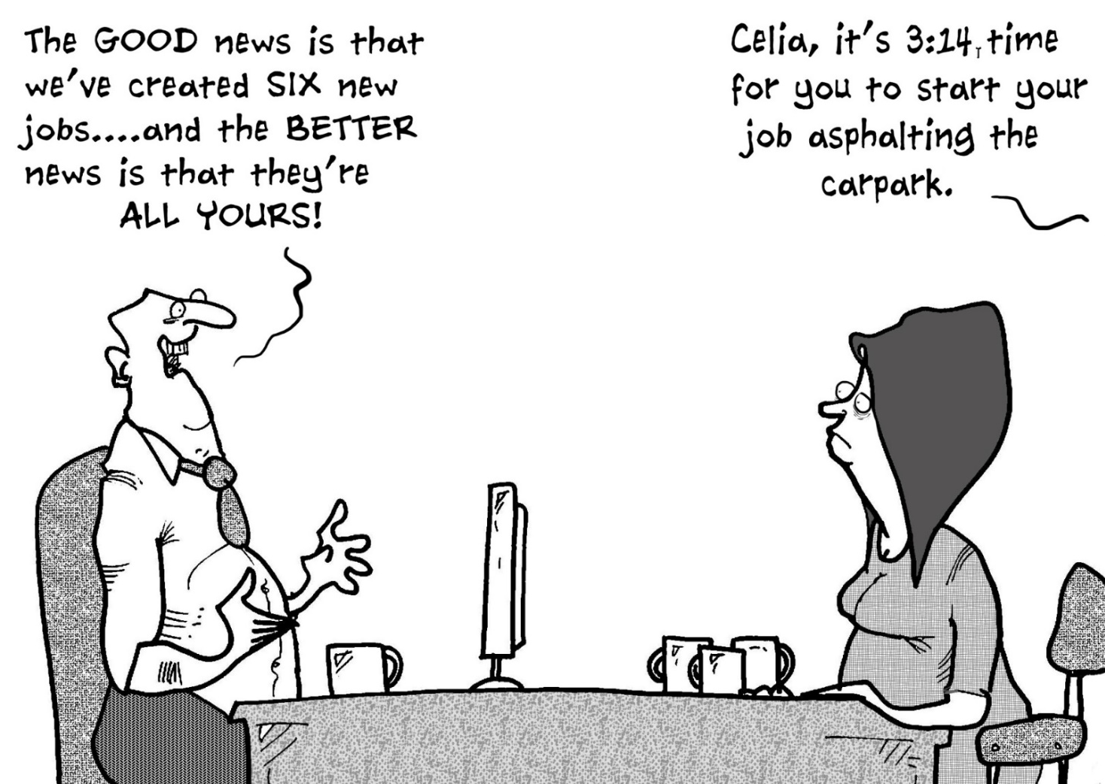
Other thoughts from Coordinators: Emergent themes
Approaches to CCC faculty review process
Recognizing time-consuming nature of work and need for support
“Food for thought” for ACGME from program coordinators
Notes:
“We have 4 CCC's - one for each PGY class. Each CCC has 5 different faculty members and they each focus on 2 residents, reviewing the data ahead of time and presenting their conclusions at the CCC meeting.”
“We held a CCC meeting for each training level. Specific faculty were assigned to assess specific residents; the CCC Chair, PD and Associate PD's reviewed all material on all residents. Use a conference room with projector and computer capability to utilize the ACGME site during the meetings, had the Education Administrator input each assessment during the meetings in the (Save Mode) and the Coordinator simultaneously recorded by hand.”
“we first divided cccs by year level and held 4 separate 2 hour meetings to discuss 4 residents each time. All faculty was responsible for presenting l resident to group with recommendations based on data. We are scheduled to hold l more 2 hour meeting to present final recommendations to entire group on each of 16 residents and will then enter data into database.”
Recognizing time-consuming nature of work and need for support:
“I think it's important to ask if the coordinators/managers have help organizing and collecting the data. It's extremely time consuming and I thankful to have 2 people helping me.”
“The challenge that our CCC is facing is finding appropriate time to devote to the meeting. Our CCC meets for two days to go through all of the residents which has caused push back from our departmental chair and other faculty members.”
“Areas of concern for us are that the evaluations that faculty need to complete are getting longer and more tedious. In addition to having to evaluate on the core competencies, they are now having to assess milestone levels. It would be great to have some shared resources on how other programs are tackling this. Ways to make evals more concise but still getting all of the necessary information.”
“The amount of administrative time it takes to prepare. It took the coordinator weeks to prepare the data and that made the CCC meeting go quickly and efficiently.”
“We believe the program coordinator's should be allowed to be full members of the CCC.”
“THE ACGME should modify the language and recognize that the coordinator plays a critical role in the success or failure of the CCC. Also, I believe rotating the chair every three years would be helpful and have discussed this with our PD at length. Especially when you have a chair of the CCC who is difficult to work with.”
“For the initial meeting to go back and look at all that data and initially place residents took an ENORMOUS about of pre-work on my part. Hopefully since that first data entry is done it will move easier. But I wish the ACGME addressed that and recognized how much effort that would require.”

Slide 43
Overall Results Summary
Overall Improved Evaluation and Documentation
Semi-annual evaluations improved
Documentation of trainee strengths and weaknesses
Time Consuming
Need leadership support
Administrative Resources
Ample planning time
CCC Membership Size
Share the burden!
Value of diverse perspectives
Faculty Roles
Responsibilities
Pairing faculty with trainees
Assigning faculty to become “milestone” experts

Slide 44
Lessons Learned / Best Practices
It’s your turn and your voice that counts!!!
How might you change your practice in light of these findings?

Slide 45
Questions?

Slide 46
Contact Information:
Nancy Piro, Program Manager/Education Specialist
npiro@stanford.edu
Kim Walker, Instructional Designer
kwalker5@stanford.edu

