Slide 1
Conflict of Interest
Laurence Katznelson, MD – No conflicts of interest to disclose
Ann Dohn, MA - No conflicts of interest to disclose
Notes:
Ann

Slide 2
SES013: Lessons Learned from NAS: The Need for an Institutional Curriculum for GME Professionals
Laurence Katznelson, MD, Associate Dean for GME
Ann M. Dohn, MA, DIO, Director, GME
Notes:
Ann

Slide 3
Agenda
Introduction and background on needs assessment for NAS education
Survey of participants
Development and implementation of new teaching models
  Timeline
  Content
  Resources
Brainstorming
Notes:
Ann

Slide 4
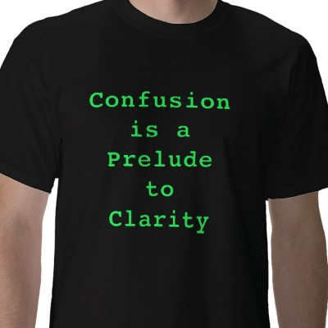
What is next?
Notes:
Ann

Slide 5
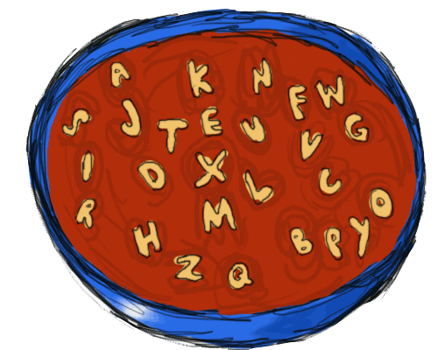
ALPHABET SOUP
Core Competencies
Self Studies
PEC
CCC
Milestones
AIR
ADS Updates

Slide 6

Overwhelmed?
Notes:
Ann

Slide 7
NAS Next Accreditation System
NAS brings many changes and innovations to Graduate Medical Education
The arrival of NAS with the departure of routine program internal reviews brings unique pressure on programs
With institutions facing up to 13 years between self-studies, and programs facing up to 10 year cycles, it critical that institutions have a unified system of strong communication/teaching with all of the stakeholders
Notes:
Emphasize point 1 Ann

Slide 8

Needs Assessment
Assessment may be unique to your institution
Survey your audience
Think of efficiency
  What is common to all
Notes:
Ann

Slide 9
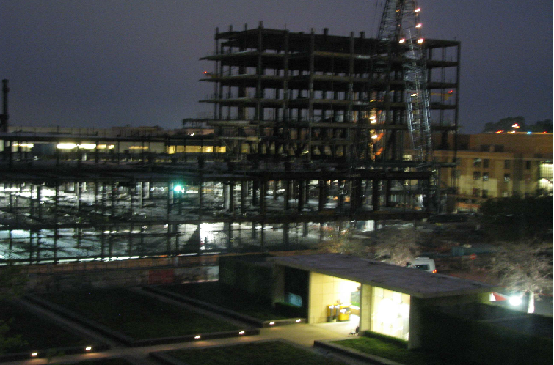
Our Institution….under construction…
Notes:
Larry

Slide 10
Stanford Medicine
Includes Stanford Health Care and Stanford Children's
99 ACGME programs
30 Non-standard programs
1155 residents & fellows
613 bed adult hospital (Stanford Hospital)
311 bed children’s hospital (Lucille Packard Children's Hospital)
1450 faculty (Stanford University School of Medicine)
Notes:
Larry

Slide 11
PD Assessment Survey:
Please rank order your interest in the following topics from 1 - 11, with 1 the most important, and 11 - the least important topic.
Engaging and rewarding faculty for teaching
Dealing with difficult residents and fellows
Dealing with difficult faculty
Faculty Development (Professionalism, "How to's" for ACGME requirements, medical education)
Grade inflation (How to offer thoughtful but critical feedback)
Notes:
Ann

Slide 12
PD Assessment Survey:
Topics for Program Director Development
Checklists and Deadlines (ACGME deadlines, GME deadlines)
Documentation (paperwork and bureaucracy)
Funding for Fellows
Mentorship (for incoming PDs, mentoring faculty, handling program tracks)
Milestones (evaluations)
How to Handle Outpatient Calls
PD Compensation (salary support for PDs, PD efforts count toward promotion)
Resident Wellness
Elective Rotations (which rotations are allowed outside of Stanford)
Strategies for Tracking Resident Performance
Technology
Time Management
Notes:
Ann

Slide 13
PD Assessment Survey:
What area of your role as PD causes you the most concern?
Administrative Paperwork (excessive documentation load, failing to document)
Attracting Good Applicants
Clinical Competence Committees (CCC)
Curriculum Development
Difficult People (faculty, trainees or both)
Entrustable Professional Activities (EPAs)
Funding Fellows
Lack of Recognition as PD
Mentorship (faculty and trainees)
Time Efficient Evaluation System (finding a time efficient evaluation system to evaluate residents)
Resident Curriculum
Resident Discontent
Rules & Regulations (following ACGME, GME, etc.)
Time Management
Notes:
Ann

Slide 14
PD Assessment Survey:
How can the GME Office better assist you?
Administrative Paperwork
Affordable Housing for Residents
GME Applications (more templates, consolidate process & transparency on application progress)
Centralized Training (professionalism, leadership, communication, etc.)
Checklists (deadlines for documents)
How to Deal with Difficult People
Education on Non-Clinical Competencies
Create Evaluations to meet Sub-competencies (inpatient and outpatient rotations)
Faculty & Staff Development
Funding Fellows
MedHub Improvements
Rules & Regulations (guidance on ACGME rules)
Notes:
Ann

Slide 15

Participant Feedback – Your needs

Slide 16
Brainstorming
Notes:
Larry

Slide 17

Where do We begin?
Notes:
Larry

Slide 18

What are our challenges?
Content
Time
Audience
Resources
Alignment
Notes:
Larry

Slide 19

What are our challenges - Content
What needs to be taught or provided?
  Fundamentals of NAS
  How to effectively run CCCs
    PECs
    APES
  ADS Updates
  Self Studies
  Responding to Focused/Special Reviews
  Milestones /New systems of evaluation
  QI
  Scholarly Activity
  etc., etc., etc.,
Notes:
Larry

Slide 20

What are our challenges - Time
Survey your Audience
  What works for them – Everybody has extremely busy and packed schedules already
    Online / In-Person – Hands-On?
  Multiple times – Multiple days
  Short Sessions vs Half Days
Notes:
Try an approach – if it doesn’t work….try something else Larry

Slide 21
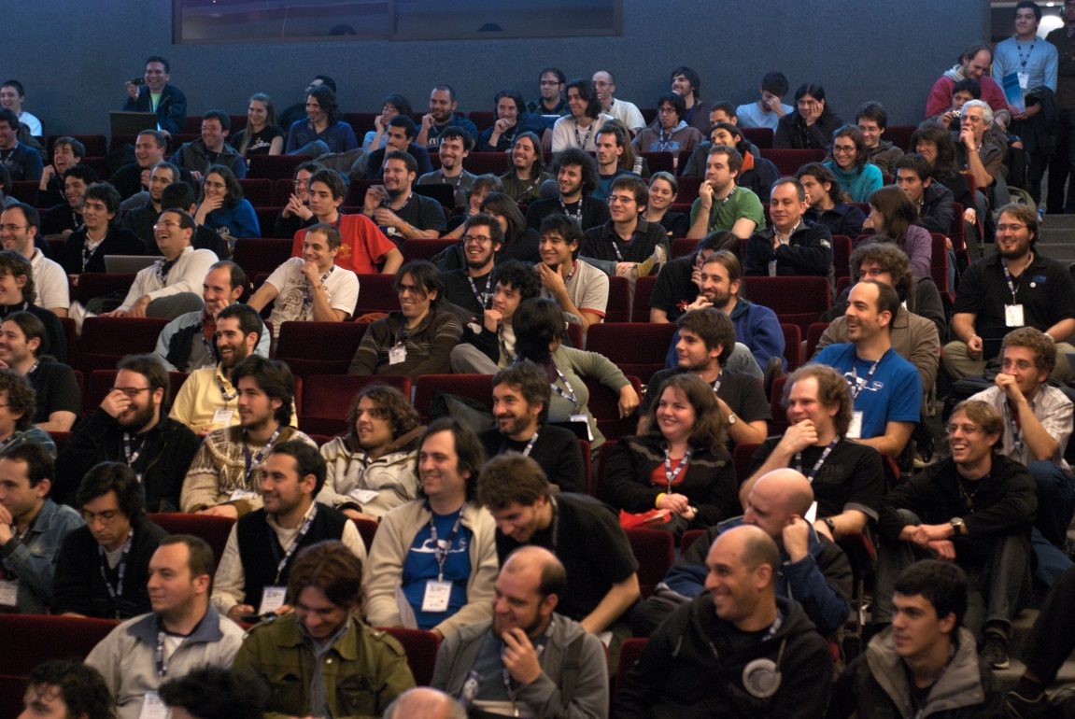
What are our challenges – Determining Audiences?
Who needs to Know What…and When?
  Program Directors (Associate Directors)
  Program Faculty
  Chairs
  Program Coordinators
  C-Suite
Notes:
Larry

Slide 22

What are our challenges - Resources?
Money – Institution/Program Funding
Protected Time
Conference Rooms
Developmental Costs
Notes:
Larry

Slide 23

What are our challenges - Alignment?
Who needs what when – to align education with needs and time requirements
Notes:
Ann

Slide 24
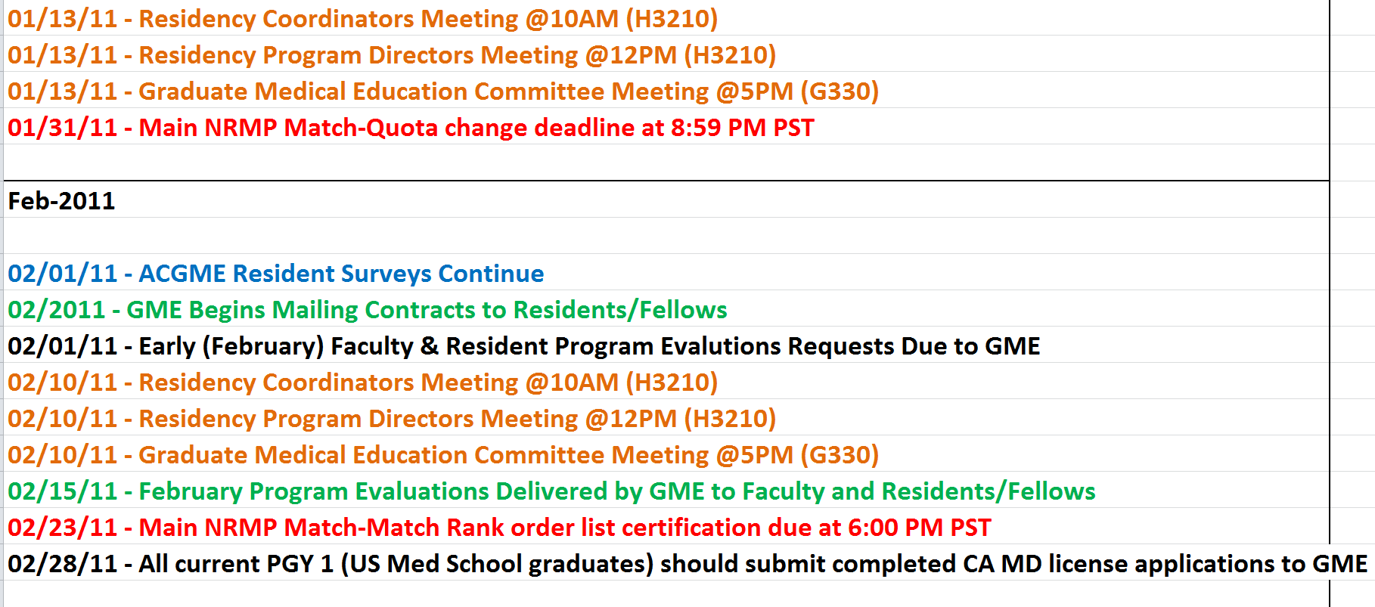
Timeline – Just-in-Time (JIT) Example
Notes:
Ann

Slide 25
Multidimensional Approach
Notes:
Ann

Slide 26
First steps: How to deliver the message
Emails/ newsletters
Updates in your Residency Management System (Med Hub, eValue, New Innovations, etc.)
Meetings/seminars
  Retreats
  Monthly Ongoing Program Director meeting
  Monthly Ongoing Coordinator meetings
  Hands on workshops, e.g. ADS, VISAs, etc.
All of the above
Notes:
Meetings/seminars;
Retreats for PDs and coordinators
PD coordinator serial meetings
Hands on workshops on e.g. , ADS, VISAs,
Online modules for visas
Committee meetings
Larry

Slide 27
What is the message or what should the curriculum contain?
The basics….what every program (including residents) needs to know
Remember people learn in different ways
Mixture of innovation and advanced topics
  Don’t overwhelm the audience
  But showcase high achievers
    Be consistent among your groups…make sure the coordinators and program directors hear the same message
Notes:
Standardize and , QI, online, professional behavior Larry

Slide 28

Suggested Steps…
Poll your groups to determine the best time to meet/teach
  If possible set up teleconferencing
  Post slides/presentations to your RMS/website
  Lay out your curriculum for 12 months
    Combine ACGME updates with educational innovation
    Survey your groups-are the sessions helpful?
      Ask what they want/need
    Provide food!!!!
Notes:
Larry

Slide 29
Hands On Modules
Time is short
Program directors are busy
Teach while they work!
  ADS updates
  New program writing
  Curriculum development
  Evaluation design
Notes:
Ann

Slide 30
Central GME Educational Development
Program directors and coordinators
Faculty
New program director orientation
C Suite
Notes:
Larry

Slide 31

Plan your year in advance…
Use input from your program directors, coordinators, faculty, & C-Suite
  What do they want/need?
Notes:
Ann

Slide 32
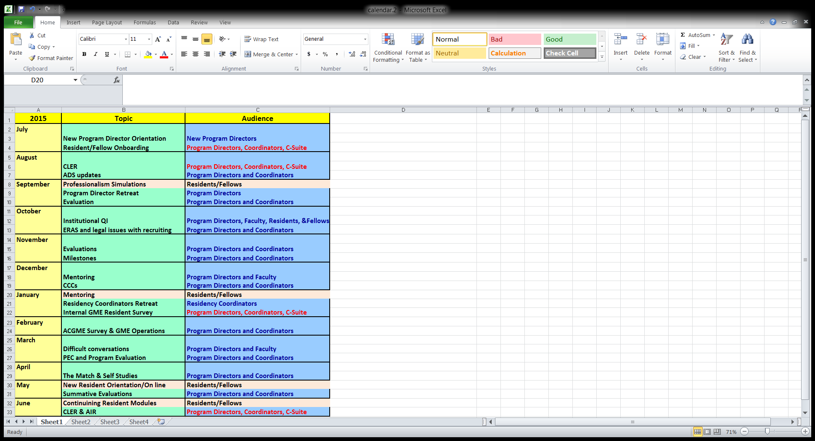
Sample topics for a year…
Notes:
Ann

Slide 33
New Program Director Orientation
Annually (or more frequent if needed)
ACGME basics
  ADS
  Milestones
  Curriculum Development
  Operations (annual calendar)
How to give feedback
Legal aspects of GME
  Interviewing
  Hiring
  Probations/Terminations
Notes:
Larry

Slide 34
Residency Coordinator Retreat
Applicants, interviews, and ERAS
Legal aspects of interviewing
Round tables:
  Resident/fellow appointments
  Visas
  CA MD licenses
  ACGME update
  MedHub
Notes:
Larry

Slide 35

Quality Improvement/Patient Safety
Centralize processes
Online curriculum
  Game to teach basics on approach to a safety event, near miss reporting
  Residents have input
  Meet ACGME and CLER goals
  For onboarding, reinforcement, QI rotations
  Quality Improvement/Patient Safety
Notes:
Larry

Slide 36

Professionalism
On-line module and simulation on consultation (professionalism and communication skills)
Work in progress
Notes:
Larry

Slide 37

Where do we go from here?
Notes:
Ann

Slide 38
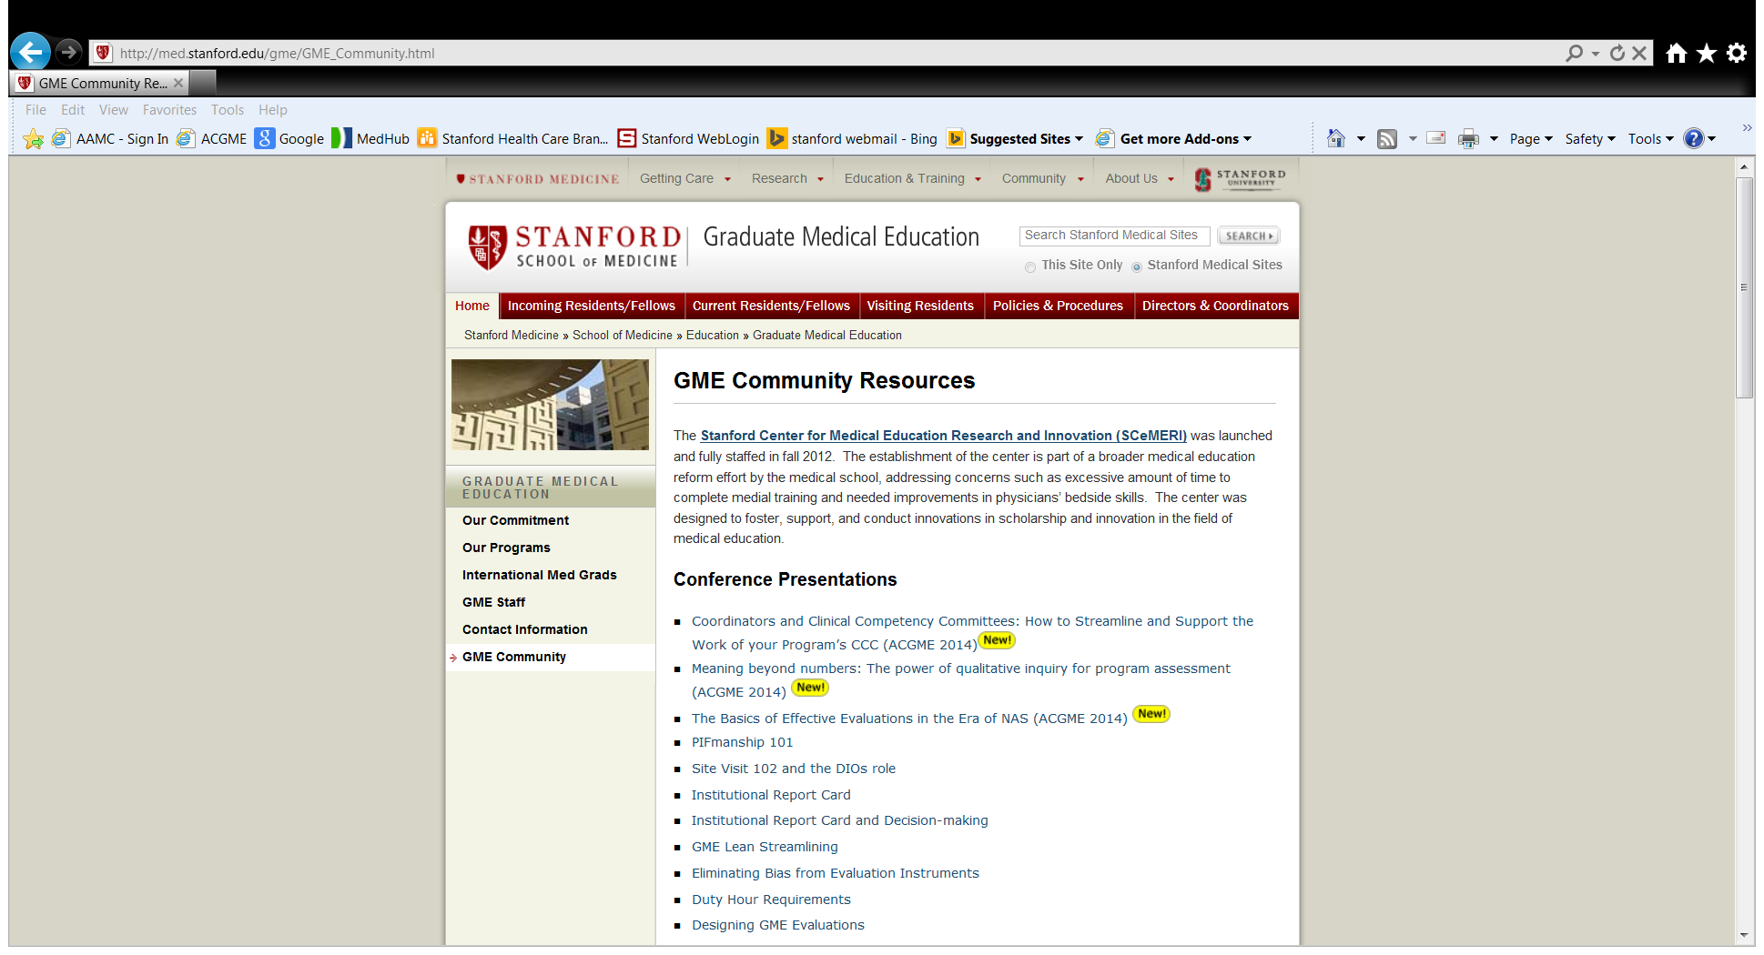
Share resources!
Put your success on your website (in front of the firewall)
Notes:
Ann

Slide 39

Notes:
Both

