Slide 1
Hope Matters: The Evolution of CF Care
Albert Faro, MD
Vice President of Clinical Affairs
Cystic Fibrosis Foundation
afaro@cff.org

Slide 2
Disclosures
Albert Faro has no personal disclosures to make. However, to advance drug development and a search for a cure, his employer the Cystic Fibrosis Foundation (CFF) has contracts with several companies to help fund the development of potential treatments and/or cures for cystic fibrosis. Pursuant to these contracts, CFF may receive milestone-based payments, equity interests, royalties on the net sales of therapies, and/or other forms of consideration. Resulting revenue received by CFF is used in support of our mission. See “How Drugs Get on the Pipeline” on the CFF website for more information.
Additionally, CFF may license CFF Patient Registry data to some companies to monitor drug safety as part of the U.S. Food and Drug Administration’s required Phase 4 clinical trials process and to encourage research aimed at improving the care of people with CF, while maintaining our obligation and commitment to protect the privacy of Registry participants. In connection with these licenses, and upon request, CFF may also assist company researchers in interpreting CFF Patient Registry data to aid in designing, analyzing, and interpreting real world studies in CF.
Notes:
This is my dense disclosure statement. It basically states that I work for the CF Foundation and that the Foundation makes mission related investments to advance drug development and that the Foundation may receive milestone payments or royalties.

Slide 3
History of CF
Some of the clinical findings of CF were recognized as early as the Middle Ages
In 1595 Professor Pieter Pauw in Leiden performed an autopsy on an 11-year-old very thin girl with odd symptoms for 8 years that was said to be bewitched
In 1606 Professor Alonso y de los Ruyzes de Fonteca described the salty taste of infants who were bewitched
“Woe is the child who tastes salty from a kiss on the brow, for he is cursed, and soon must die.”
Fanconi was probably the first to note bronchiectasis in 1936
Dorothy Andersen in 1938 coins the term cystic fibrosis of the pancreas
1951 - Andersen reports on heat prostration in her patients
1953 - Paul di Sant’Agnese determined the cause of the heat prostration leading to the sweat test
1982- Paul Quinton, studying sweat glands, identifies the channel responsible for the inability to conduct chloride across the epithelium
Notes:
Pieter Pauw death had been caused by the pancreas which was oddly swollen. 17th century Spanish, German and Swiss literature warned “Woe is the child who tastes salty from a kiss on the brow, for he is cursed, and soon must die.” Dorothy Andersen discovers this disease by performing post-mortem exams on deceased infants. This disease that had been around for centuries and it is discovered by performing autopsies on deceased infants. You don’t get more deadly; more hopeless than that.

Slide 4
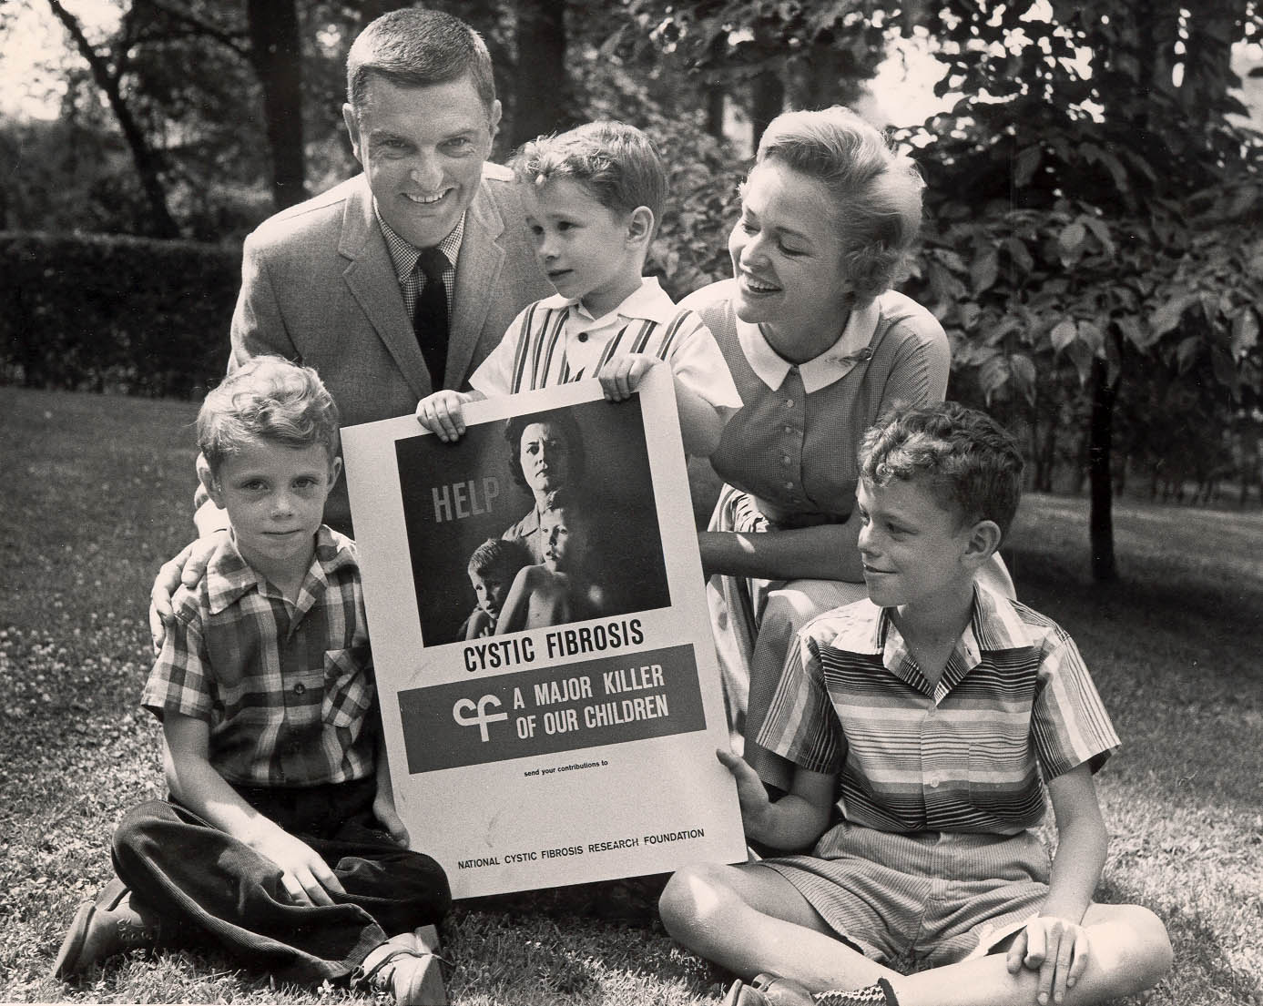
The National Cystic Fibrosis Research Foundation - 1955
Mission:
To assure the development of the means to cure and control CF
Notes:
Let’s return to the 1950’s. We have a disease that is recently given a name beyond “bewitched” and we have children with median survivals of around 2-3 years of age. Milton, a pediatrician in Philadelphia, and Evelyn Graub had 2 children with CF. Rather than remain mired in a sense of helplessness and hopelessness they were determined to fight back and began to raise money for a disease that most people had never heard of. Evelyn sat in Dr. di Sant’Agnese’s waiting room, and ask yourselves if you would do what she did, but she would stop parents as they came to clinic and would say “I know your child is probably going to die and my 2 children are going to die before it makes a difference but will you join with me and start an organization that can make a difference in children’s lives.” As opposed to dealing with her grief by running away she sat there over and over for years talking to other parents saying would you join me and they did, and they did. They worked out of a basement and not only did they raise money but they found a publicist to raise awareness of this killer of children. This was the genesis of today’s CF Foundation.

Slide 5
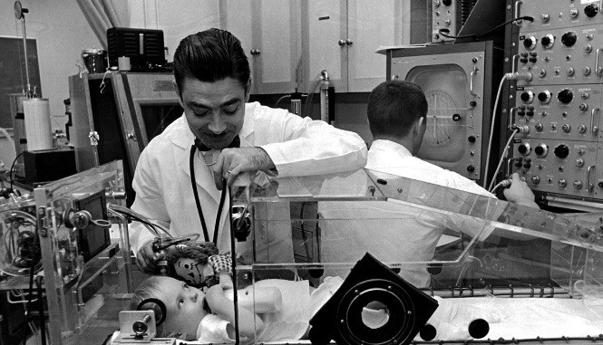
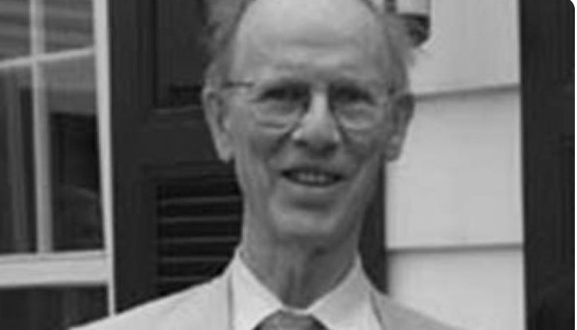
Cornerstones Set in Place: 1960’s
CF Care Center Network
Benefits:
Interdisciplinary care
Descriptive research
Exposure to faculty and trainees
Patient Registry
Benefits:
Natural history of the disease
Track the impact of interventions
Notes:
in the 1960’s the cornerstones for treating CF were being put into place. Modeling itself after Polio the nascent CF Foundation made a decision to establish a network of medical centers. They were funded by local chapters and the first two were established in 1961 at Babies Hospital and Boston Childrens. By the mid-1960s there were more than 30 centers. This allowed for some comparison between centers and in Cleveland they were claiming to have patients dying at 21 where everywhere else it was 3. Some claimed Cleveland was cooking the books. So the Foundation gave Dr. Warren Warwick in Minnesota $10,000 to collect the data; establishing the patient registry.
As it turns out Dr. Leroy Matthews had developed a comprehensive program that started with bonding with and nurturing the parents. He filled them with hope. He gave them hands on lessons in doing airway clearance, he used antibiotics on a scheduled basis and saw them in clinic monthly. He focused on nutrition with digestive enzymes and maybe his only mistake, a low fat diet. But his comprehensive approach worked.

Slide 6
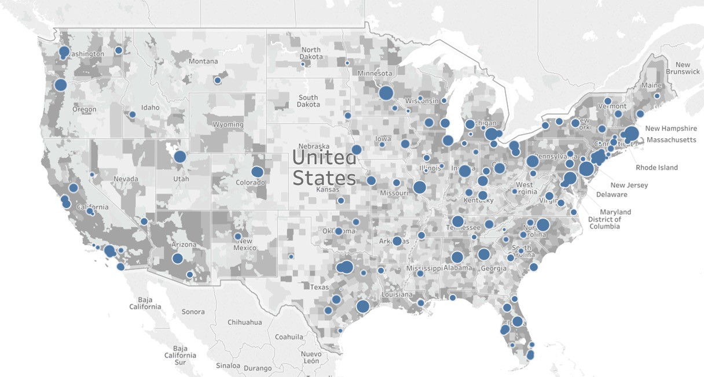
CF Foundation Care Center Network
Pediatric Programs
132
Adult Programs 119
Affiliate Programs
35
Notes:
Today there are over 130 CF Foundation accredited centers broken down into 286 programs. They undergo annual paper reviews and site visits every 5 years or sooner depending on the results of previous reviews all run by the Center Committee; a committee of their peers. They must provide interdisciplinary care and contribute to the patient registry. They are expected to practice continuous improvement and have QI processes in place. The majority of centers also contribute to CF research and educate trainees.

Slide 7
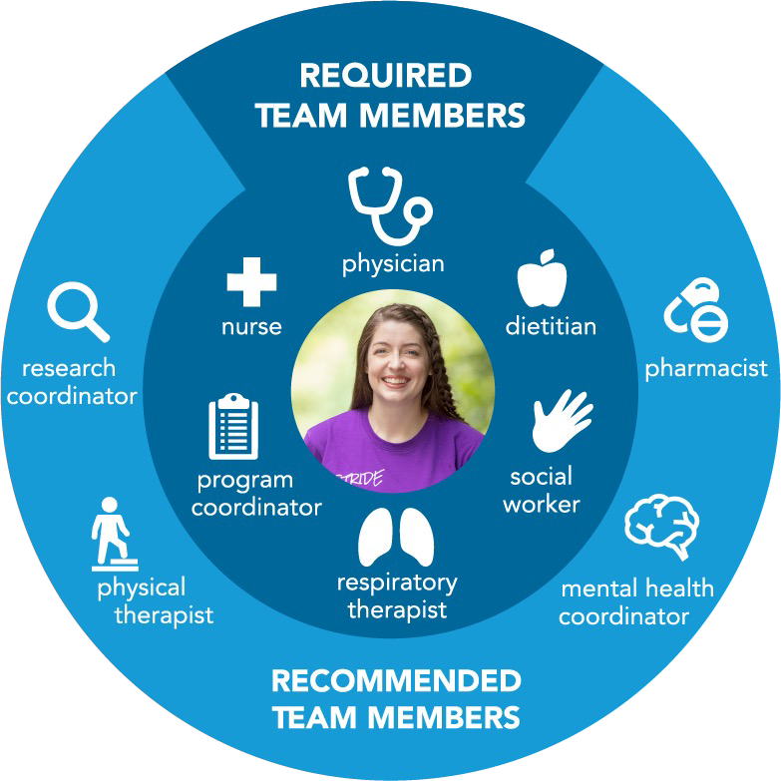
Care Centers Staffed by Interdisciplinary Teams
Practice informed by CF Foundation Clinical Care Guidelines
Notes:
The expectation is that the CF care team will have sufficient time from a specialized CF physician, program coordinator, nurse, dietitian, respiratory therapist, and social worker. In addition it is recommended that teams also have pharmacist, mental health coordinator, physical therapist, genetic counselor, and research coordinator.
Their practice should be informed by CF Foundation clinical care guidelines of which we produce several every year. Again it is run by a committee and follows strict rules in reviewing the literature and using a standardized PICO format to develop the search questions and finally a vote on the recommendation.

Slide 8
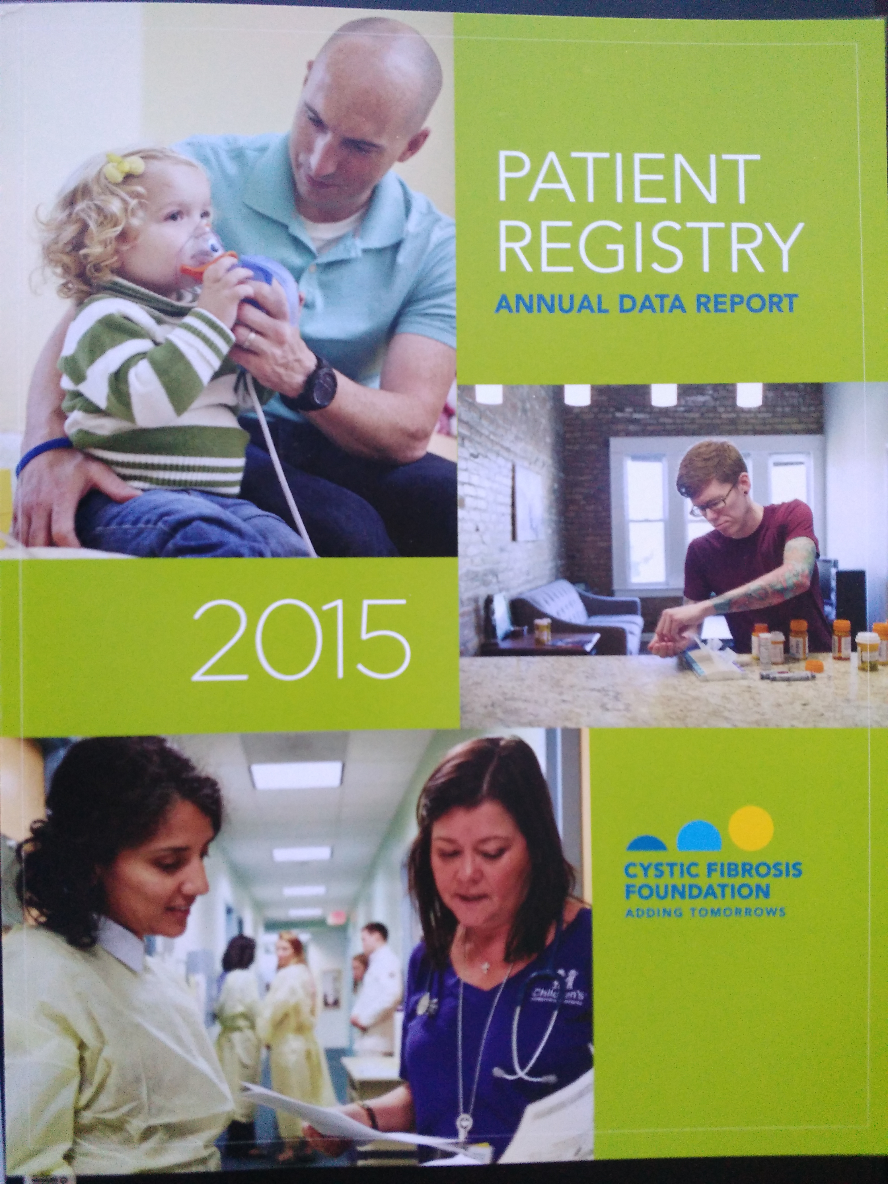
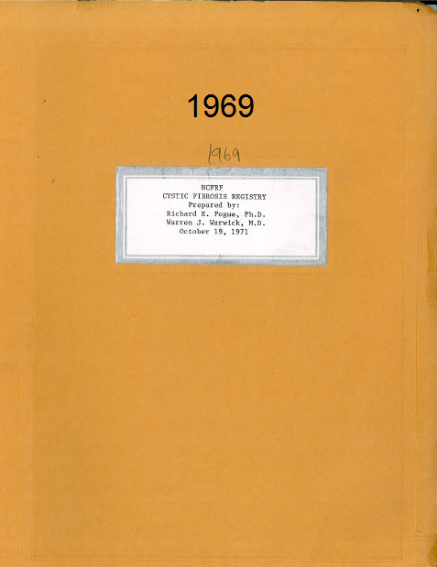
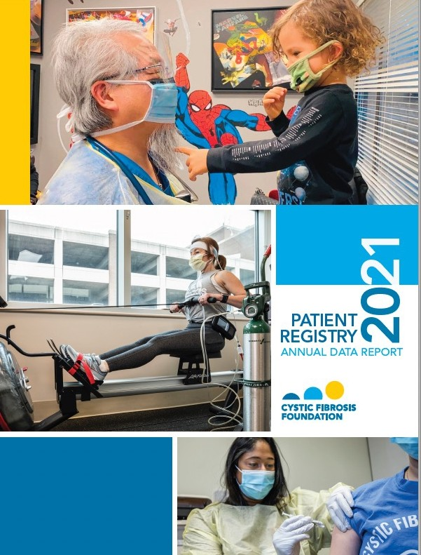
High-Quality Specialized Care: Patient Registry
From 1986 through the end of 2014:
48,463 unique patients
632,022 person-years of data,
2,497,178 clinic visits, and
241,984 hospitalizations and/or home IV episodes
Knapp EA, et al. Ann Am Thorac Soc 2016;13(7):1173-1179
Notes:
Returning to the Registry, it is our crown jewel with 84% of all individuals with CF enrolled and each providing hundreds of fields of data every year; at every encounter. The CFFPR is truly the envy of many other organizations and is also a model that others aspire to. Just a few months ago I spoke at a National Academies of Science meeting as they explored how they could improve care for ALS and they were impressed by so much of what we do at the Foundation, but it is the registry that they came back with wanting to further explore.

Slide 9
Uses of the CF Foundation Patient Registry
Post-Marketing Surveillance Studies
Framework for Clinical Trials
Comparative Effectiveness Research
Disease Surveillance
Quality Improvement
Track progress in curing CF and the impact of treatments
Test promising new therapies
Ensure safety and effectiveness of approved products
Provide all patients with high-quality care
Promote evidence-based clinical decision making
Notes:
The registry serves many purposes since Dr. Warwick started it to see whether or not Rainbow Babies was cooking the books when they claimed to have a median survival of 20 when every other center in the country was between 2-3 years of age. The Registry indeed validated that Dr. Mathews and Babies was doing something that every other care center could learn from. And since then, the Registry has evolved over time to provide understanding into disease trajectory, establish a framework for clinical trials, undertake post-marketing surveillance studies, continue to monitor differences in outcomes across programs and facilitate QI and lastly promote evidence based clinical decision making.

Slide 10
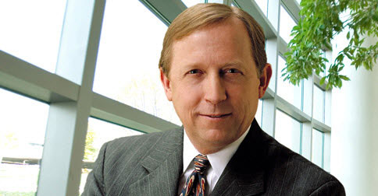
“The CF Improvement Story: We Count Our Successes in Lives”
Brent C James, MD MStat
BMJ Quality and Safety 2014;23:268-71
“Some have estimated that we could achieve as much benefit for patients if we could routinely apply and deliver current best medical knowledge, as will be achieved by the next 25 years of government funding for new research.”
“Obviously the healing professions should vigorously pursue both courses – new biomedical research and care delivery science – as has been done in CF…”
It represents a massive opportunity for clinical
scientists and the patients that we serve.”
Notes:
What about QI?

Slide 11
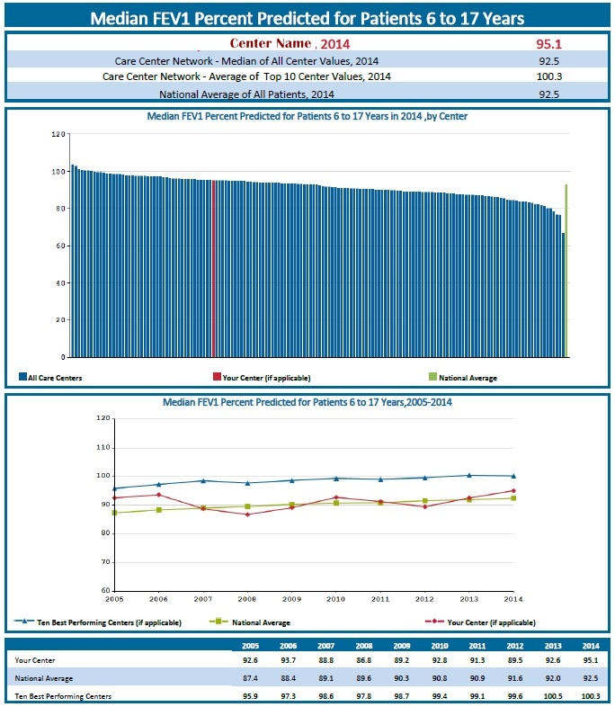
Annual Center-specific reports
CFFP Center-Specific Report
Notes:
Care centers annually receive a care center report in it they can see how they compare to other care centers in many different facets including outcomes. This bar graph from 2014 represents the lung function, as measured by FEV, in 6 to 17 year olds at every center. The red bar represents your center. They can see they are above national average and also see that there are many centers doing better and this may be an area they wish to work to improve. What I want you to see as well is the great variability in outcomes with the highest performing center achieving FEV1 over 100% and the worst performing site at about 70 pp.

Slide 12
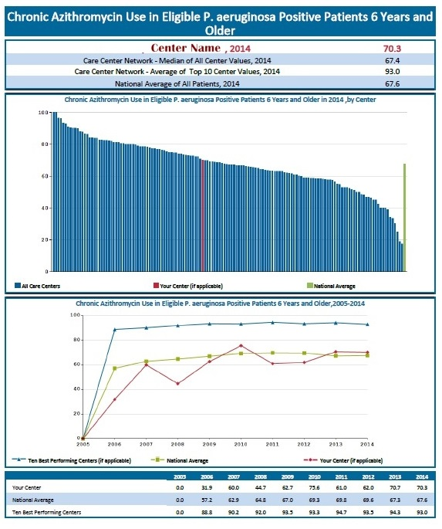
Notes:
Why do we need QI? Variability of performance; in this case in the use of azithromycin. they also receive data on how they use guideline recommended interventions. In this case I am showing you the use of chronic azithromycin in patients 6 years and older as per guideline recommendations. The center in red is right at national average, but has opportunity to improve as only some 70% of their eligible patients are on it. And again take note of the variability between centers. There are some that achieve 100% and some were not even 20% of their patients are on national guideline recommended treatments.

Slide 13
How does the CF Foundation Support QI?
Sharing of registry data
Care center peer review accreditation process
Evidence based clinical care guidelines
Benchmarking
Engaging people with CF and their families
Leadership and Learning Collaboratives (LLC)
CF Learning Network
Coaching – discipline specific programs
“Data for learning, not judgement”
Notes:
The Foundation recognized this and set a goal that care delivery and outcomes should be similar across the care centers. We aim to achieve this aspirational goal by supporting QI. Look at slide.

Slide 14
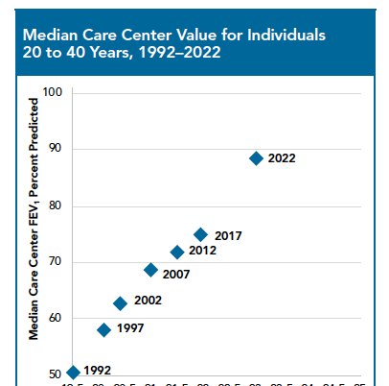
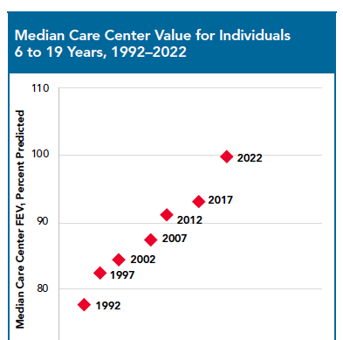
Notes:
And here is the impact of supporting the CF care model of interdisciplinary care, registry data, evidence-based guidelines and quality improvement. There are always going to be superstars and there are always going to be laggards, but the care center network as a whole has continued to improve. You can see this when graphing lung function against BMI for adults in the first and children in the second graph. Incremental improvements are obvious in 5 year bands across the care center network. Something important happens between 2016 and 2021 and we will soon get to that.

Slide 15
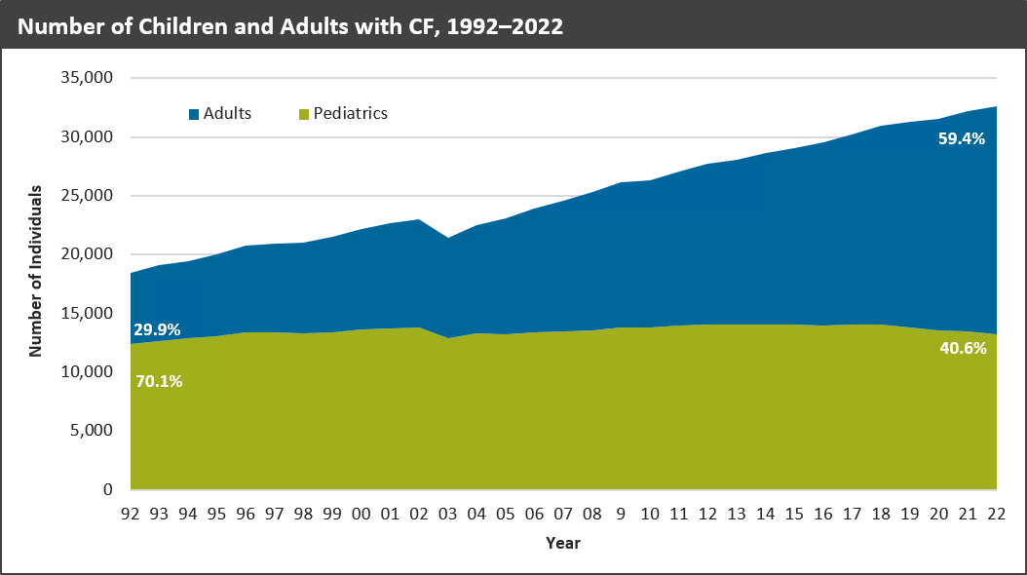
Notes:
The result is not just FEV1 or BMI. The result is that this killer of children is now a disease of adults. Even in 1992 only 30% of individuals with CF were adults. Today, it is 60%. I hope you are starting to get a sense of why this may be the best story in medicine.

Slide 16
It is more than just about the lung function or the weight!
Holistic Approach to Care!
Notes:
And YES it is more than just about lung function or weight. From Dr. Matthews recognition that he needed to treat the family to today a hallmark of CF care and the care model is holistic care.

Slide 17
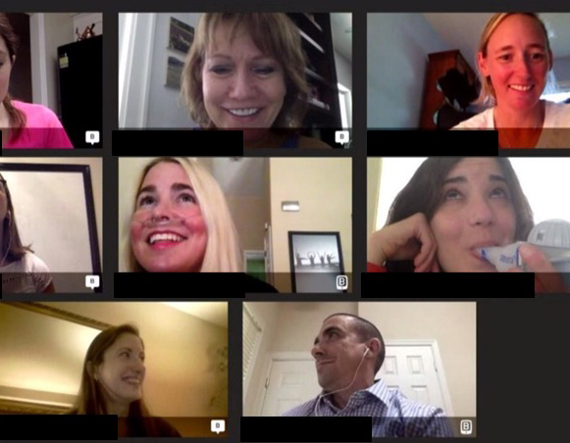
Listening to the Voice of the Person With CF
Community conferences
Serving on committees
Leading QI projects
Quality of care surveys
Local patient family advisory boards
Leading the Board of Trustees!
Notes:
as the adult population grew and they reminded us that there is more to living with CF than hours on end of therapies. The voice of the person with CF within the Foundation was reawakened. We have quickly evolved over the past 7 years to offer community conferences, have individuals with CF serve and lead committees and QI projects. The Chair of our Board of Trustees is KC White a person with CF. Again, the Chair of the Board of this disease that was discovered through autopsies of infants is an adult with that disease. Best story in medicine?

Slide 18
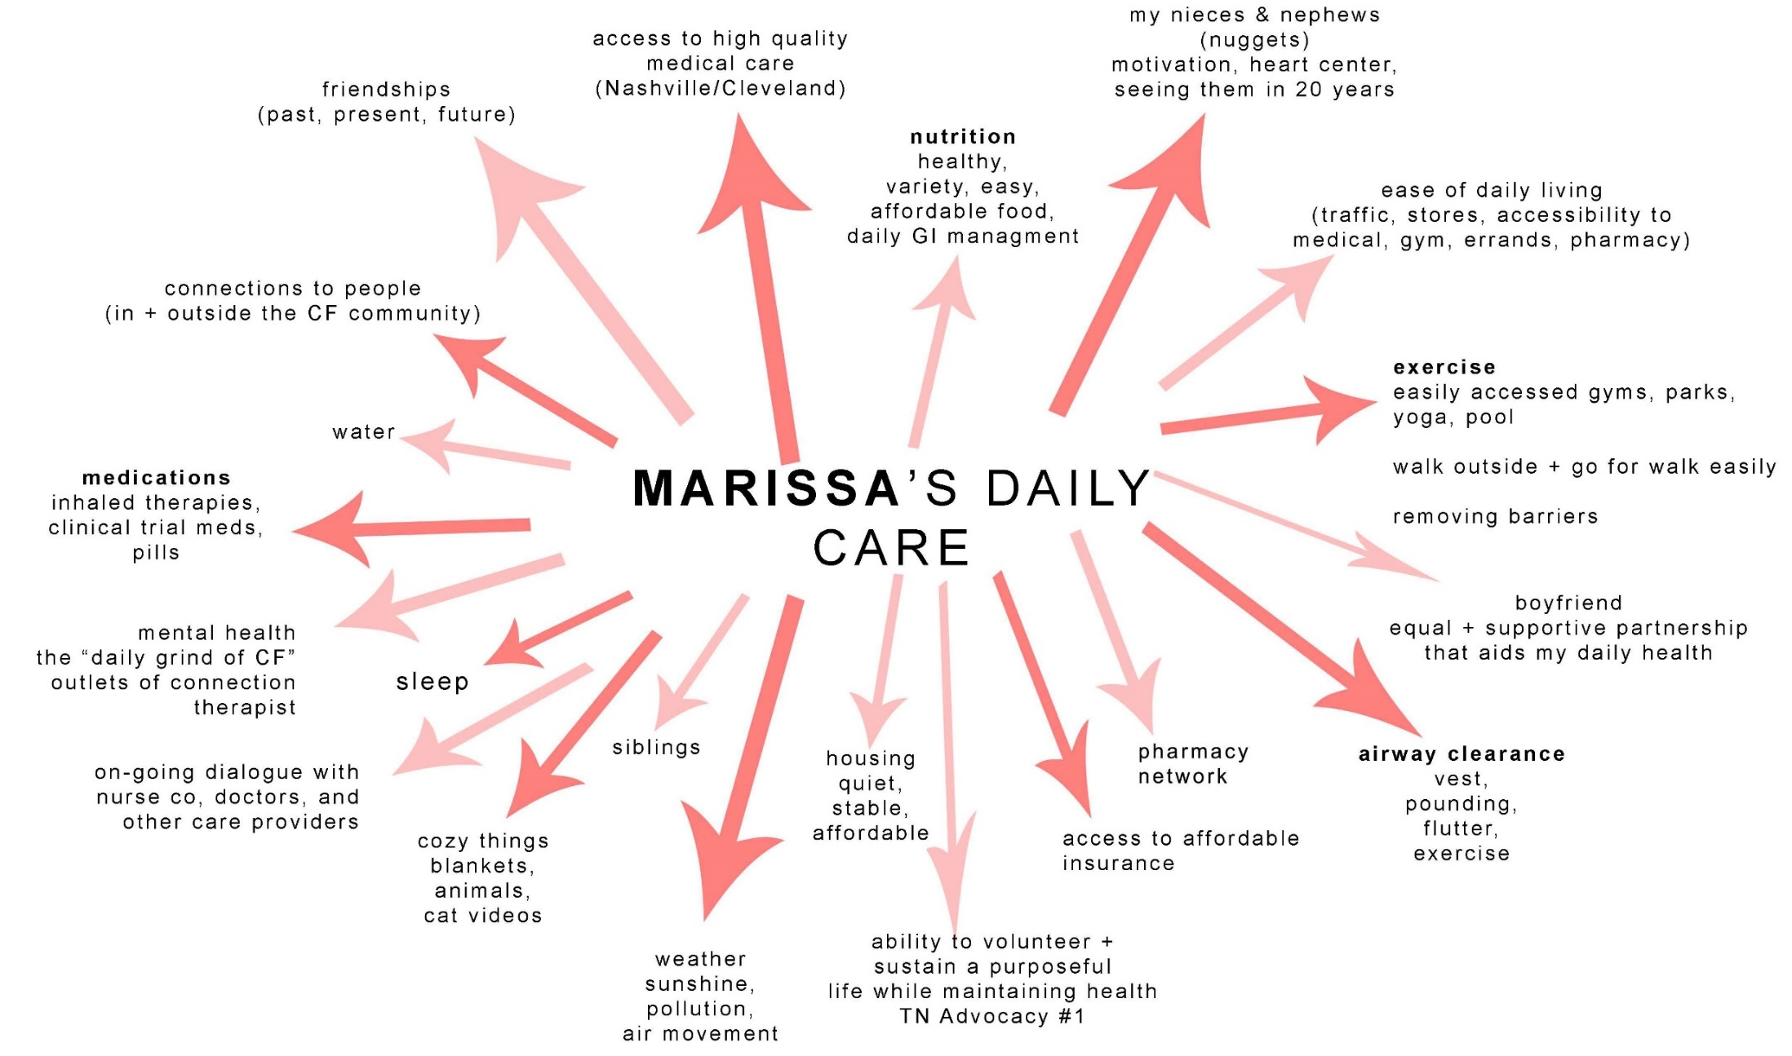
Daily Care – the whole picture
Notes:
But the voice of the individual with CF doesn’t stop there. Care providers are encouraged and dare I say now trained through offerings from the Foundation to be more empathetic and understanding of what an individual’s day can look like. The treatment burden for people with CF has traditionally been heavy. Through our Partnerships Enhancement Program care teams are taught more effective ways to partner and communicate and the ultimate result is improved ability to sustain daily care and these burdensome regimens.

Slide 19
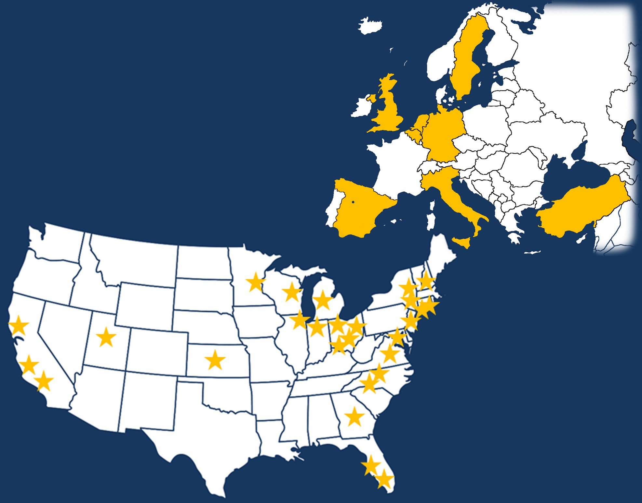
Quittner et al. Thorax. 2014;69(12):1090-7.
8 EU Countries
45 US Care Centers
Notes:
In 2014 an international study we funded assessing the state of mental health in individuals with CF was published, called TIDES.

Slide 20
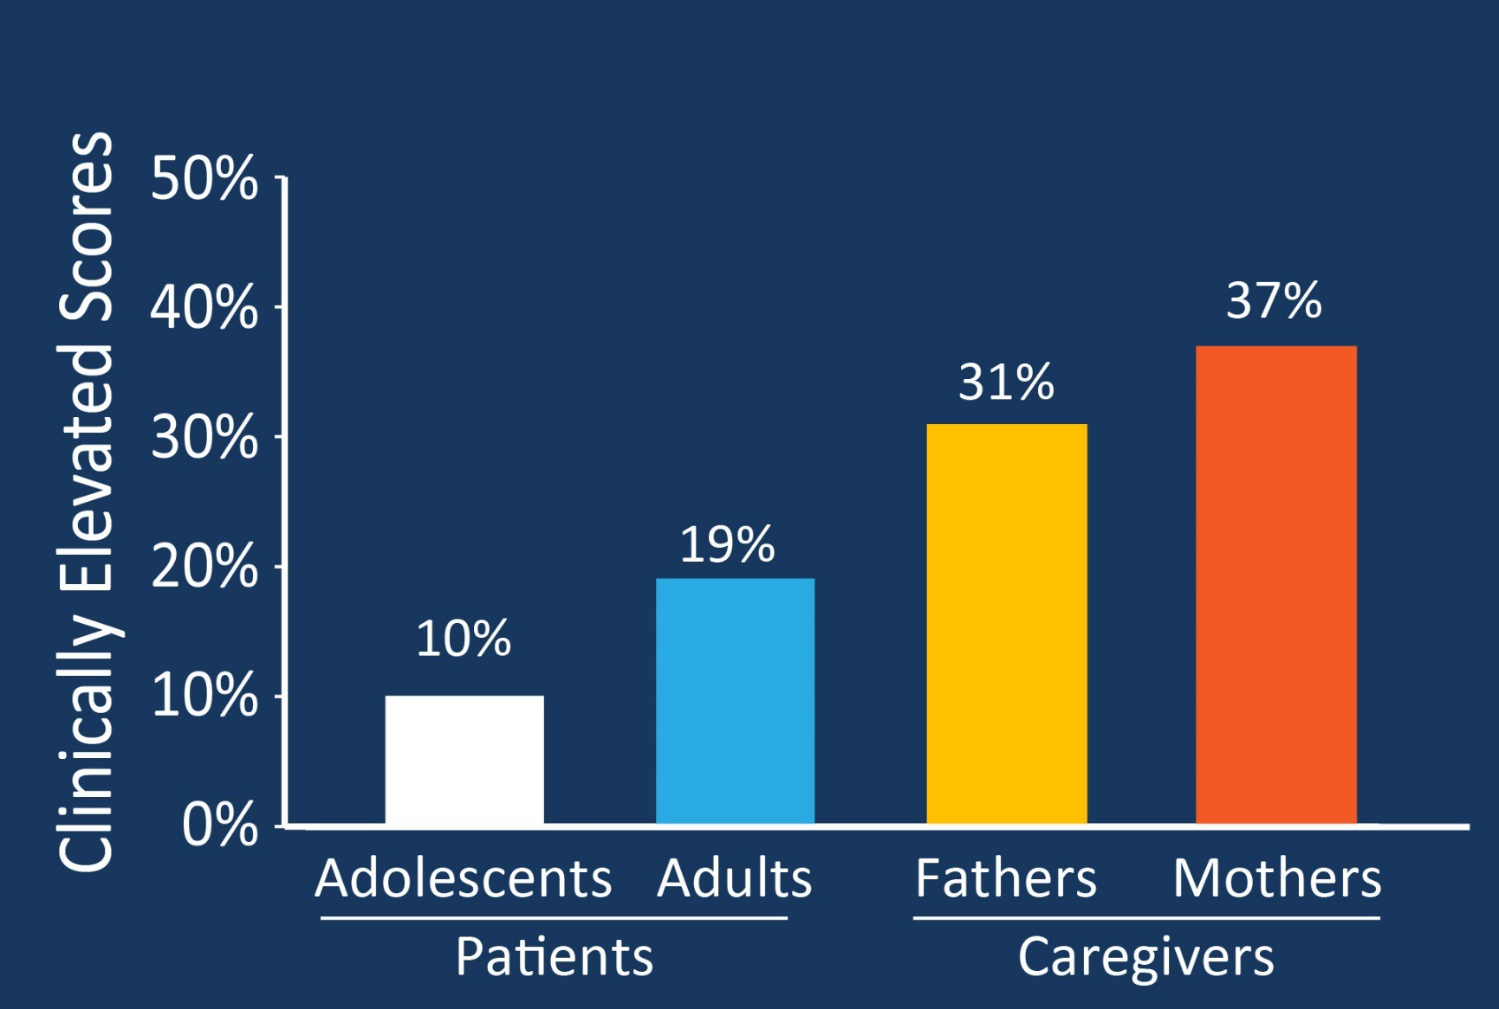
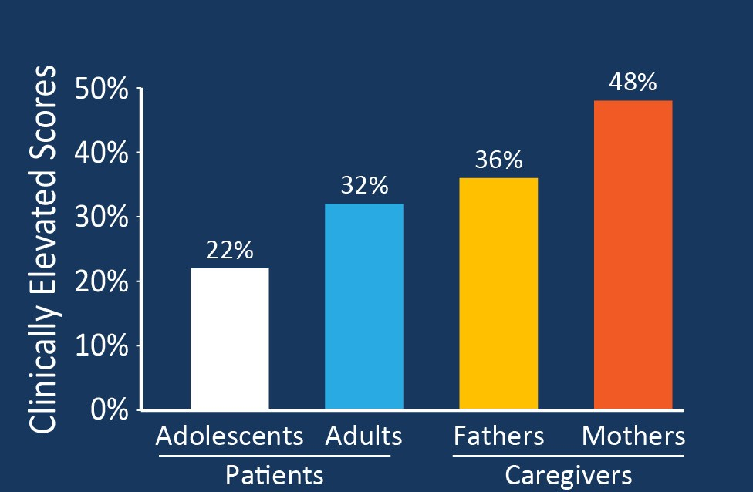
Prevalence of Depression and Anxiety
2 to 3 Times Community Prevalence
Quittner AL et al. Thorax. 2014;69(12):1090-7
Notes:
Probably no surprise but people with CF and their caregivers were found to suffer from depression and anxiety at 2 to 3 times the general rates.

Slide 21
Integrating Mental Health into CF Care:
Formed Mental Health Advisory Committee to support implementation
Established required mental health coordinator (MHC) position
MHCs to develop and implement strategies:
Prevention
Screening
Treatment, as appropriate
Case management for those needing interventions
Provide direct care if trained in psychotherapy
Notes:
What may be surprising is what we did about it. This was a call to action for us. As my boss and the Chief Medical Officer at the Foundation, Bruce Marshall said there is no health without mental health. Read slide.

Slide 22
The National Cystic Fibrosis Research Foundation - 1955
Mission:
To assure the development of the means to cure and control CF
Notes:
I could go on with clinical care and I will in a moment, but remember the initial mission of the CF Foundation was to find a cure for CF.

Slide 23
Notes:
So let’s pivot from care to cure.

Slide 24
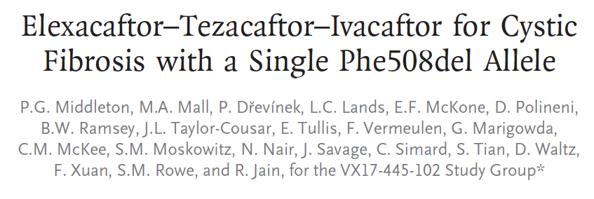
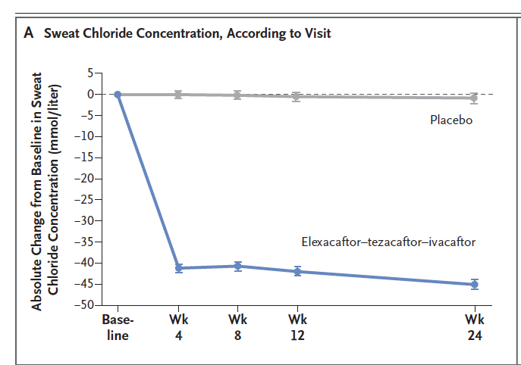
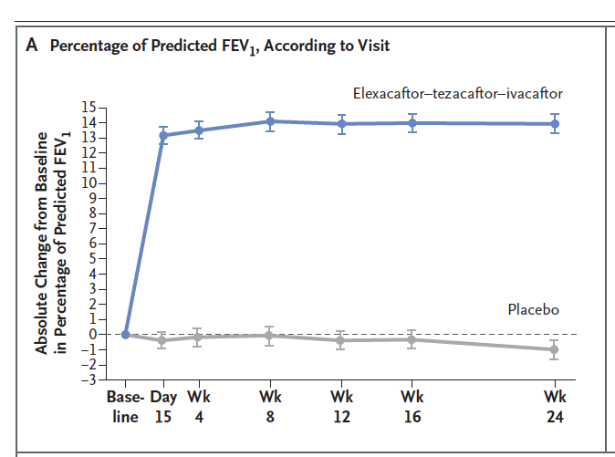
Notes:
There were other modulators but I am going to jump straight to 2019 when in 2019 a RCT was published showing that a triple combination of a potentiator with 2 correctors could treat those with just a single F508 deletion, which in the US makes up to close to 90% of individuals with CF. The corrector molecules improve both processing and trafficking of CFTR, in other words the basic defect. In blue you can see a significant decrease in sweat chloride values and about a 14% increase in FEV1. Since its introduction in the US in late 2019 this drug has been transformative for those eligible to take it based on their genotype.

Slide 25
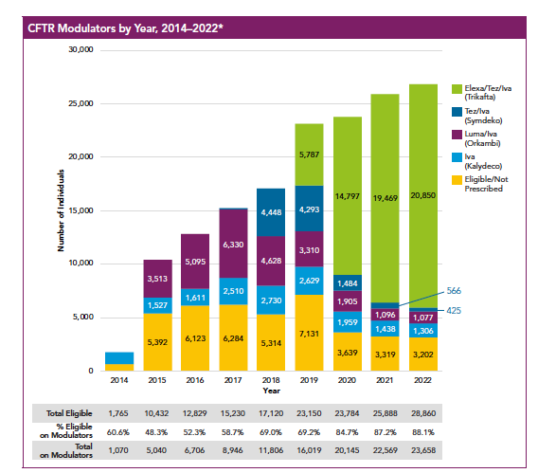
Notes:
Here is the number of pwCF in the US CFFPR who are eligible based on their genetics who are on modulators. In yellow are some 3000 peope who are eligible but for some reason are not on it.

Slide 26
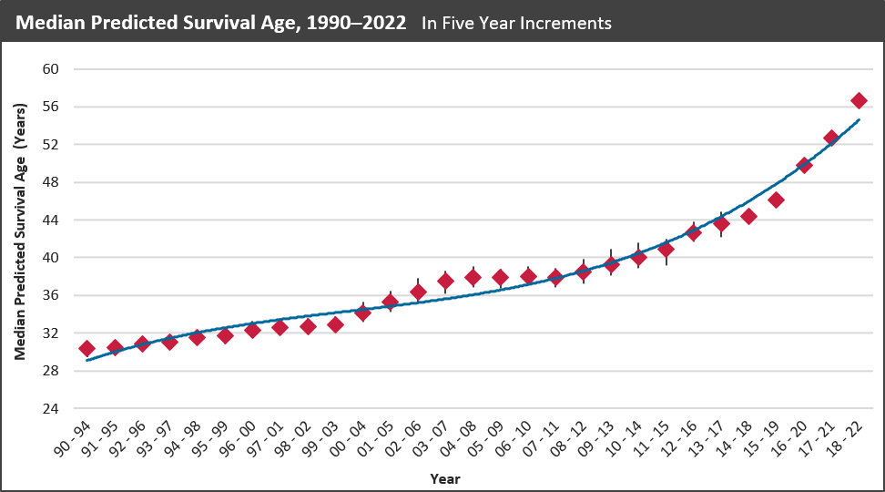
Survival
Notes:
You can see the remarkable increases in predicted survival we’ve witnessed.

Slide 27
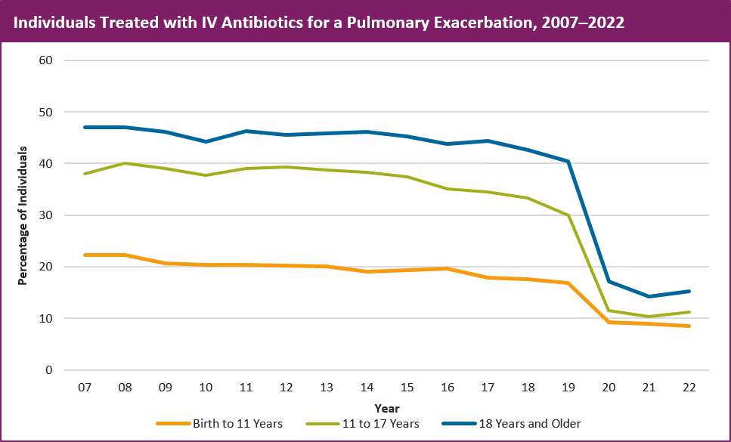
Notes:
Here you can see the marked decrease in individuals with pulmonary exacerbations requiring IV antibiotics. And yes we had a global pandemic begin a few months after the introduction of ETI, but the changes were evident prior to the pandemic and have remained despite the lifting of mitigation practices.

Slide 28
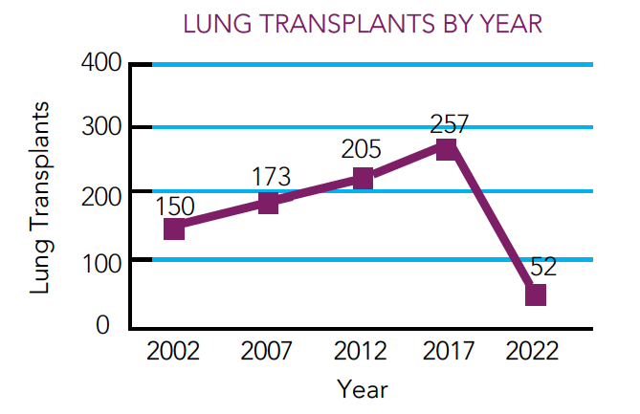
Notes:
Shows the number of CF lung transplants per year in the US and again you can see the sharp decline in the number of lung transplants in 2022.

Slide 29
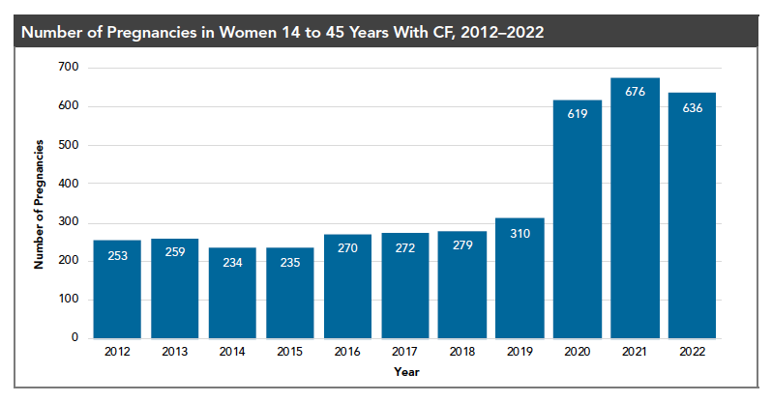
Notes:
But it isn’t all about lung function or lung disease. It is about what matters most to individuals with CF, living a fulfilling life as they define it. With ETI, we have experienced a baby boom!

Slide 30
Care Goals Highlight:
Evolve CF care
Current Model
Happening Now
Seek to Learn
Routine CF care:
Clinic
4 times/year
Respiratory cultures
4 times/year
Pulmonary Function Tests (PFTs)
2 times/year
Multidisciplinary care team member assessment
1 time/year
Fewer clinic visits, sputum cultures, and PFTs
Some individuals feel that care model is more than they need
For others, care needs have not changed
Are there gaps in how the current approach meets patient needs?
How can these needs be better addressed?
Notes:
The science has resulted in amazing changes in outcomes and therefore we can come back to care and ask the very legitimate questions if the care model still applies in this new era for so many with CF. You can see the current model as well as the reality of what is happening now and some of the things we need to learn recognizing that the CF population is more diverse in terms of needs.

Slide 31
Evolution of the CF Care Model Initiative
2023
2024 – 2025
Tools for Remote Care
Two-year implementation awards were granted to 7 sites to better understand the impact of remote monitoring on CF care
Data Gathering
The Adapting CF Care Survey was deployed to collect perspectives and preferences of people with CF and their families, and CF care teams from across the country
Interim Guidance
Anticipate the publication of two position papers providing interim guidance on:
Visit frequency
CF care team structure
Real-World Research
Utilize the CF Learning Network (CFLN) to test critical aspects from the guidance to improve clinical and patient-reported outcomes
2024
2022
Notes:
We are actively in the midst of re-examining our guidelines. We sent out the Adapting CF Care Survey almost 1300 respondents almost evenly split between individuals with CF or caregivers. We have 2 committees reviewing the available evidence and writing guidance documents which we hope to be out by the end of the year and we will then leverage the CFLNI to test the guidance.

Slide 32
Approximately how long does it take <you | them> to travel to <your | their> CF care center>? (n=675)
How often would <you | they> want to see the CF Care team in-person assuming <you | they> are in a typical state of health? (n=670)
Notes:
This is some unpublished data from the survey. Please do not take pictures. On this slide I want to focus your attention on how often pwCF want to see their care team in-person and 41% say every 3 months and another 39% every 4 to 6 months.

Slide 33
How valuable are the routine in-person visits to the CF care centers for <you | them> (n=668)?
Notes:
And pwCF do find value with 76% saying extremely or moderately valuable and only 6% saying not very valuable..

Slide 34
What are the most important factors to consider in how often a person needs to be seen in-person at a CF care center clinic for routine visits? Community (n=682) and Providers (n=598)
Notes:
This question is interesting in that asks what are the most important factors in determining how often a person should be seen in-person. In purple are responses from the clinical providers and in blue from the community and although the percentages differ there is pretty good consensus among the top 5.. Big differences are noted when it comes to difficulty following treatment plan or challenging social situations.

Slide 35
Future
Retain interdisciplinary approach
Engage new disciplines/subspecialties
Maintain evidence-based care
Advance health equity
Leverage technology
Activate people with CF
Advocate for sustainability of high quality, specialized, CF care
Adapted from Prickett MH, et al., JCF 2023;22:;9-16
Notes:
In summary the the care model and I just want to remind everyone that the current CF care model is tried and true, serving people with CF well for decades and a model for other chronic diseases and it has never been static. The CF care model is so much more than 4 visits per year, including evidence-based care driven by data and guidelines, delivered holistically with a focus on the person and family and not just the lungs or GI tract, resulting in co-production of care within the framework of trusting relationships. Our mission for the future is to (read slide)

Slide 36
Summary
Notes:
I hope that what you take away is how nothing is impossible and nothing is hopeless. None of what I covered could have been accomplished without committed parents and families who have held thousands of events to raise the money to fund specialized care centers, a registry, and the science that has forever changed medicine. “Never doubt that a small group of thoughtful, committed, citizens can change the world. Indeed, it is the only thing that ever has.”

