Slide 1
ADULTING WITH CF
Meg Dvorak, LCSW and Kate Yablonsky, LCSW
Social Work Clinicians, Adult Cystic Fibrosis Center

Slide 2
adult·ing
/əˈdəltiNG,ˈaˌdəltiNG/
Noun INFORMAL
the practice of behaving in a way characteristic of a responsible adult, especially the accomplishment of mundane but necessary tasks.

Slide 3
It is not the strongest of the species that survives, nor the most intelligent that survives. It is the one that is the most adaptive to change.
-Charles Darwin

Slide 4
For the first time, the median predicted life expectancy for a child born with CF today has reached 53 years, up 15 years from just a decade ago

Slide 5
CF Across The Lifespan
Childhood
Parent handles health care needs
Parent interacts and advocates on behalf of child
Child with CF learns the importance of self care at a young age
IEPs, 504s
Teen years
Teen starts taking over aspects of care
Teen meets with providers alone
Teen develops more independence
Teens start taking risks
Middle adulthood
Marriage/partnership
Career
Finances and future planning
Insurance
Family building
Older adulthood
Work cessation
Managing increasing health needs
Maintaining insurance through life transitions
Disability/retirement income
End of life
CF becomes full time job
Advanced directive
POLST
Advanced care planning
Young adulthood
Moving out
Individuation, relationships
Going to college or trade school
Working
Navigating CF care independently for 1st time

Slide 6
Education – Beyond High School
College--moving away vs community college
Disability accommodations in higher education
Most go through the school’s disability office
Not the same legal structure as elementary/middle/high school, but accommodations still available
CF providers can assist with forms and letters
Scholarships

Slide 7
What About Trade School?
Great alternative to a 4-year college
Important for those getting a new start later in life
Shorter duration of schooling
Quicker entry into career
Career focused classes
On the job training and placement
Direct entry into career
Letsrockcf.org—Bowman Bros Scholarship for trade school (awards 5 $5,000 scholarships every year)

Slide 8
Career Planning
As survival improves, more adults with CF are entering the workforce
In 2020, there were 17,967 adults with CF
40% (7,187) of adults employed full time
12.1% (2,156) of adults employed part time
NACFC 2022

Slide 9
Financial Planning – “Should I start a retirement account??”
Knowledge is power!
Educate yourself on the options in your specific circumstances, then decide what is best for you
Consultation through employer-provided retirement plans
Helpful resource:
https://us.etrade.com/knowledge/investing-basics

Slide 11
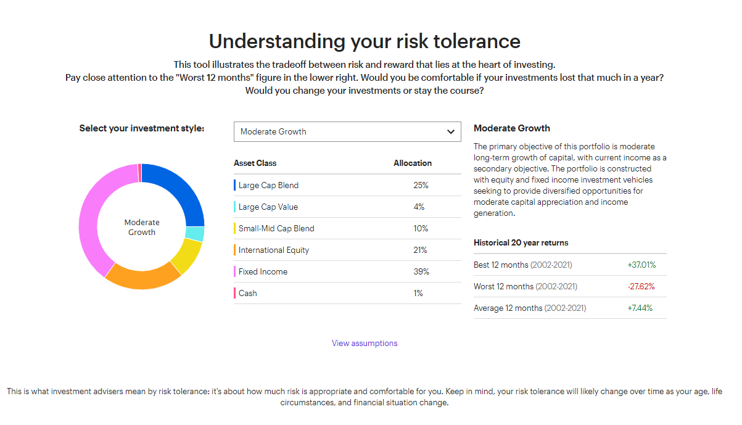

Slide 12
Finances in adulthood
Journal of CF, 2023 study George Washington University
A total of 1,856 CF patients in the U.S. were included
64% financial burden
55% debt issues
26% housing issues
33% food insecurity issues.
Other issues revealed: unmet prescription needs, delayed or shortened a hospitalization, delayed or skipped a care center visit as a result of the cost of care.
Highest risk is people dually covered by Medicare and Mediciad

Slide 13
SSI and SSDI: Comparison
SSI
“Supplemental Security Income”
Financial need based
To Qualify:
Meet medical criteria
Making no or low income
Less than 2k in assets
(less than 3k if married)
SSDI
“Social Security Disability Insurance”
Dependent on how many taxable work credits made from working
Ex: worked full time in minimum wage job for 5 of the last 10 years will likely qualify
Same medical criteria as SSI
Provides income based on earnings history

Slide 14
Insurance Options: Private Insurance
Private insurance through employer’s health plan
Available through self, spouse, or parent (until age 26)
At age 26, person with CF can stay on plan if:
Unable to self support
Many Options!
HMO, PPO, POS, EPO

Slide 15
Insurance Options: Genetically Handicapped Persons Program (GHPP)
California based health care program to help people with specific genetic diseases
Covers: Clinic visits, hospital stays, prescriptions, medical equipment, and lung transplant surgery
Application requirements:
CF genotype
Social Security Number
Proof of CA residency (utility bill, proof of registration to vote in CA…)
Income verification, tax statements from previous year
Follow this link: http://www.dhcs.ca.gov/services/ghpp/Pages/Apply.aspx
Source: www.dhcs.ca.gov

Slide 16
Insurance Options: Medi-Cal and/or Medicare with Disability
Becomes an option after applying for, and receiving, Social Security Disability Insurance (SSDI)
Benefits to people who can’t work because they have a medical condition that’s expected to last at least one year or result in death
After 24 consecutive months getting SSDI benefits you will be enrolled automatically into Medicare or Medi-Cal
This can be in addition to existing insurance plan
waiting period for benefits to begin
Source: www.socialsecurity.gov

Slide 17
Insurance Options: Medi-Cal (through income)
Medi-Cal (State level program for Medicaid)
Free or low-cost health coverage for children and adults with limited income and resources
Provides essential health benefits
Medi-Cal is offered at free or lowest cost, as opposed to Covered CA plans
Managed Medi-Cal Plan vs. “Straight” Medi-Cal
Managed (ex: Health Plan of San Mateo, Santa Clara Family Health Plan)
Keeps networks of health providers specific to county
“Straight” Medi-Cal
Allows you to be seen by any provider who accepts Medi-Cal
No in-network limitations
Being on Medi-Cal or getting a Managed Plan is determined by your county of residence
Source: www.coveredca.com, www.disabilityrightsca.org

Slide 18
Insurance Options: Covered California
Created by the Affordable Care Act (ACA)
(aka ObamaCare)
The California version of healthcare.gov
Not an individual insurance plan, but instead an
Insurance plan store (marketplace)
Provides insurance options for individuals who are ineligible for MediCal/Medicaid and do not have an employer insurance option
To apply:
http://www.coveredca.com/faqs/ or call a representative at 1-800-300-1506.

Slide 19
Stanford’s Financial Assistance and Financial Counseling
If all else fails…
Feel free to consult with Financial Counseling Department
Insurance questions specifically related to getting care at SHC
Billing related concerns or questions
650-498-2900, Option 2 to speak with a counselor
Financial Assistance Application
Evaluation to see if SHC can help with payment plan or bill forgiveness
Proof of income
Completed application
https://stanfordhealthcare.org/for-patients-visitors/financial-assistance.html

Slide 20
Personalized service to help you with insurance, financial, legal and other issues you are facing
One-on-one work with a dedicated CF Foundation case manager
Compass is available to anyone with CF, their family and their care team, regardless of income or insurance status.
Free and confidential ☺
1-844-COMPASS (844-266-7277)
Monday - Friday, 8:30 a.m. - 5:30 p.m. EST
Email: compass@cff.org
Online service request form:
https://www.cff.org/support/compass-online-service-request-form

Slide 21
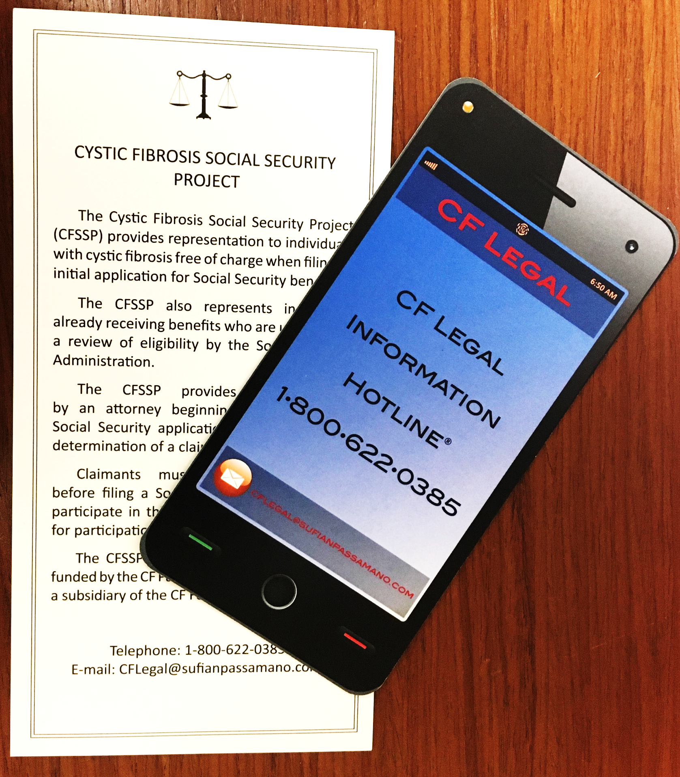
CF Legal Information Hotline
Provides free confidential information to individuals with CF and caregivers
SSI/SSDI eligibility and benefits
CF Social Security Project
Medi-Cal/Medicare/Private Health Insurance
Education
Employment
Sponsored by the CF Foundation
1-800-622-0385
CFLegal@sufianpassamano.com

Slide 22
Financial assistance to eligible individuals to cover coinsurance, copayments, health care premiums and deductibles for certain medications and therapies
Specific to CF: vitamins, supplements, hypertonic saline solution, nebulizers paired with treatments, and certain handsets
Money is loaded onto a Visa card for your convenience
Maximum award is $15,000
How to apply:
Apply online: https://www.healthwellfoundation.org/patients/apply/
Call hotline: 1-800-675-8416. Monday–Friday 9 a.m. – 5 p.m. EASTERN STANDARD TIME.

Slide 23
Fertility, Family planning, and Parenting
Pregnancies in 1990 = 124
Pregnancies in 2020 = 600
Between 2019 – 2022, pregnancies doubled
More men are considering family building
Talk to your CF providers about reproductive health, get referrals to specialists who can help—urology, fertility specialist, high risk OB, genetics
Check your insurance plan for fertility coverage
Many resources in CF community available to meet this growing demand

Slide 24
Living Well with CF
Attending to mental health and wellness
Whatever this means to you
Using the great resources within the CF community
Exercise and regular medical follow up
Connections with others
Planning for a long future while living day to day
Openness to change

Slide 25
SO many resources available
CFF, CFRI, CFLF, CFReSHC, Living Breath Foundation (CA, AZ only)
Project CF Spouse
Mentorship (SHC, Peer Connect)
Community Blog
Social media groups—Reddit, Facebook, Instagram
Breath Cons, Mini Cons, BEAM
Support groups and other CFRI programs
Podcasts and family education
Financial support
Research and development pipeline

Slide 26
Advance Care Planning
“It’s always too early until it’s too late”
Offered through any clinic appointment
Pilot for 2023: ACP-specific visits
Online forms and education at your fingertips
Physician Orders for Life-Sustaining Treatment (POLST) vs Advance Directive (AD)
Talk to your loved ones
If you haven’t already, identify a surrogate

Slide 27
Our Favorite Advance Care Planning Tools:
Prepare for Your Care: https://prepareforyourcare.org/en/welcome
The Conversation Project: https://theconversationproject.org/
Stanford Letter Project: https://med.stanford.edu/letter.html
Five Wishes: https://www.fivewishes.org/
SHC has free paper copies
Stanford Palliative Care Resource Page: https://med.stanford.edu/palliative-care/patientsandfamilies/ACP.html

