Slide 1
Cystic Fibrosis Patient and Family Advisory Council
Partnering Inward and Reaching Outward
Angel Mammino-Haynes, Secretary CF PFAC March 7, 2015

Slide 2
CF PFAC
Committed to excellence and the betterment of the healthcare experience for the CF patient
Partnering Inward
Partnering with the Stanford CF clinic, the Stanford Patients and Family Partners program, and the MyHealth team to continuously improve patient care and support
Reaching Outward
Working with the CFF and Dartmouth University to improve the standards of CF care across the US

Slide 3
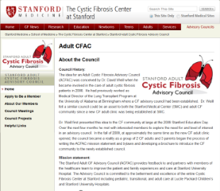
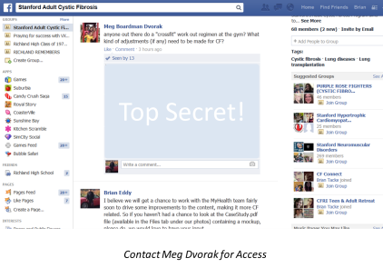
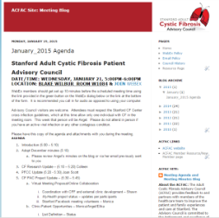
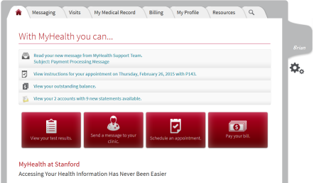
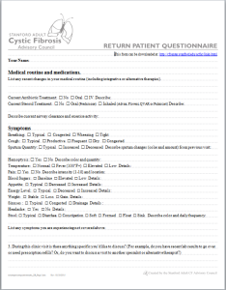
Collaboration and Support
Blog/ Website
Patient Only Facebook Page
Patient Questionnaire
MyHealth
Reaching Out – External Collaboration

Slide 4
Current Activities
CF Encounters
Develop patient case studies to assist clinic personnel in the understanding of patient feelings for common discussions
Issue Escalation
Working with the clinic, define the appropriate escalation path when the patient has concerns on care or perceived inappropriate behavior
Virtual Healthcare and Online Collaboration

Slide 5
Join Us!
Contacts
CF PFAC Membership Chair, Colleen Dunn
Phone: 650 736-0388
Email: cedunn@stanford.edu
Patient Only Facebook Page - Meg Dvorak
Phone: 650-518-9976
Email: mdvorak@stanfordhealthcare.org

