Slide 1
Cystic Fibrosis Patient and Family Advisory Council “Do you hear the call to serve the CF Community?”
ACFPFC March 10, 2018

Slide 2
Mission Statement
The Stanford Adult CF Patient & Family Advisory Council (CF-PFAC) provides feedback to and partners with members of the healthcare team to improve the patient and family experiences and care at Stanford Health Care and in The Cystic Fibrosis Center at Stanford including pediatric, transitional and adult care at Lucile Packard Children’s and Stanford University Hospital.

Slide 3
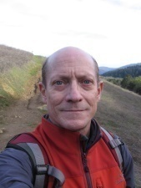
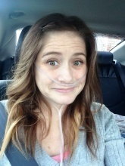
Cystic Fibrosis Memorial Space
Purpose: Sparked by the loss of 2 strong, highly respected and popular members from our council over the past 12 months, our goal is to investigate the possibility of having a memorial space at Stanford or nearby for those who have lost their fight with CF.
Status: Effort has just begun
Next Steps: Work with Stanford Patient Relations Services to determine if this is an obtainable goal.
Jay Archibald
Monica Wood

Slide 4
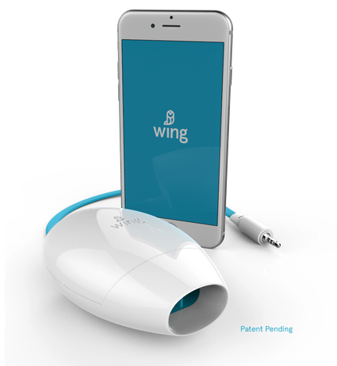
Home FEV1 Measurement
Purpose: Investigate value, as perceived by the patent, of home monitoring of FEV1 measurement.
Status: Four council members have participating in this informal trial for ~9 months and impressions have been positive. Results align with studies performed by other organizations that have also shown benefits for the patient.
Next Steps: Summarize experiences, particularly relative to the Wing device (shown), and determine what the next step should be.

Slide 5
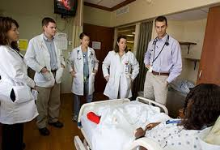
CF Stanford Hospital and Clinics Patient Encounters
Purpose: Capture anonymous stories from patients on interactions with healthcare professionals, both positive and negative, which can be used as a teaching tool for caregivers.
Status: Examples have been documented and reviewed by several organizations within Stanford. Feedback has been very positive and offers potential benefit for all involved.
Next Steps: Identify opportunity and best approach to expand concept within Stanford Hospital.

Slide 6
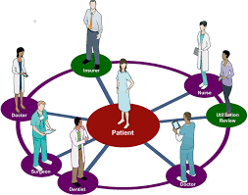
CFF Collaboration – Clinic Development
Purpose: Partner with the CFF in their patient care initiatives with the goal of improving healthcare through both CF clinic development as well as educating other healthcare disciplines
Status: A council member has donated his time and highy valued experience to represent the CF patient community in the initial phase of the project, identifying focus areas for improving the quality of care for CF patients. This initial phase has been successfully completed
Next Steps: Support follow on projects to implement initiatives identified in the initial phase of the project
“We aim to develop a comprehensive, collaborative quality improvement system to ensure patient and family involvement in a continuous, sustainable, long-term adoption of QI with a network of accountable, front line accomplished leaders in both the cystic fibrosis community as well as across all healthcare.”

Slide 7
Information Sheet on Masks
Purpose: Develop information pamphlet on appropriate selection and usage of masks based on health status and need.
Status: Draft is completed, on clinic approval will make available to CF community via Facebook page
Next Steps: TBD

Slide 8
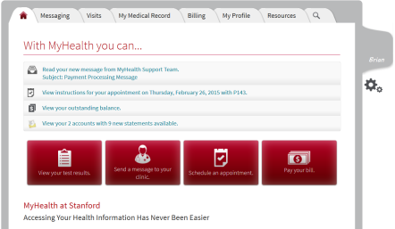
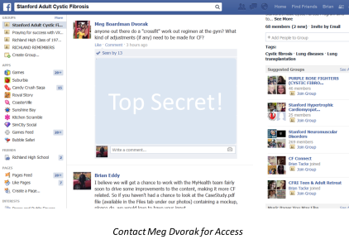
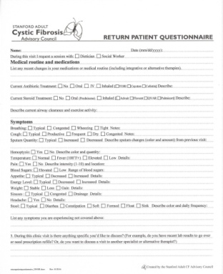
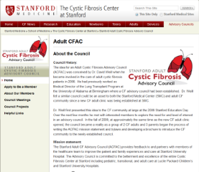
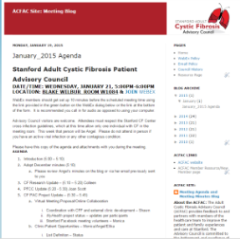
Collaboration and Support
Providing Vision and Input to the MyHealth
Development team
Patient Only Facebook Page
Blog/ Website
General Stanford Volunteering Support

Slide 9
Future Activities
Family Planning
Investigate to improve patient access to family planning information
Transplant Education
Evaluate opportunities for CF patients to gain access to information about the transplant process at an earlier time so they are better prepared to discuss it with care-givers if their health reaches that point

Slide 10
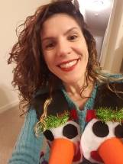
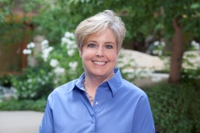
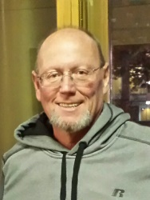
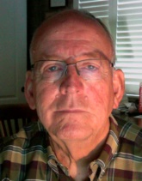
Council Members
Brian Eddy
CF Adult
Angel Mammino
CF Adult
Colleen Dun
RRT, RPFT, CCRC
Shawn Taylor
CF Adult
Ed Kinney
Volunteer / CF Groupie
Aimee Braddock
CF Adult
Abby Lewis
CF Adult
Larissa Marocco
CF Adult

Slide 11
Join Us
If you hear the call to serve your CF Community and are interested in participating in the council please contact our Membership Chair Colleen Dunne @cedunn@stanford.edu

