Slide 1

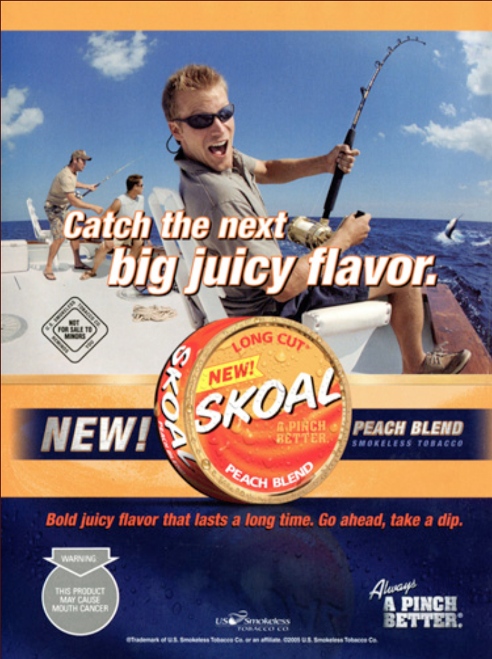
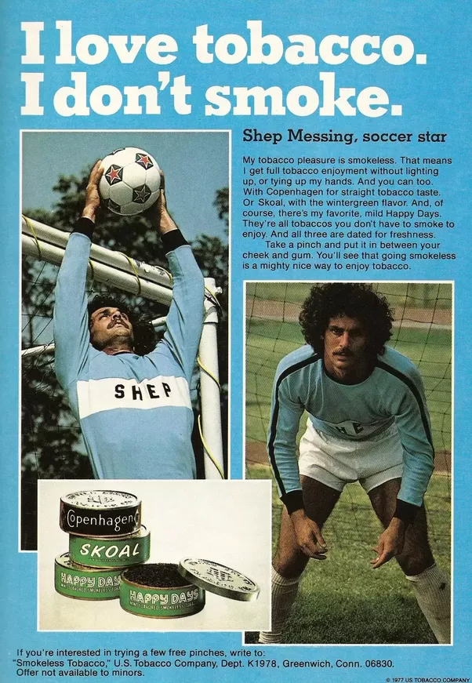

Tobacco & Sports

Slide 2
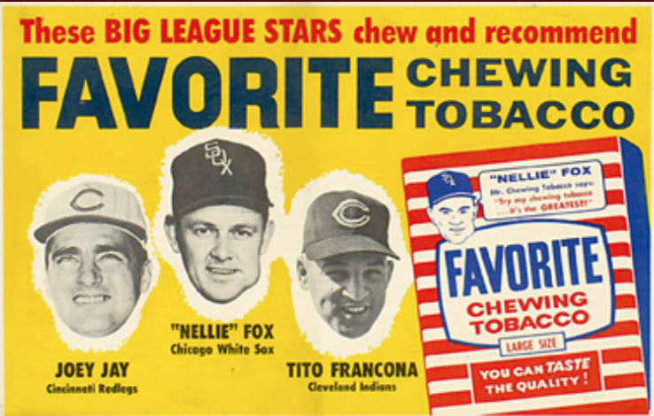
History
American Habit
Germ Theory
  Basic principle of medicine
  States that microorganisms naked to the eye enter the human body and are responsible for disease
Notes:
Teacher Talking Points:
During the 1800’s, tobacco chewing became known as the “American Habit.”
A communal snuff box and cuspidors were even installed for members of congress, a practice which continued until 1935.
The germ theory (see definition on slide) was proved at the end of the 19th century bringing public outcry against unsanitary practices of spitting, in which disease could be spread. Spitting tobacco became socially unacceptable and unlawful, especially in public spaces.
In 1970’s, spit tobacco began to slowly shift from a product primarily used by older men to one used predominantly by young men and boys. From 1970 to 1991, the regular use of moist snuff by 18-24 year old males increased almost ten-fold from less than 1% to 6.2%.

Slide 3
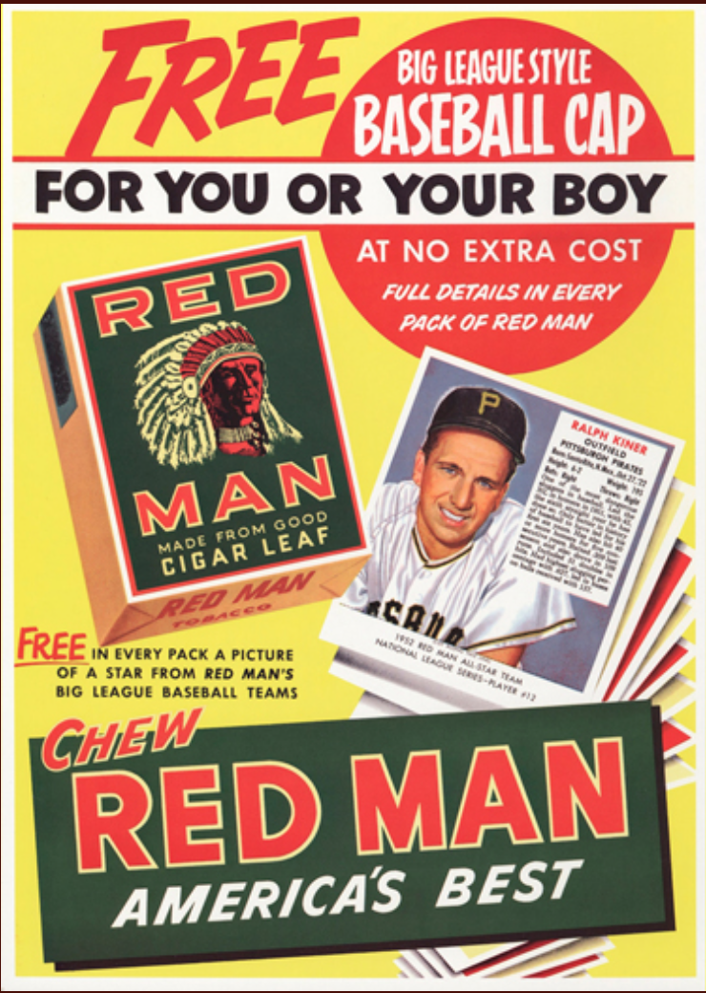
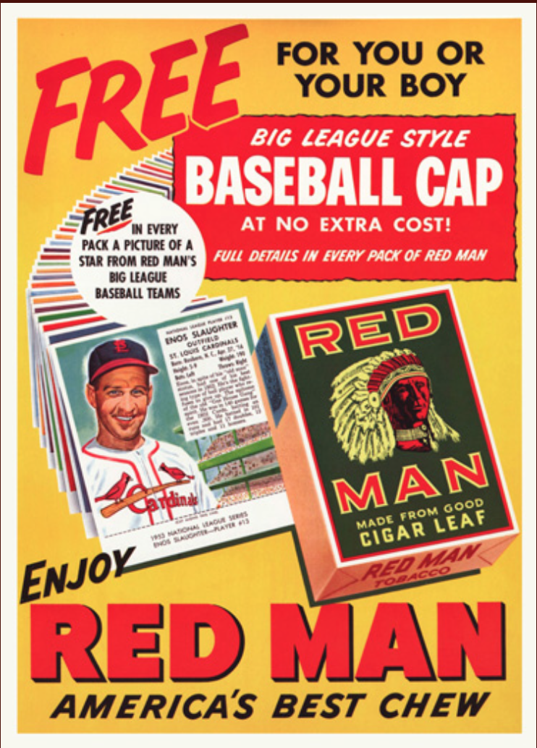
“I dip because you do”
Notes:
Teacher Talking Points:
Player images were included in cigarette packages, known as trading cards; meant to intrigue youth to collect these items of their favorite athletes and teams.
Many of the athletes who used chewing tobacco could be seen on the fields chewing, and would even carry the products out on to the field while playing.
For the youth who looked up to these teams, they also became curious as to what their favorite athletes were chewing. This was one of the ways that they would start chewing themselves as well. (Click) “I dip because you do” type of mindset; making tobacco products seem cool and athletic.

Slide 4
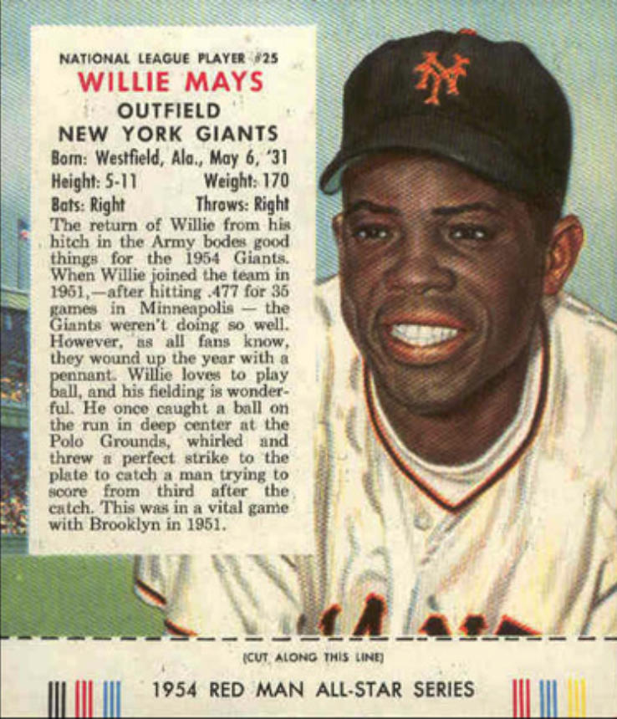
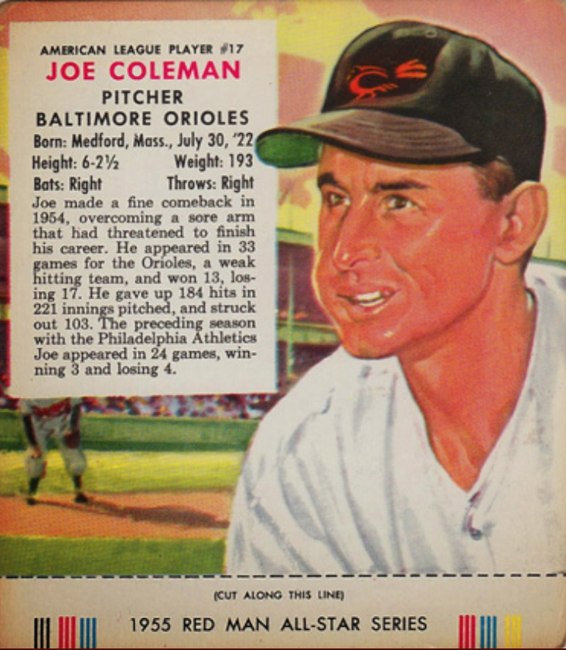
Red Man Ads
Notes:
Teacher Talking Points:
Between 1952 to 1955, Red Man had produced a series of baseball cars, the only tobacco company to do so after 1920.
Consumers saw them as valuable with the appearance of top players such as: Stan Musial, Yogi Berra, Willie Mays, Joe Coleman, and others.
Red Man had a series of athletes that they sponsored and printed information on them (notice that the Red Man name is placed below the images in small font).

Slide 5
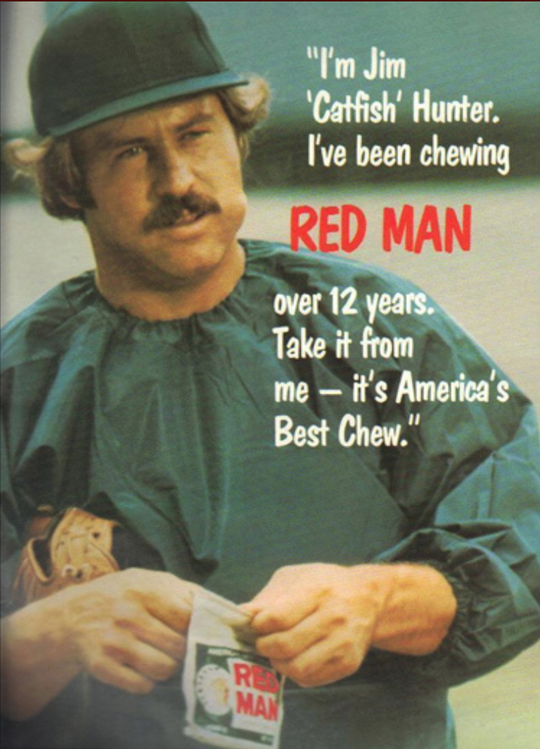
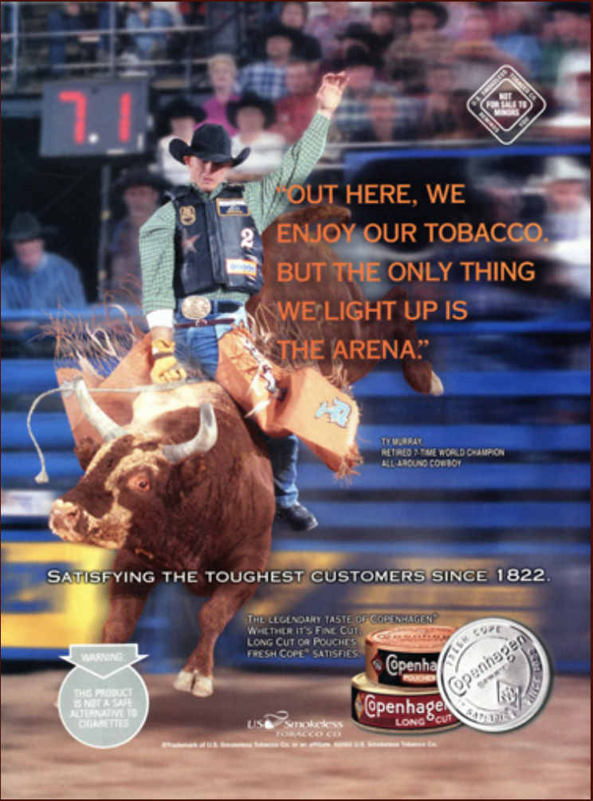
MO
R
E
A
D
S
Notes:
Teacher Talking Points:
The Red Man brand of chewing tobacco was first introduced to the US in 1904.
Much of their advertisement revolved around rural and outdoor sporting events and activities.
These athletes then became walking billboards for these brands; images of them represented these large tobacco corporations.

Slide 6
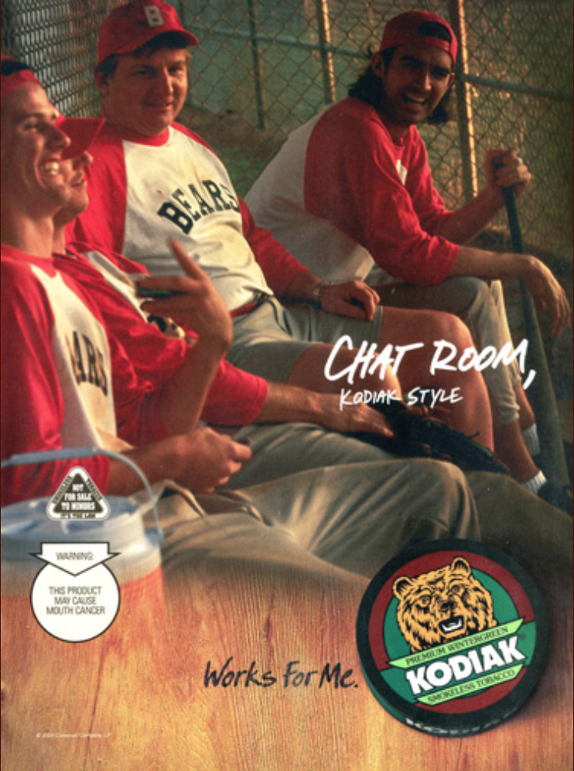
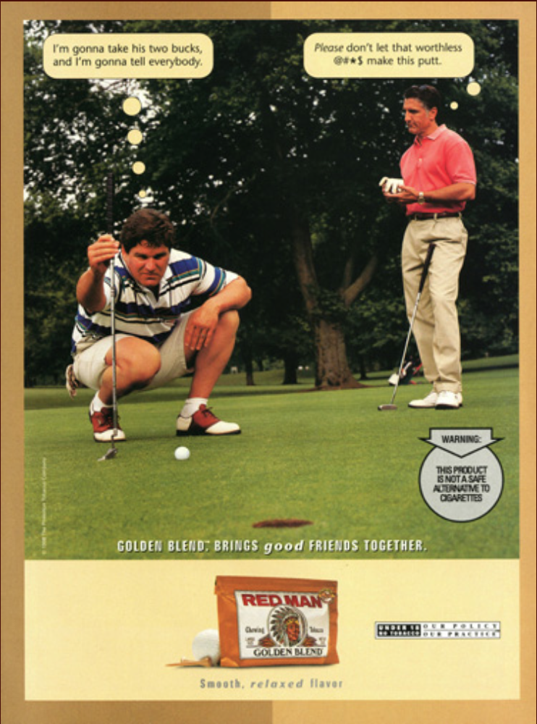
Notes:
Teacher Talking Points:
Tobacco companies specifically target audiences by promoting these ads to them, looking specifically at new potential consumers, such as adolescents and athletes.
It is important to note that adolescents mimic the behaviors of those they look up to and identify with. For example, an adolescent may be influenced by their favorite athlete, such as Steph Curry, and the choices they exhibit.
With regards to coaches, athletes who perceived that their coaches used smokeless tobacco were more likely to use smokeless tobacco themselves.

Slide 7
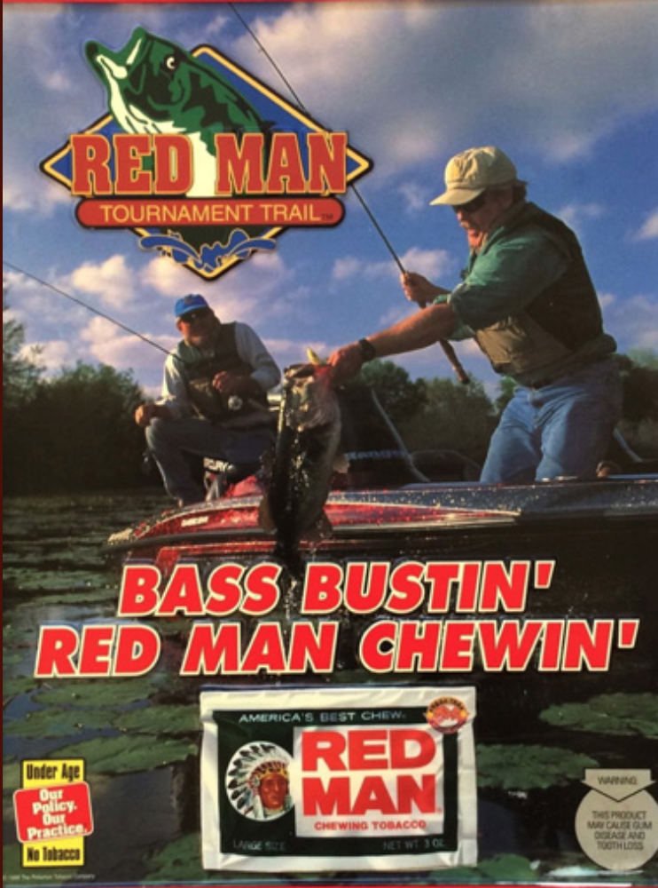
F
I
S
H
I
N
G
Notes:
Teacher Talking Points:
The ads we have viewed so far are geared towards a male audience and male sports in particular.
As advertised in these specific ads, fishing is one of the other sports that is also labeled as a male sport.

Slide 8
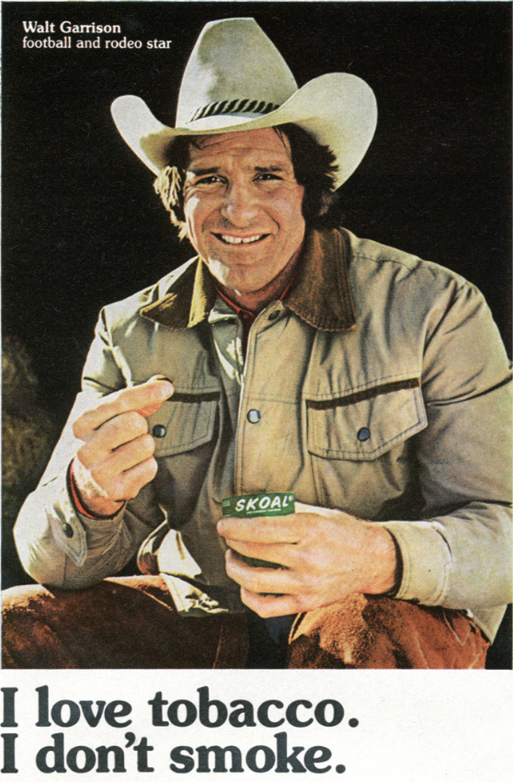
Notes:
Teacher Talking Points:
Some other targeted audiences as illustrated in these advertisements are for rodeos and soccer athletes.
Males have been known to be a targeted audience for many smokeless tobacco products.

Slide 9
Think, Share
Is smokeless tobacco harmless?
Notes:
Teacher Talking Points:
Everyone can get into pairs or think about this on their own.
What do you think of when you hear the term “smokeless tobacco”? Specifically speaking on tobacco termed as smokeless, does that make it less harmful or harmful at all?

Slide 10
Adolescent Tobacco Use, United States (males, grade 9 -12)
Source: Youth Risk Behavior Survey
“Each year, about half a million kids age 12-17 use smokeless tobacco for the first time.”
– Tobacco-Free Baseball
Past
Month
Use, %
Cigarettes
Smokeless Tobacco
1999
’01
’03
’05
’07
’09
’11
’13
2015
Notes:
Teacher Talking Points:
As for adolescent use with smokeless tobacco, not much has shifted between 1999 and 2015, as seen in the graph.
There is a steady rate for the use of smokeless tobacco; that means that there is a constant influx of consumers and new users each year (click).
“Each year, about half a million kids age 12-17 use smokeless tobacco for the first time.”

Slide 11
2015: 7.3% out of all High-School students
11.9% of High School Boys
Who uses smokeless tobacco?
2013: 17.4% of Male High-School Athletes
Athletes use at twice the rate of Non-Athletes
[11% increase from 2001 to 2013]
Notes:
Teacher Talking Points:
The prevalence of smokeless tobacco use among entering rookie professional baseball players (31%) was similar to the the 33% reported in 1999 for Minor League professional baseball players in general.
This finding suggests that most smokeless tobacco users in professional baseball start using smokeless tobacco before they join the professional ranks.
“Because we found an association between the use of smokeless tobacco and the desire to be successful in baseball regardless of health risks, smokeless use-prevention programs provided for rookie and student baseball players should reinforce previously reported findings that smokeless tobacco use does not improve athletic performance.”
For years, public health leaders have urged Major League Baseball (MLB) and the MLB Players Association to end smokeless tobacco use in baseball. The new collective bargaining agreement between owners and players reached on Nov. 30, 2016 prohibits all new MLB players from using smokeless tobacco-which means baseball is on the clear and inevitable path to become tobacco-free.

Slide 12
Think, Share
What is the legal age you can buy smokeless tobacco in California?
21
Notes:
Teacher Talking Points:
Discuss this with the entire class:
What do you think of when you here the term “smokeless tobacco”?
Once everyone has shared….(click)
Raising the minimum age from 18 to 21 occurred just recently under California governor Jerry Brown, in 2016.
However, we cannot say the same for all the states. Only Hawaii, which was the first to make the change; and about 145 other locations in 11 states have followed behind. But states like Michigan, Minnesota, Delaware, Arkansas, Florida, and many others….. still allow 18 year olds to purchase smokeless tobacco.
Can have a discussion and ask the class how they feel about states not being on the same page.

Slide 13
Tobacco Age Restrictions
75% of ST users reported their parents were aware of their ST use!
ST more acceptable by parents and public than smoking
Misconceptions that ST is harmless
35% of smokers reported their parents were aware of their smoking!
Notes:
Teacher Talking Points:
To buy tobacco for smoking, dipping, chewing and vaping, you must be 21 and older (was 18 years of age before California Gov. Jerry Brown raised the age).
Retained the 18-year old age for military personnel, as well as for medical marijuana-users.
Hawaii was one of the first states to take this age restriction into effect, with California following close behind and it is expected that the other states will also follow similar measures.
Tobacco Age Restrictions for Smokeless Tobacco: 75% of smokeless tobacco users reported that their parents were aware of their use, while only 35% of smokers reported that their parents were aware of their smoking. Parent awareness or acceptance, relatively speaking, for one tobacco product over the other represents the lighter stigma around smokeless tobacco and not smoking, which may be perceived as taboo in some households!

Slide 14
July 22nd, 2010: Smokeless tobacco products packaging and advertising must bear one of the following required warning label statements:
WARNING: This product can cause mouth cancer
WARNING: This product can cause gum disease and tooth loss
WARNING: This product is not a safe alternative to cigarettes
WARNING: Smokeless tobacco is addictive
Notes:
Teacher Talking Points:
As of July 22nd of 2010, smokeless tobacco products’ packaging and advertising must bear one of the following required warning label statements.
For example, “Warning: This product can cause mouth cancer/gum disease and tooth loss”, “Warning: This product is not a safe alternative to cigarettes”, or “Warning: Smokeless tobacco is addictive.”
Ask the class the following questions and have a few students share their thoughts:
Do you think bearing at least one of the required warning labels is good or bad, and why? How might you change them? (Note: There is a Smokeless Tobacco Warning Label Activity)

Slide 15

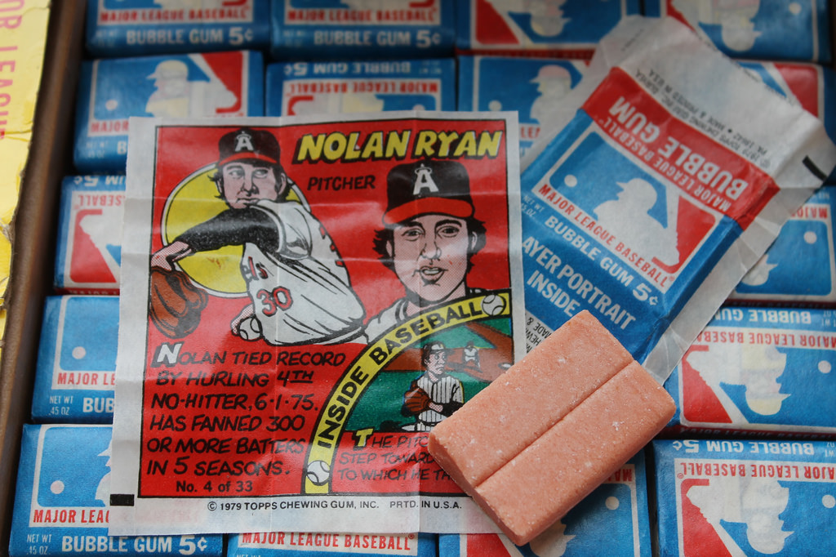
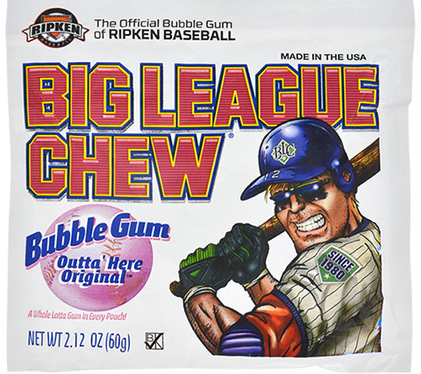
→ Tobacco Free Baseball
Smoking-Free Stadiums
(Or Designated Areas)
→ Tobacco Alternatives
Notes:
Teacher Talking Points:
Now a days in the field, baseball players can be seen chewing bubblegum or sunflower seeds instead of chewing tobacco; making for a healthier alternative.
“Athletes serve as role models for youth, and smokeless tobacco manufacturers have used advertising, images, and testimonials featuring athletes and sports to make smokeless tobacco products appear attractive to youth. Children and teens closely observe athletes’ actions, including their use of tobacco products, and are influenced by what they see. Adolescents tend to mimic the behaviors of those they look up to and identify with, including baseball players and other athletes.” [http://tobaccofreebaseball.org]
San Francisco, Boston, Los Angeles, Chicago, New York City, Washington, D.C., Milwaukee, Tampa Bay and St. Louis have all passed ordinances prohibiting smokeless tobacco use at sporting venues, including their major league stadiums. A statewide law in California will take effect before the 2017 season. Once all of these laws are implemented, 14 of 30 major league stadiums will be tobacco-free, and other MLB cities are considering similar measures.

Slide 16
Real Stories
Pitching great Curt Schilling went public about treatment for oral cancer
“The Tragic Choice: The Bob Leslie Story” (OHA; video)
“The Dangerous Game” (NCI; video)
→ Hall of Famer, Tony Gwynn, died from salivary gland cancer (age: 54)
→ Family sues tobacco company, Altria Inc. (2014) for targeting audiences and for a lack of health awareness
Notes:
Teacher Talking Points:
The Bob Leslie Story (YouTube; video is 10 minutes long): https://www.youtube.com/watch?v=Bo3RHwTzw88
Misconceptions: Tobacco improves sport performance. Reality is that tobacco will degrade your peak performance and increase the likelihood of other illnesses and cancerous-diseases.
In 2014, Hall of Famer, Tony Gwynn died at the young age of 54 from salivary gland cancer from countless years of using smokeless tobacco including during his entire baseball career.
In light of the harmful effects associated with the use of smokeless tobacco, after his death, the family sued the tobacco company also in charge of Philip Morris, known as Altria Inc., for not advertising the risks associated with using smokeless tobacco.
Additionally, the family felt that they had exclusively selected Tony Gwynn to sponsor and promote their brand, as he could target specific audiences as well.

Slide 17
Resources
“Spit (Smokeless)- Tobacco Use by Baseball Players Entering the Professional Ranks” – NCBI (Article)
https://www.ncbi.nlm.nih.gov/pmc/articles/PMC164901/pdf/attr_38_02_0126.pdf
“History of Smokeless Tobacco” – Tobacco Free Utah
http://www.tobaccofreeutah.org/pdfs/hissmkls.pdf
“Toll of Tobacco in the United States of America” – Tobacco Free Kids
http://www.tobaccofreekids.org/research/factsheets/pdf/0072.pdf
“State-by-State”- Tobacco 21
http://tobacco21.org/state-by-state/
“Get the Facts”- Tobacco Free Baseball
http://tobaccofreebaseball.org

