Slide 1
Hookah/Waterpipes 101
© Stanford University

Slide 2
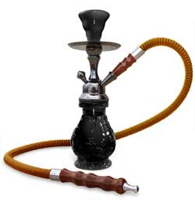
In this presentation
What is Hookah?
How does it work?
What is it made of?
Are there any risks?
Image Credit: via thenounproject.com
Notes:
Teacher Talking Points:
(Click) Today we will be discussing hookah.
(Click) We are going to learn about the specific parts of a hookah and how they work.
(Click) Then we will learn about what is actually in hookah smoke clouds.
(Click) And lastly, we will talk about the risks involved with using hookahs.

Slide 3
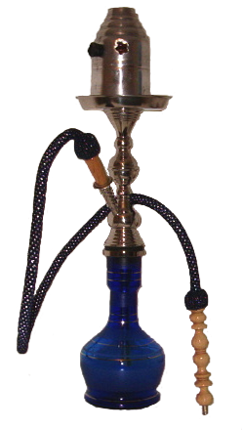
What is Hookah?
Shisha
Goza
Argileh
Narghile
Hubble-bubble
Water Pipes
Notes:
Teacher Talking Points:
So what is Hookah?
(Click) It is tobacco that is smoked using a water pipe.
(Click) The tobacco is usually sweetened and flavored using additives.
(Click) Other common names include: Shisha, Goza, Argileh, Narghile (när’ɡə-lē’), Water Pipes and Hubble-Bubble (click).

Slide 4
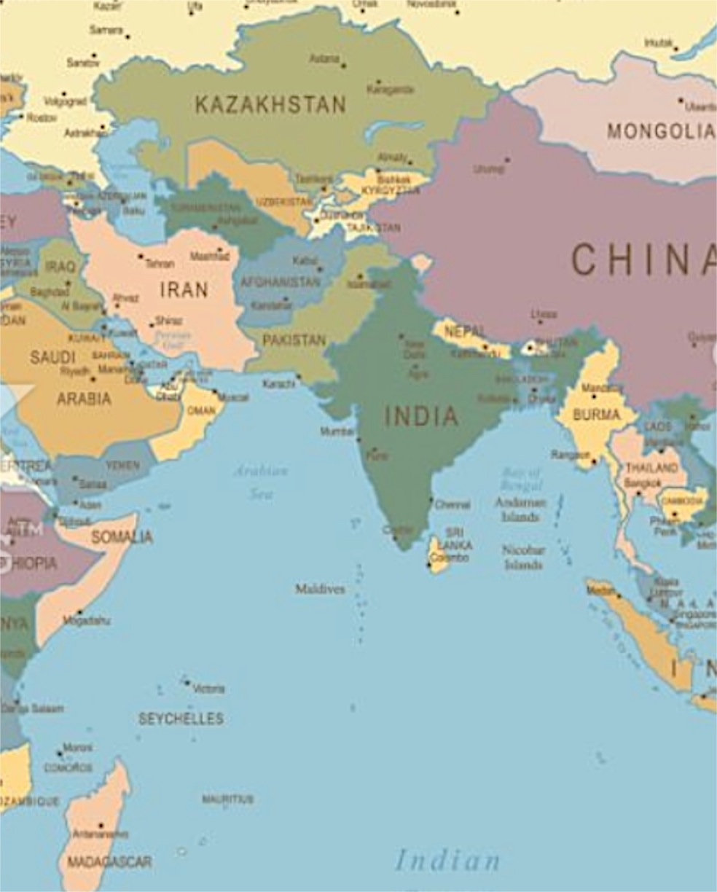
Hookah’s History
…clouds made by hookah was just “water vapor”
Do you think that is true?
Notes:
Teacher Talking Points:
(Click) Originated in ancient Persia and India and spread throughout the Middle East and Asia to Turkey during the Ottoman Empire (Iran, Syria, Jordan, Greece, India, Pakistan, Palestine, Egypt, and Saudi Arabia). As Middle Eastern and Asian communities have immigrated to Europe and the US, hookah bars/cafes have opened and gained popularity in Western society.
In the late 1900’s sweetener and flavor additives were added to the tobacco with the goal of attracting female consumers.
(Click) For so many years consumers were told that the clouds made by hookah were ”just water vapor.”
(Click) Do you think that is true? (take responses from the class)
(Click) No, the clouds made by hookah are not simply water vapor; the are actually aerosols.

Slide 5
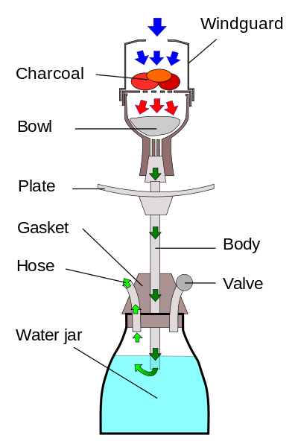
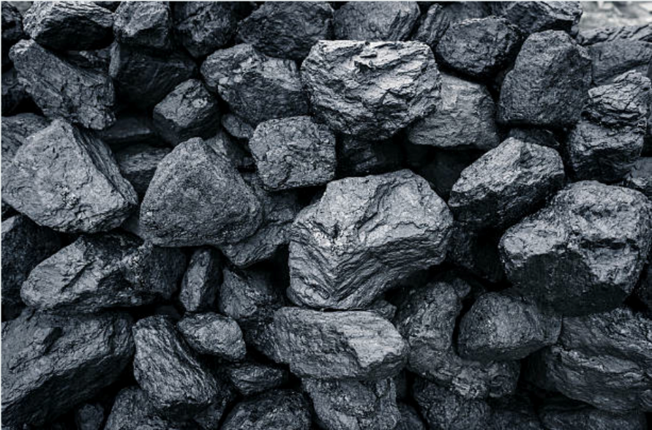
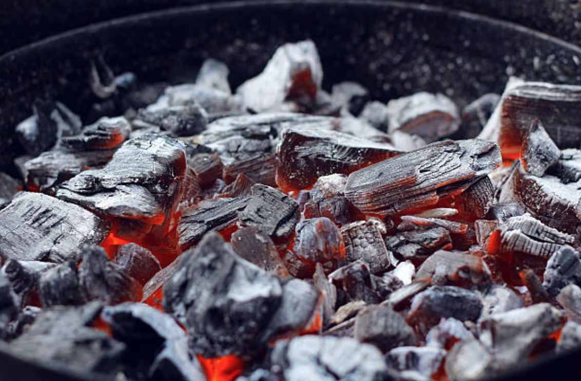
How is Hookah Smoked?
Notes:
Teacher Talking Points:
So how does a Hookah work?
(Click) Tobacco is heated with burning charcoal or embers.
(Click) The smoke passes through the water pipe’s water bowl and is cooled as a result.
(Click) Smoke is drawn through a hose to a mouth piece.
Typically hookah is smoked in a prolonged social session where the hose is used by multiple people.

Slide 6
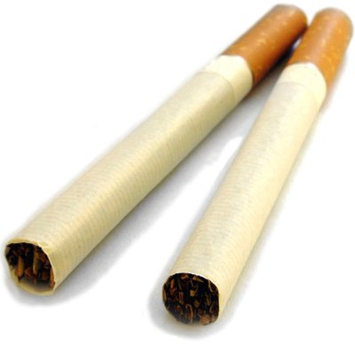
Cigarettes vs. Hookah
Notes:
Teacher Talking Points:
Now, we will be discussing the risks involved with using Hookahs

Slide 7
Think, Pair, Share:
Is hookah less harmful than smoking cigarettes?
Notes:
Teacher Talking Points:
Now, turn to a partner and answer the following question. Make sure to justify your answer.

Slide 8
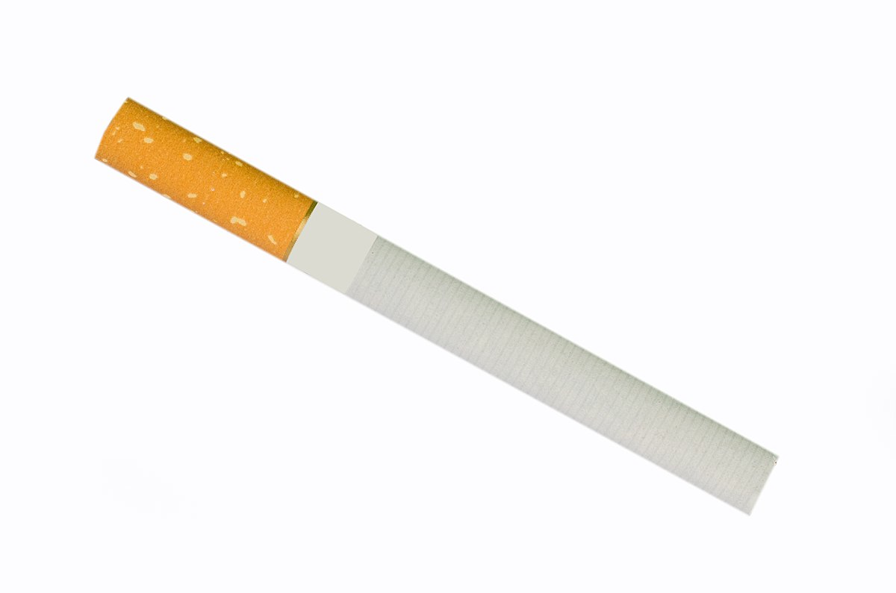
Hookah is NOT LESS HARMFUL than Cigarettes
You expose yourself to the addictive chemical nicotine, heavy metals, and tar.
Burning tobacco at a high heat due to the charcoal leads to smoke that is at least as toxic as cigarette smoke.
Prolonged periods of smoking = expose your body to more toxic substances than cigarette smokers.
200 puffs
20 puffs
Notes:
Teacher Talking Points:
(Click) Despite the smoke being filtered through water, when you smoke Hookah you expose yourself to the addictive chemical nicotine, heavy metals, and tar.
(Click) When you smoke Hookah you are burning tobacco at a high heat due to the charcoal. This leads to smoke that is at least as toxic as cigarette smoke.
(Click) Because hookah is usually smoked in a prolonged period, smokers may expose their bodies to more toxic substances than cigarette smokers.
For Example:
(Click) 1 cigarette = 20 puffs
(Click) 1 hour hookah session = 200 puffs

Slide 9
Think, Pair, Share:
Do you think smoking Hookah can cause similar and/or different diseases than cigarettes?
Notes:
Teacher Talking Points:
Based on the information you learned on the last few slides, make a hypothesis about whether or not you think smoking hookah can cause similar and/or different diseases than cigarettes?
Now, turn to a partner and answer the following question. Make sure to justify your answer.

Slide 10
Hookah Health Effects
Oral Cancer
Stomach Cancer
Reduced Lung Infection
Lung Cancer
Esophageal Cancer
Decreased Fertility
Notes:
Teacher Talking Points:
Smoking hookah may cause the same diseases as smoking cigarettes. These diseases include: (click) Oral Cancer; (click) Lung Cancer; (click) Stomach Cancer; (click) Esophageal cancer; (click) Reduced lung function; (click) Decreased Fertility.
Secondhand Smoke: health risk for nonsmokers. It contains smoke from the tobacco as well as smoke from the heat source used in the hookah.

Slide 11
Hookah and Infectious Diseases
Tuberculosis
Herpes
Hepatitis
Notes:
Teacher Talking Points:
Because Hookah is typically smoked in groups, in a manner where multiple people use the same hose from one person to another, smokers are at risk for infectious diseases including: (click) Tuberculosis; (click) Herpes; (click) Hepatitis.

Slide 12
What do you want your peers to know about hookah?
Public Service
Announcement
Notes:
Teacher Talking Points:
Working in pairs, please sketch out a public service announcement poster that educates students like you about the effects of using hookah.
Note: Refer to the Positive Youth Development Module at StanfordTobaccoPreventionToolkit.Stanford.edu for more information about PSAs

Slide 13
Resources
CDC: Hookah Facts/Data
https://www.cdc.gov/tobacco/data_statistics/fact_sheets/tobacco_industry/hookahs/index.htm
CDC: Dangers of Hookah Smoking
https://www.cdc.gov/features/hookahsmoking/index.html
ALA: Tobacco Policy Trend Alert – An Emerging Deadly Trend – Water Pipe Tobacco Use
http://www.lungusa2.org/embargo/slati/Trendalert_Waterpipes.pdf
WHO: Tobacco Product Advisory
http://www.who.int/tobacco/global_interaction/tobreg/Waterpipe%20recommendation_Final.pdf
Notes:
Picture(s) From:
https://commons.wikimedia.org/wiki/File:Shisha-edit.png
https://commons.wikimedia.org/wiki/File:Hookah-lookthrough.svg
http://www.istockphoto.com/vector/vintage-world-map-gm469297954-62339524?irgwc=1&esource=AFF_IS_IR_Andrian%20Valeanu_372642&asid=Andrian%20Valeanu&cid=IS

