Slide 1
Managing Pain When Living with Cancer
Grant Smith, MD
Clinical Assistant Professor of Medicine
Section of Palliative Medicine
Stanford School of Medicine
@GSmithHPM
Notes:
Good afternoon and thank you so much for joining today. I am so excited that you are here, and I hope today’s talk is helpful for everyone who has joined.
My name is Grant Smith, and I am one of the palliative care doctors at Stanford.
I want to thank our community partners who helped make this session happen!
Thank you to Cancer Carepoint, Bay Area Cancer Connections, New Hope Chinese Cancer Care Foundation, and Latinas Contra Cancer.
Also, thank you to our interpreters (Amada, Miriam, Grace, and Zoe) for helping make this session available in Spanish and Mandarin.

Slide 2
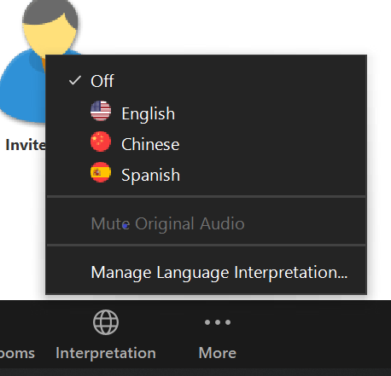
Using Zoom Interpretation
On the bottom right of your screen, you’ll see an “interpretation” button.
Click on it, then click on the language you’d like.
Notes:
Before we jump in, make sure to enter the correct room for your language.
Click the Interpretation Icon at the bottom of the screen, then select the appropriate language

Slide 3
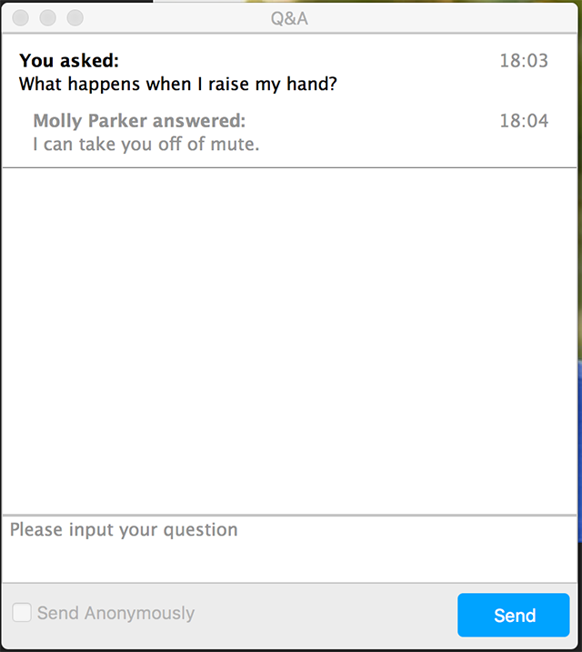
Quick Intro to a ZOOM Webinar
To ask a question:
Click on the “Q&A” box
Click “send anonymously” if don’t want your name to appear
Type your question and click “Send”
Type your question here
Once there are questions:
You can “Like” questions, by clicking the “Thumb Up” icon
Notes:
To ask a question, clock on the “Q&A” button On the bottom of your screen
This will open a new dialog box where you can type in your question. You are welcome to type your question in English Spanish or Chinese.
Once questions have been asked, you can click the thumbs up icon to vote for that question as one that you would also like to have answered.
We will answer questions at the end of the presentation, and our interpreters will help to ask questions in Spanish and Chinese.

Slide 4
Roadmap
Co-Hosting Organizations introductions
What is palliative care?
What is pain?
How do we relieve pain?
How do you get help for pain?
Notes:
The outline for today's talk will include:
An introduction from our Co-hosting organizations
Next we will talk about what is palliative care
Then, we will review what is pain
Then, we will spend a majority of our time talking about how we can relieve pain
And finally, will provide advice about how to get help from your doctor for pain

Slide 5
bayareacancer.org
Emotional Support
Post-Treatment Programs
Library
Bay Area Cancer Connections supports anyone affected by breast​ or ovarian cancer with personalized services that inform and empower.
Fitness Classes & Wellness Workshops
Boutique with wigs, hats & breast prosthesis
Financial Assistance
Personalized Research
Annual Cancer Conference
Community Resources
Personalized Care
Educational Sessions with Medical Professionals
40+ Free Programs & Services
Notes:
Colleen Carvalho, Director of Programs and Services:
emphasize personalized care

Slide 6
Latinas Contra Cancer slide
Notes:
Tina Tai, Executive Director

Slide 7
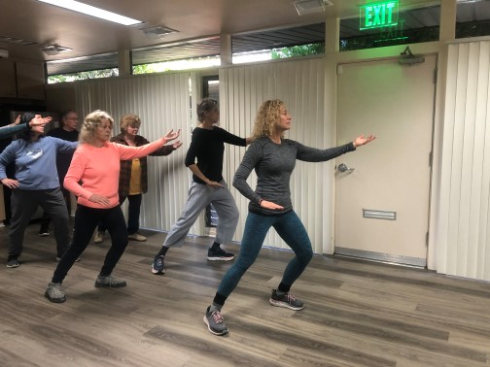
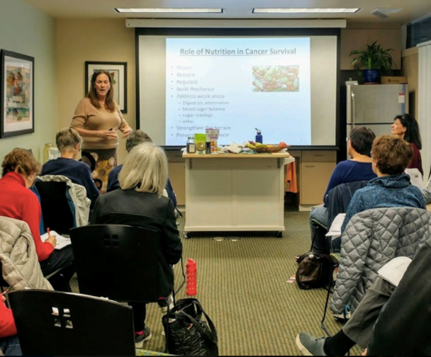
Cancer CAREpoint
Silicon Valley-based non-profit
providing non-medical support services
to any individual impacted by cancer
no matter:
their cancer type
where they get medical treatment
their insurance status
At No Cost to the Individual
Notes:
Morrigan Bruce, Director of Programs
Karla Miramontes, Community Programs Coordinator

Slide 8
Health Education
Cancer Health Education Events, Presentations,
Health Information Tables, Wellness Events
Patient Navigation & Patient Advocacy
Support for People in Need of Screenings, Clinics and Hospital Navigation, Health Based Case Management,
Community Resource Navigation
Survivor Support
Monthly Support Groups, One-on-One Therapy,
Survivor Community Calendar of Events, Website Resource Page,
No Cost Wig & Prosthesis Boutique
Research & Advocacy
Biennial National Latino Cancer Summit, Participatory Research & Focus Groups, Survivor/Caregiver-led Research, Patient Organizing
Latinas Contra Cancer exists to create equitable and just access to health and the healthcare system for the Latino community around issues of cancer and cancer prevention.
408.280.0811
Latinascontracancer.org
Office@latinascontracancer
Notes:
Darcie Green, Executive Director

Slide 9
Roadmap
Co-Hosting Organizations introductions
What is palliative care?
What is pain?
How do we relieve pain?
How do you get help for pain?
Notes:
Next we will talk about what is palliative care

Slide 10
What is Palliative Care?
Definition:
Palliative care is specialized health care for people living with a serious illness.
This type of care is focused on providing relief from the symptoms and stress of the illness.
The goal is to improve quality of life for both the patient and the family.
Center to Advance Palliative Care (CAPC), 2019
Notes:
Thank you again to our Co-hosting organizations.
As I mentioned at the beginning, I'm a palliative care doctor. Many people do not know or have not heard of palliative care. And, there are many misconceptions about palliative care.
I'd like to start by reviewing a definition of palliative care to help clarify what it is.
Palliative care is specialized health care for people living with a serious illness. This type of care is focus on providing relief from the symptoms and stress of the illness. The goal is to improve the quality of life for both the patient and the family.

Slide 11
What is Palliative Care?
Provided by a specially-trained team, palliative care specialists work together with a patient’s other doctors to provide an extra layer of support.
Palliative care is based on the needs of the patient, not on the prognosis. It is appropriate at any age and at any point in a serious illness and can be delivered with curative treatment.
Center to Advance Palliative Care (CAPC), 2019
Notes:
-Provided by a specially-trained team, palliative care specialists work together with a patient’s other doctors to provide an extra layer of support.
-Palliative care is based on the needs of the patient, not on the prognosis. It is appropriate at any age and at any point in a serious illness and can be delivered with curative treatment.

Slide 12
Team-Based Approach
Who’s On Our Team:
Doctors & Nurses
Social Workers
Chaplains
Medical Assistants
Physiologic
Psychologic
Person
Patient
Social
Spiritual
Derived from World Health Organization definition of palliative care, 1998
Notes:
In palliative care, we operate as a team.
We believe that it takes a team to support patient and families, because we want to address not only the physical symptoms but also help to meet psychologic, social, and spiritual needs.
Because of the expertise needed to address these issues, our teams include
-Doctors, nurses, social workers, chaplains, medical assistants, and child life specialists

Slide 13
Team-Based Approach
Doctor & Nurse
Prescribes medication
Social Worker
Emotional Support
Chaplain
Spiritual support
Helps with medical decisions
Caregiver support
Medical equipment
Financial concerns
Existential distress
Prayers and blessings
Coordinates with other doctors
Notes:
While all team members work together to provide care, each member has a different area of focus.
The Doctors and Nurses:
-Focus on managing bothersome symptoms (like pain) and help with prescribing medications
-We also help patients and families with medical decisions and advance health care planning
-We also help coordinate with the other doctors on your care team
Social Workers:
-Provide emotional support through regular phone calls, video visits, or check ins
-Provide caregiver support to your loved ones or other caregivers
-Help get medical equipment
-Talk through financial concerns and look for assistance if possible
Chaplains:
-Provide spiritual support
-Address existential concerns (which we will talk more about soon)
-Offer prayers and blessings

Slide 14
Palliative Care
Hospice
Notes:
Many people think that palliative care and hospice are the same.
However, palliative care and hospice are NOT synonyms,
Palliative care is a large and broad field focused on symptom management and helping make sure the care plans focus on what matters most to patients. Palliative care can see patients of any age, at any stage, and can be involved even when someone is getting a treatment that could cure their illness.
Hospice is a form of palliative care that is meant for individuals at the very end of their lives, who choose to focus primarily on comfort rather than life prolonging treatments. Hospice can be provided at someone’s home or in a facility like a nursing home.

Slide 15
Roadmap
Co-Hosting Organizations introductions
What is palliative care?
What is pain?
How do we relieve pain?
How do you get help for pain?
Notes:
Next we will talk about what is pain

Slide 16
What is Pain?
An unpleasant sensation in the body
A signal that there is injury or damage to the body
Notes:
Let’s start by asking the simple question, “What is pain?”
-Pain is an unpleasant sensation in the body, and
-Pain is a signal that there is injury or damage to the body.

Slide 17
Pain is Common for People Living with Cancer
Stage in Cancer Treatment | Prevalence of Pain
Advanced or metastatic cancer | 66%
During anti-cancer treatment | 55%
Notes:
Pain is a common experience for people living with cancer
-66% of people with metastatic or advanced cancer have pain
-Slightly more than half of people experience pain while they are getting anti-cancer treatment
I say this to affirm that if you are having pain from cancer, you are not alone.
And, you should feel welcome to let your doctors know if you are having pain.

Slide 18
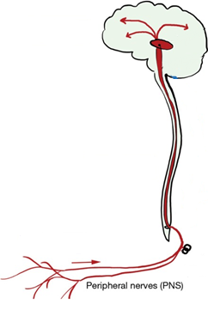
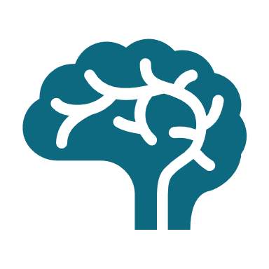
How Do We Feel Pain?
Nerves sense injury to our bodies
They send a signal through the spinal cord to the brain
Once the signal is received in the brain, we feel pain
Notes:
Let’s consider, how do we feel pain?
As this will provide the foundation for how we can treat pain.
-Nerves throughout our body can sense when there is an injury or damage to a part of our body.
-These injuries trigger the nerves to send out a signal that the body is injured
-These signals travel though multiple nerves, up through the spinal cord, and ultimately to the brain
-In the brain, the signal is received and causes us to perceive the pain

Slide 19
Pain is More Than a Physical Sensation
Pain is an emotional experience
Pain is a subjective experience
Pain is stressful for patients and doctors
Notes:
However, we know that pain is more than just a physical sensation caused by nerve signals
Pain is an emotional experience!
-We know that pain causes fear and anxiety, and it is a normal, biologic and physiologic response to have an emotional reaction to pain
-In fact, when pain signals from nerves reach the brain, those signals are sent both to the part of the brain that processes sensory information AND the part of the brain the processes emotions and decision making
-We also know that for people living with cancer, pain can cause worry or concern that the cancer may be getting worse
Pain is a subjective experience
-Unfortunately, there is no blood test or device that can measure pain, so pain is something that has to be managed through a trusting relationship, meaning that both the patient and provider need to believe each other about the experience
-However, this also means that there is room for misunderstanding and challenges, especially when working across different cultures or languages
-Pain can be especially challenging because everyone shows their pain in different ways (some people may cry, while others may be silent)
-Many people worry that they will not be believed that their pain is real because there is not a way to objectively measure it; however, I want you to know that it is OK to tell someone about your pain, and we will talk later about some strategies for talking to your doctor about this.
Pain is stressful for patients and doctors
-Doctors want to relieve their patients’ suffering, as this is one of the primary duties of doctors!
-So, when patients are in pain, patients are stressed and this is stressful for doctors
-Another challenge that both doctors and patients face are societal concerns about the opioid crisis and this has placed hurdles and challenges for managing pain for patients living with cancer
-Despite this, we have many things we can do to overcome these challenges and help make pain better.

Slide 20
Roadmap
Co-Hosting Organizations introductions
What is palliative care?
What is pain?
How do we relieve pain?
How do you get help for pain?

Slide 21
How Do We Relieve Pain?
How we perceive pain is complex
There are pathways in the brain that help regulate pain
These pathways can both INCREASE and DECREASE the perception of pain
Notes:
The brain can be VERY powerful in changing the way we feel pain.
Attention, suggestion, and other emotional factors can have a major impact on how we feel pain
For example, athletes who are injured in the middle of an intense competition may feel less pain than someone who gets the exact same injury but is not in a competition. The idea is that the athletes who are focused on the competition, are paying less attention to the pain and thus feel it as less.
Another example is that people will feel pain when they are given an injection of water but told that it is a medicine that will cause pain.
Similarly, studies have shown that people will get pain relief when they get an injection of water but told that it will help with pain (we call this the placebo effect in medicine).
All of this is to say, that the brain has powerful ways of regulating the amount of pain we experience, and it is an important tool we use in managing pain.

Slide 22
How Do We Relieve Pain?
Pain
Medications
Psychological
Integrative
Spiritual
Pain is complex
Need to use multiple strategies to manage pain
Notes:
As we have discussed, pain can be a challenging issue that is more than just a signal sent to your brain by your nerves.
Because pain is complex, we recommend using multiple tools to address pain
These tools include: -Medicines
-Psychological interventions
-Considering integrative techniques
-Consider spiritual concerns

Slide 23
Medications for Pain Management
Gabapentin, Pregabalin, Duloxetine, Venlafaxine
NSAIDs/Steroids
Acetaminophen
Opioids
Nociceptive, Neuropathic
Neuropathic
Inflammatory
Nociceptive, Inflammatory
Notes:
In terms of medications, there are many options for medications to help with pain.
For each person, it is important to talk with your doctor about which medications might be right for you, because everyone’s case is unique.
In general, I think about the medications we use on a balance between safety and benefit of relief.
In this figure, I show a pyramid. As you go up the pyramid, there are some increasing risks to the medicines; however, that does not mean that the risks outweigh the benefits. Sometimes, people need stronger medicines to manage pain that is more severe. That is OK and expected.
You may notice that opioids (which are medicines like morphine or oxycodone) are at the top of this pyramid.
MANY people living with cancer-related pain, may need opioid medications. Your doctors can help to use these medications safely.
I want to note that many people worry about using opioids because of the opioid crisis in the United States. Please know that using opioids for cancer-related pain is OK and part of medical recommendations. Your doctors will help to use these medications as safely as possible if they are needed in your case.
As doctors, we think about the different types of pain, which include “nociceptive pain – caused by damage to the body” “neuropathic pain – caused by injury or damage directly to nerves” and “inflammatory pain – caused by inflammation”
So for example, even though some of the medicine for Neuropathic or nerve pain are higher up on the pyramid, if the main type of pain someone is having is nerve-related pain, like neuropathy, we would recommend starting with these particular treatments first, b/c they are most likely to relieve your pain
Using a combination of medicines can help us address the multiple types of pain that an individual may be experiencing.

Slide 24
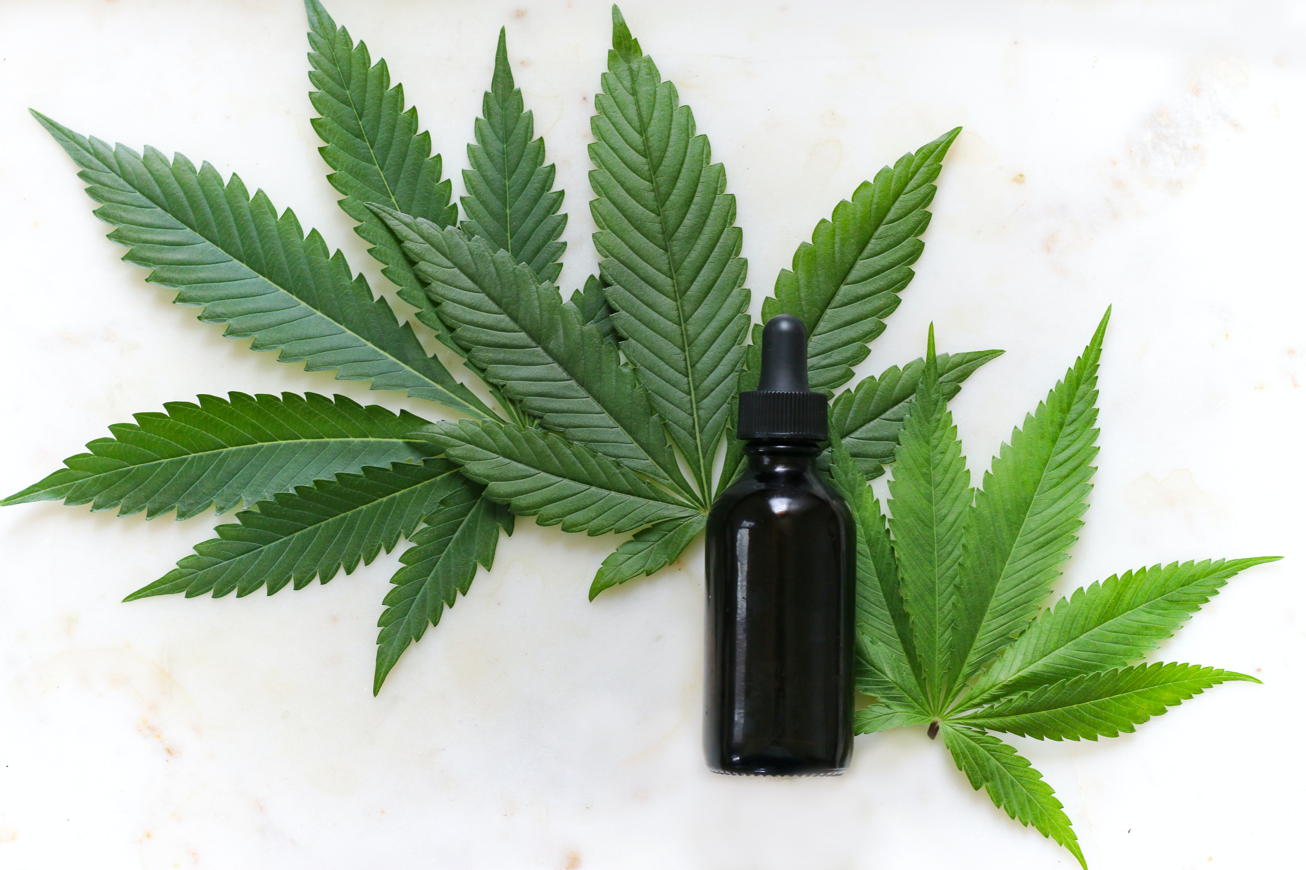
A Word About Cannabis (Marijuana)
There is mixed data about its ability to treat pain
Some doctors support using cannabis, while others do not
In California, cannabis is legal, and you do not need special permission from a doctor to purchase or use cannabis
Use “tinctures”
Start with a small dose
Increase SLOWLY
Notes:
I also wanted to take a moment to mention cannabis (or marijuana) as this is a common question for patients with cancer
Cannabis or marijuana is FDA-approved for 2 indications: Nausea and vomiting from chemotherapy-induced nausea and vomiting and for appetite stimulation in advanced cancer.
-Based on the research studies available, it is not clear if cannabis is helpful for pain
-However, there are many patients with personal stories of having pain relief when using cannabis products
-Because of the limited scientific evidence, some doctors support the use of cannabis, while others are more hesitant
-In California, cannabis is legal for both medical and recreational use, so you do not need a doctor’s note in order to purchase and use cannabis.
-If you are using cannabis, I recommend using tinctures rather than smoking or eating cannabis products
-I also recommend starting with a very small dose and increasing very slowly over time

Slide 25
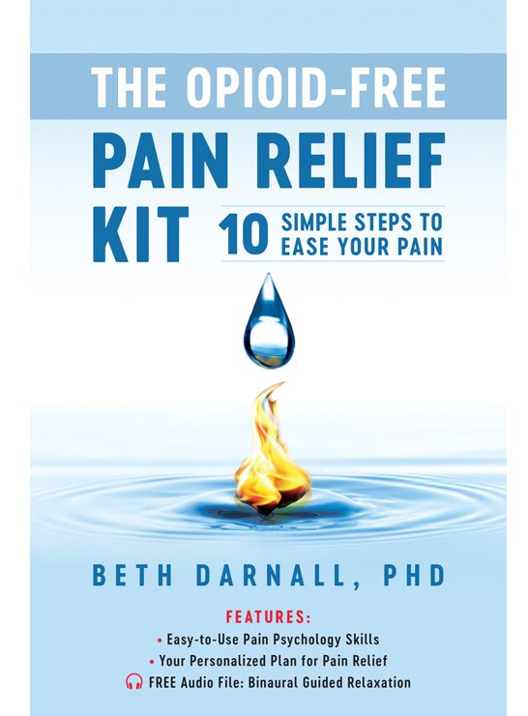
Psychological Strategies for Pain Management
The Opioid-Free Pain Relief Kit
Meditation and relaxation techniques
Sleep
Exercise and activity
https://osher.ucsf.edu/guided-imagery-meditation-resources
Cognitive-Behavioral Therapy
Mindfulness-Based Stress Reduction
Meditation applications
Notes:
As we mentioned before, the mind has a powerful influence over the way we experience pain.
So, we often recommend using strategies to maximize people’s ability to cope with pain. Think of this as a way to help your other treatments work even better
Our clinic recommends the book called “The Opioid-Free Pain Relief Kit.” It is currently only available in English, but consider looking for similar books that help focus on mindfulness and psychological approaches to pain.
-USCF’s Integrative Medicine Center also has a great website listed here, which has resources for guided-imagery.
-In some cases, meeting with a pain psychologist or a therapist can help in reducing pain as well. Examples of therapies that have shown improvements in pain include cognitive-behavioral therapy and mindfulness-based stress reduction therapy.
Some of our patients also enjoy using smartphone applications like “Calm” or “Headspace”
However, there are 1000s of these videos freely available on YouTube that can help you to relax and reduce your pain

Slide 26
Integrative Medicine for Pain Management
Heating/Icing
Massage
Acupuncture
Aromatherapy
Hypnotherapy
Tai Chi
Notes:
Integrative medicine, which has also been called complimentary or alternative medicine, refers to approaches to improve pain that do not involved taking medicines
For all for all of these interventions, there is not a lot of high-quality research studies to say that these treatments will definitely work for people; however, my experience is that some patients can provide a lot of relief in using some of these modalities
Integrative techniques include heating/icing, massage, acupuncture, aromatherapy, hypnotherapy and tai chi.

Slide 27
Spiritual Care for Pain Management
Spiritual Care can help address existential pain/suffering
Why did this happen to me?
What is God’s plan in this?
What happens after we die?
Spiritual Care can offer
Listening
Open-hearted conversation
Calm presence
Prayers and blessings
Notes:
Spiritual care is an important aspect of pain management.
I use this term very broadly, and believe that this applies even to people who do not practice a particular religion or have a particular faith they follow.
Spiritual care can help to address existential pain.
Existential pain is the suffering that can be caused when wrestling with questions like:
“Why did this happen to me?”
“What is God’s plan in this?”
Or even concerns about getting sicker or what happens after we die.
Having these thoughts and questions can be a very normal part of dealing with a serious illness.
Spiritual care or chaplains can help by offering listening, open-hearted conversations, a calm presence, and prayers and blessings

Slide 28
Roadmap
Co-Hosting Organizations introductions
What is palliative care?
What is pain?
How do we relieve pain?
How do you get help for pain?

Slide 29
How to Ask Your Doctor for Help with Pain
I am worried cancer is causing my pain
AND, it is limiting my function
What can you do to help my pain?
Do you think I should see a palliative care doctor or a pain management specialist?
Notes:
Many people are concerned about taking with their doctors about their pain out of fear they may not be believed or be seen and “drug-seeking”
In general, when you have a cancer-diagnosis, your doctors should acknowledge and understand that this is a condition known to cause pain.
That being said, I have some words of advice that may help put your doctors in the right frame of mind.
Start by saying “I am worried that my cancer is causing my pain”
If you are limited in what you are able to do physically because of pain, I would recommend adding “AND it is limiting my ability to function”
Next, ask “What can you do to help my pain?”
Finally, ask “Do you think I should see a palliative care doctor or a pain management specialist?”
USE THIS TALK AS AN EXCUSE! You can say, “I went to a talk from a palliative care doctor, and they seemed helpful!”

Slide 30
How to Ask Your Doctor for Help with Pain
Ask about what to do if your pain gets worse
Who can you call?
What about nights/weekends?
Do they have initial recommendations?
When to go to the Emergency Room
Notes:
A few other pieces of advice to bring up when you are talking to your doctor.
Consider asking what to do if your pain gets worse:
Who can you call?
What about nights/weekends?
Do they have initial recommendations for what to do if your pain is worsening?
When to go to the Emergency Room or call 9-1-1?

Slide 31
Where to Get Help?
Cancer Doctor (Oncologist)
General Doctor (Primary Care Provider)
Palliative Care Team
Pain Medicine Specialist
Integrative Medicine Specialist
Social Worker
Chaplain/Spiritual Care
Notes:
So, where can you go to get help?
The first place to go to ask about help with pain is probably with the doctor who knows you best.
I would recommend talking with your cancer doctor (oncologist) or your general doctor (primary care doctor)
They may get things started with trying both medicines and non-medicine techniques to help you with your pain
If they are not helping you get adequate relief, I would recommend asking for a referral to palliative care or a pain specialist.
A pain medicine specialist is another type of doctor who can help with pain. They tend to focus on using medications only, while palliative care doctors tend to look at other aspects of pain. That being said, they can be very helpful, and we often work very closely!
An integrative medicine specialist is another possible resource, although this resource is somewhat more limited.
Other source for help include social workers and chaplains or spiritual care team members who may also help you get connected with palliative care, pain medicine, or help with non-pharmacologic approaches to pain management.

Slide 32
Palliative Care in the Bay Area
Kaiser San Rafael
Marin General Hospital
SF Veterans Admin Medical Center
UCSF
Zuckerberg San Francisco General Hospital
Kaiser – San Francisco
Sutter
Palo Alto Medical Foundation
Stanford

Slide 33
Thank you!

