Slide 1
Caregiving During Covid
Amy Yotopoulos, MHA, MS.,
Program Manager, Caregiver Center
Charisse Lee, J.D.,
Senior Consultant, Caregiver Center
Stanford Health Care
Health Education, Engagement, and Promotion Program
Notes:
CLAIRE:
Good morning everyone! We are going to get started now. Hello, and welcome. Thank you for joining us this morning for our webinar on caregiving during COVID. This webinar is being recorded. My name is Claire Bleymaier, and I’ll be helping host and moderate the Q&A section of this webinar. I work as a project manager with our palliative care health education team, and since palliative care provides care not only to people living with serious illnesses but also their caregivers and families, we are happy to partner with our colleagues at the Caregiver Center to put on this webinar today.
Our presenters today are Amy Yotopoulos, who is the Program Manager of Stanford’s Caregiver Center, and Charisse Lee, who is a Senior Consultant for the Caregiver Center. They both cofounded the Caregiver Center last fall! They’ll be telling you a little bit more about themselves and how they got into these roles in a few minutes. Amy, Charisse and I are part of Stanford Health Care’s Patient Experience Dept, and we are in the Health Education, Engagement, and Promotion Program.

Slide 2
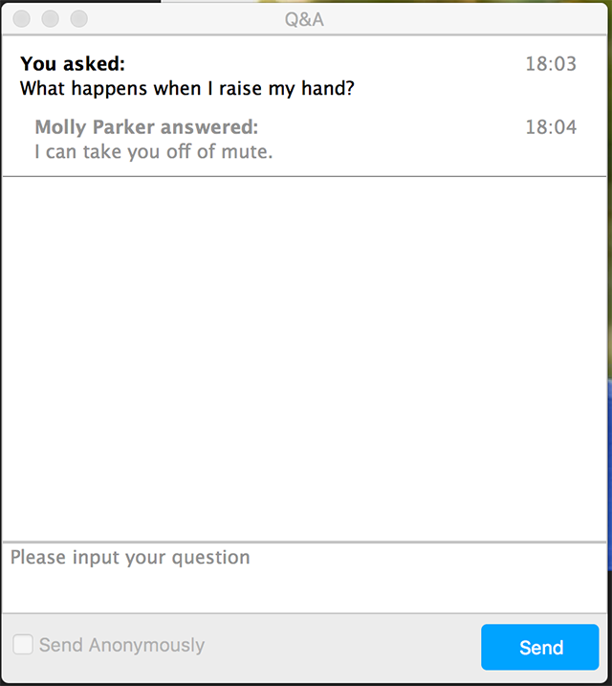
Quick Intro to a ZOOM Webinar
To ask a question:
Click on the “Q&A” box
Type your question and click “Send”
Type question here
Notes:
CLAIRE:
Before we jump in, I wanted to give a quick intro about how to use the webinar features of ZOOM. We will not be using the chat or raise hand functions today.
After Amy and Charisse present, we will have a question and answer session with you all. To ask a question, you can click on the Q&A box in the bottom control panel. This will open a new dialogue box. You can type in your question there and press Send.

Slide 3
Quick Intro to a ZOOM Webinar
To ask a question anonymously:
Click the ‘send anonymously’ box before sending
Notes:
CLAIRE:
We want to remind everyone that any question you send or information you share, will be visible to all webinar attendees this morning. However, if you would like to make your question anonymous, before sending it, you can check the box next to the “send anonymously” wording circled here.

Slide 4
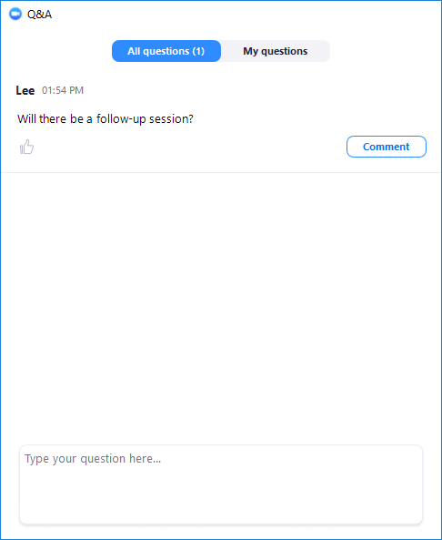
Quick Intro to a ZOOM Webinar
Once there are questions:
You can “Like” questions, by clicking the “Thumb Up” icon
This will help us answer the most popular questions first
Notes:
CLAIRE:
As questions are submitted, you will be able to see them in the Q&A box
You can read through these and “Like” a question by clicking on the “Thumbs Up” icon below the question.
“Liking” a question is essentially voting for a question, and if we have a lot of questions, we will try to answer the questions with the most likes first. We do want to remind everyone that Amy and Charisse are not clinicians, and cannot answer medical or clinical questions. This webinar is also intended for a non-clinician audience. We will be choosing to answer questions first that can apply to more of the general audience of this webinar, rather than those that apply to very specific or personal situations. If we have a lot of questions, we unfortunately may not be able to get to them all, but you will be able to contact Amy and Charisse and the Caregiver Center with the question, if you’d like to follow up, by emailing the Caregiver Center or calling, and they’ll be providing that contact information.

Slide 5
Quick intro to a ZOOM Webinar
Viewing: In the top right corner, you can adjust viewing options
Viewing can also be adjusted at the top toolbar:
Notes:
CLAIRE:
You can change your viewing settings by clicking on the buttons on the top of your screen. Gallery view will show you all presenters who have their videos on, while speaker view will only show you the person who is speaking at that time. Viewing can also be adjusted by clicking on the “view options” tab at the top of the toolbar.
Finally, at the end of the webinar, we will send an email with links to the slides (and all the resources contained within the slides) and the recording, which will be uploaded to our Palliative Care and Caregiver Center websites. There will also be a brief survey that we’d love for everyone to complete, as it helps us get your feedback and improve our offerings for the future.
And now I’d like to let Amy and Charisse begin by telling you a little bit more about themselves.

Slide 6
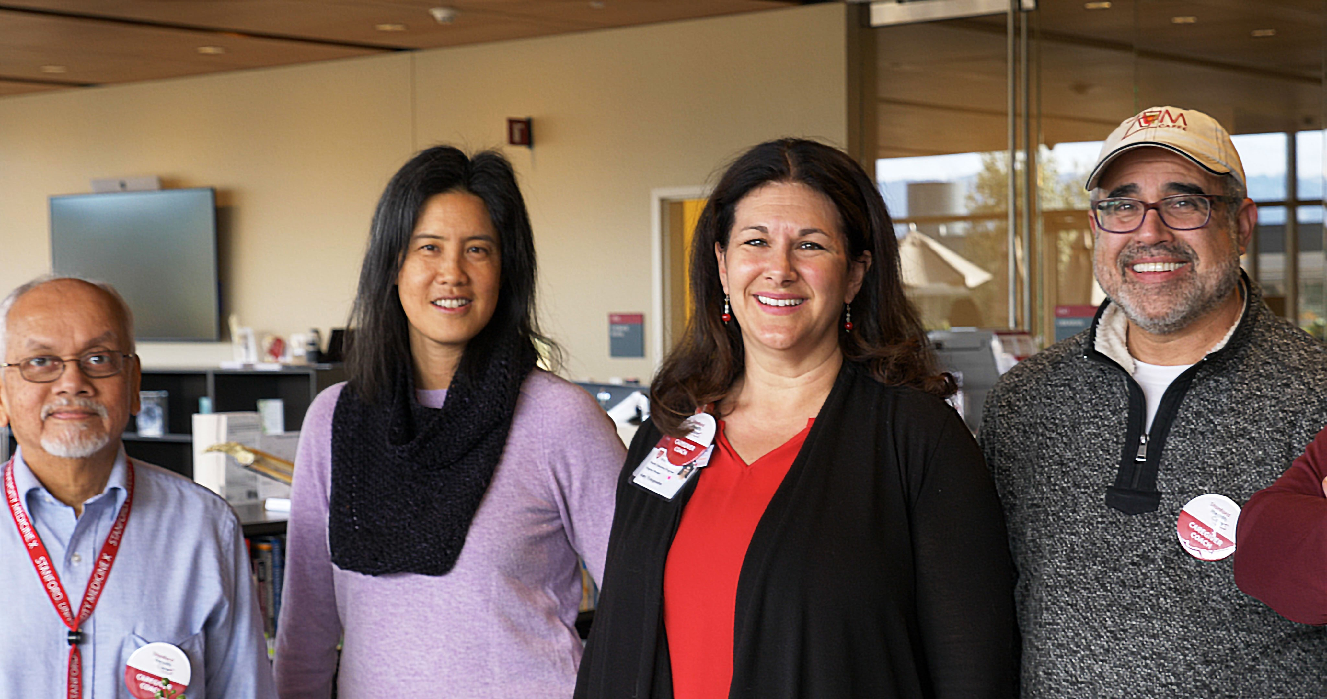
More about Charisse and Amy…
Notes:
CHARISSE AND AMY:
Good morning, my name is Charisse Lee and I am a senior consultant in the Health Education Engagement and Promotion group at Stanford Health Care. Amy and I cofounded the Caregiver Center at Stanford’s new hospital which opened in November 2019. I came to the caregiving field initially when my late husband was diagnosed with pancreatic cancer in 2016. I was my husband’s caregiver through chemo therapy, a whipple surgery, more chemo, radiation, multiple hospitalizations, metastasis, and finally home hospice. I did this while managing his dental practice and raising our three sons then 13, 11, and 9 years old. I’ve been fortunate to turn my proverbial lemons into lemonade at Stanford Health Care and I’ve worked to improve the caregiving experience here since 2018.
Hi everyone, I am Amy Yotopoulos, and I am the manager of the Caregiver Center at Stanford Health Care. I joined the team last year, after almost 5 years at the Stanford Center on Longevity. My entire professional career has been in the gerontology and aging fields, and yet it was a huge shock to me when my husband and I became his father’s caregiver after a dementia diagnosis. For over 10 years we struggled with the demands of both of our full-time jobs, raising our children and providing care during his progressive illness. After years of telling others who to give care, I realized how smug I had been and to be honest, even with my experience and skills, it brought me to my knees. On the other side, it was also a beautiful lesson in how to connect with one another in completely new and unexpected ways. I am delighted to be here today and to share with one another.

Slide 7
Caregiver Center: Connection, Guidance and Respite
Caregiver@stanfordhealthcare.org
Notes:
AMY:
A little background on the Stanford Caregiver Center:
We opened in Nov 2019 on PD1 of the new Stanford Hospital and was founded to provide a place for caregivers to receive connection, guidance and respite. We offer connection through our staff and volunteer Caregiver Coaches; all of us have personal experience with caregiving and have been trained to offer an extra layer of support. We are not clinicians but you can think of us as peer supports who are experienced, empathetic, and want to spend time listening to YOU. We also provide guidance and resources by collaborating with the Stanford Health Library. We offer a wide variety of information and connect caregivers to services. And finally, the space offers respite: a soft place to fall when you need rest and relaxation.
Of course today, due to Covid, the hospital has limited visitors and we are not hosting caregivers in our space. Instead, we are available virtually over the phone or email and can provide connection and guidance remotely.
We created this webinar as another way to reach out to you and provide an opportunity to connect, especially during this time of Covid.
Caregiving has always been difficult, and it is even harder now given Covid and the Shelter in Place. I’ve heard things like “families are the first responders to covid” and “everyone is a caregiver now” lately and it rings true.
There is a wide range of what Caregivers are doing now, for example:
If a Day care program is closed or if our loved one was removed from a senior living system, we now have our loved one at home and are juggling more than ever before (along with working/parenting/teaching from home).
For healthy loved ones, we started getting their groceries, organizing food, supplies and prescription delivery, and reaching out more to provide social contact via calls and video.
Many of us found ourselves reaching out to neighbors who are older or ill to mow lawns, bring necessities, and just to check in.
And we are also trying to help loved ones decide when and how to access healthcare (for provider visits, elective surgeries, cancer treatments, etc.) as well as helping connected them via telehealth.
Overwhelmingly, Covid has changed how we give and provide help to loved ones, for example:
Many health care facilities have limited visitor policies such as at hospitals and rehab centers so we can’t visit with them and advocate like we did before.
Due to SIP, and the fear of infecting loved ones with certain conditions or older age, combined with the lack of PPE and availability of masks, we are finding we need to rely on creativity and one another to provide the help and connection.
Charisse?

Slide 8
Take Away Messages
Connection
Control
Cope
Contact us!
Notes:
CHARISSE:
Today we will be focusing on four themes: 1) Connection, 2) Control, 3) Coping, and 4) Contact Us.
I want to acknowledge that caregiving is hard work, it can be isolating and stressful. Caregiving during a pandemic is even more challenging when you consider the physical and social distancing and the risks involved in what used to be our everyday normal activities. For all the caregivers out there, I want to say that I see you, and all the work you are doing each and every day. Some of you may be new to your role as a caregiver, and some of you may have been doing this for a long time – in any case, I hope you come away from this webinar with something useful to you.

Slide 9
Connection: You are not alone
Be involved in your loved one’s care
Activate support structure
Communicate creatively
Where to get help
Notes:
CHARISSE:
CONNECTION:
You are not alone in the caregiving journey. 53 million Americans (1 in 5 Americans) are providing unpaid care to an adult with health or functional needs.
Caregiving can feel like a paradox. Sometimes it feels like you are alone on an island to do the heavy physical and emotional work of caregiving. And yet, it is the connection to others that will help ease the load and help you to be a better caregiver. So what does it mean to connect to others as a caregiver?
Connect to the care team, be involved in your loved one’s care and ADVOCATE.
If you haven’t yet already done so, get “share access” or “proxy access” to your loved one’s medical record so you can stay informed and connect directly and privately with clinical team. The pandemic has brought to the forefront (a) Internet based patient portals to access medical records and (b) tele-health visits. These apps allow you to see parts of the medical record, prescriptions, schedule appointments.
Ask questions of your loved one’s clinical team. Consider getting questions from other family members. Don’t be shy about not understanding a scientific term or medical diagnosis – the Stanford Health Library provides scientifically based medical information to help you make informed decisions about your health and health care. Free to all; it does not matter where your loved one gets their health care.
Remember that you, the caregiver, are an essential part of your loved one’s healthcare team. And your voice is important.
Use your connections, activate informal/family support structures, and lighten the load
Have the mindset that others do want to help you. Do not have the mindset that you are bothering or inconveniencing other people. You will be pleasantly surprised at how people are willing to help – especially at this time when everyone is feeling the need to connect to others.
Brainstorm: who of your family, friends, neighbors, faith community, book club, poker group can help… now get organized:
What worked for me: only used two friends to do all of my communications. One to be our communicator of health updates via email. One to organize meal drop offs.
Be specific about the tasks that need to be done and ASK for specific things ( “can you make a vegetarian dinner for us, every Monday, and drop off by 5pm” “I need someone to take my 6th grader out for a social distance walk on afternoons.”)
Utilize tech to connect (Caring Bridge, Zoomers to Boomers)
Don’t forget the power of anonymous strangers who are going through the same thing you are. Smart Patients Caregivers’ Community is an example of an online support community.
Communicate Creatively
Staying connected with loved ones: (whether you are living at home with someone who is quarantined or live far away from someone you cannot visit)
Time to be creative! Video chats have been great, try the “old fashioned” phone call or written letter, meeting outside/between windows, playing games online, digging up old photos and scanning/sharing, music, story telling, etc. “book groups” watching movies “together” via Netflix or projecting on wall.
As I support my MIL from afar, my kids and I have enjoyed regular FaceTime video calls
If you’re a long distance caregiver, try reading books together… calling and reading Harry Potter for 20 minutes every other evening.
When my husband had 40 straight days of radiation therapy, family and friends sent us 40 envelopes of encouraging notes in a countdown of days till the end of the course.
Consider surprise vs. scheduled visits (need both). Include kids/pets
Backyard or driveway social distance picnic
Connecting to others during the caregiving journey will improve the caregiver’s, as well as the patient’s, emotional health.
Where to get help

Slide 10
Connection Resources
Connect with other Caregivers:
Smart Patients
https://www.smartpatients.com/partners/stanford-caregivers
Connect with professionals:
Family Caregiver Alliance
https://www.caregiver.org/coronavirus-covid-19-resources-and-articles-family-caregivers
Avenidas (Palo Alto-based senior services agency)
https://www.avenidas.org/programs/avenidas-without-walls
Area Agencies on Aging:
https://eldercare.acl.gov/
Connect with Friends, Neighbors, even Acquaintances:
https://www.caringbridge.org/, https://www.ianacare.com/

Slide 11
Control: Only what you can!
Set expectations
There is no perfect
Plan ahead
Questions to ask
Notes:
AMY:
CONTROL: It’s ironic that I am doing this section because it is an issue I struggle with personally. Many of us like to be in control, right? We prefer to live in a world where we can plan for something ahead of time. We want absolutes and “Truths with a capital T” to help us decide what to do. And now with all of the uncertainty and the constant change of information and policies, we find ourselves worried because we feel like we can’t depend on uncertainty.
So one thing that can help is when we set realistic expectations. For many of us, that means LOWER than normal. I know this is a strange thing to hear as I was raised to keep setting the bar higher and higher for myself (and am raising my kids the same way). But what does setting realistic expectations look like? Is it realistic to expect we can work our jobs from home while raising kids and helping them with online learning (or worse, making sure they have a safe and enjoyable summer?) all while figuring out how to keep your ill or disabled or elderly loved one healthy and safe and comfortable…all at the same time? Can we really be as productive at work, can the kids really learn as much online as they used to in person, and will your loved one feel as happy and comfortable as they were before, the way you want them to feel? Nope. Not likely.
So: think about your expectations for how things should be. Most importantly, lower your expectations for yourself. You cannot do all things, all the time, perfectly.
Ah the word perfect. Now is the time to really grasp the concept that There is no perfect. There never was, but even more so today. There are no perfect spouses or children or situations or conditions. When I feel like “nothing is going my way” it is time to rethink what “my way” is. Is my way really the only way? The only right way? Nope. Figuring out how to embrace imperfection. Let go of the ideal. We are in a big mess, that is true. And we are all doing the best we can, given the situation. Allowing ourselves to truly understand that for ourselves AND OTHERS will give us a much-needed break from the suffering that comes from comparing what we want versus what we have. Or comparing how we want things to go versus what is actually happening.
This is not a perfect time. There is no perfect plan. There is no perfect solution/execution. There is no one right answer. Just what works now.
Which leads to Plan Ahead. Letting go of what you cannot control and turning to focus on What Works NOW? Let’s focus on controlling what little we can. Whether your loved one needs just a little of your help now or if you are providing care 24/7, we can turn our attention to specific tasks where we can gather information and resources and have a plan in place. Some areas include: planning in advance for medications. What needs to be done for your loved one’s pets? Organize finances and set up a plan to pay their bills and taxes. Get all of the paperwork in order. Research home care or home health agencies. Etc. And when you are planning in advance, there are
Some questions to ask yourself, to help focus on what you can do:
What does my loved one need? (bathing, dressing, meds, food, laundry, bills, yard, or even just bringing in their mail?). (My Gma story of going down stairs to get mail). And what is the best way to help AND keep everyone safe? Where and/or how can they receive care (is it via telehealth or an in-person doc visit? Is it in a rehab/snf facility or their home, your home, with our without paid help? Or some combination?) Now is a good time to research your options. Find out financial requirements.
And talk to the entire family, especially about:
Who can help with caregiving? We all need to get really comfortable with and used to asking for help. The silver lining in this pandemic is I see more people reaching out to one another and to support each other. Certainly if someone asks: “How can I help?” you want to have a list ready that you can hand them or email or text them. Be specific about the requests. No task is too mundane or too demanding. Need someone to take your trash bins to the curb on Monday nights and back on Tuesday nights? Ask. Need an entire week off and need 24/7 care for your loved one? Ask. Ask family (near and far). Ask friends. Ask your loved one’s friends. Ask your kids and their friends. Ask neighbors and faith groups and book clubs.
What will keep my loved one happy? Given the situation, how can I provide the best quality of life right now? (Maslow’s needs pyramid: basic needs 1st, next is quality of life). Make a list of things that can, even in small ways, make your loved one’s day. Having a neighbor pickup their favorite ice cream and bring it by, or sitting outside and watching the bird feeder action, or listening to your song together over Zoom…Whether you can be together in person or not, find little ways to “make their day”.

Slide 12
Control Resources
Stanford Palliative Care website:
http://med.stanford.edu/palliative-care/
Dr. Grant Smith’s webinar:
“What if I Get Seriously Ill? Guidance on Making Your Health Care Decisions During COVID-19:
http://med.stanford.edu/palliative-care/news.html
Stanford Health Resource Hub:
https://stanford.auntbertha.com/
https://www.aarp.org/content/dam/aarp/caregiving/pdf/2020/coronavirus-preparedness-for-caregivers.pdf
Notes:
AMY:
Control resources:
If you are like me and love a list, you are gonna LOVE the AARP checklist! https://www.johnahartford.org/images/uploads/resources/AARP_Coronavirus_info_05.pdf
Pull together a team (we just talked about that)
Inventory essential items (masks, gloves, food, etc.) 2 week supply
Get medication in order and ask for extra:
For medication help: order Rx online (instead of 30 day do 90 day), order blister packs instead of bottles (pharmacist groups meds by dosage), use medisets or med delivery systems/apps that send reminders, etc.
Create a plan to stay connected (Charisse talked about this)
Maintain personal safety and self-care (we will talk about self-care in a bit)
Other resources:
If you haven’t done your own Advanced Care Planning or perhaps your loved one hasn’t either, visit the Palliative Care website and watch Dr. Grant Smith’s webinar for more information. Remember we are talking about what we can control and we can control what we want done and what we don’t want done when it comes to our care. So take charge of that part of your life and make sure you complete the paperwork for yourself and encourage your family and friends to do the same.
Look for resources in your area, by zip code, Stanford Health Resource hub: it is an online database for you to explore free and reduced-cost health resources and services both within the community and at Stanford. Just enter in the zip code and you can find out what is available. Even if you don’t need them right now, it is always helpful to see what is available in housing, transportation, meal assistance, respite care, etc.
https://www.aarp.org/content/dam/aarp/caregiving/pdf/2020/coronavirus-preparedness-for-caregivers.pdf

Slide 13
Cope: Choosing optimism
Create coping statements
Document daily feelings
Use negative emotions
Find meaning
Notes:
AMY:
COPE:
OK so we’ve done our best to connect to others, and to control only what we can. But how do we cope with the rest? There is still a mountain of uncertainty and stress and loneliness and fear to deal with…how can we find a way to take care of ourselves, and take care of others, during this trying time?
Here’s some advice from experts at AARP:
Create coping statements: I bet many of us have these already. Those words or phrases that lift our spirits and keep us going or at least bring a smile to your face when you really want to yell or cry. It’s the little voice in our head that encourages us to keep going.
There are religious or spiritual ones, like Buddhist principles or the Serenity Prayer if that works for you.
Or phrases like:
I can do this.
This too shall pass
Mama said there’d be days like this
I think I can I think I can…
Bring It ON!
Or channel your favorite sports coach’s phrase. Or use what you would tell a friend who needed a boost of encouragement to keep your head up and to keep going.
Have fun with it! And when you inevitably have a rough time, instead of the voice that says “what fresh hell is this” or “I can’t do this anymore” try replacing them with your coping statements instead.
Document daily feelings both positive and negative!
Write down your positive feelings, or record them on your phone. Or draw a picture or take a photo. Anything that focuses your attention on what IS working. Focus on what you are grateful for. Describe where you found joy in today or something you are looking forward to. There are many ways of doing this. Even a dinner ritual can cover these:
we started talking about our apple/onion/spaghetti/grapefruits when my kids were in preschool. Every night at dinner, we all share the best part of our day, the worst part, the funniest or silliest and what we are most grateful for.
Charisse story: 2x3 notebook for gratitude journal. Simple.
Use negative emotions
How do you do that? There is great power in recognizing and listening to the sadness and anger and confusion and fear and worry. So set up a time a designated time to worry. The key is to channel all that creative energy into one hour per day (which is a really long time, btw!) or however long you need (but no more than an hour!) Schedule it. Put it on your calendar. Fret and steam and let it all out (on paper).
Some tips?
Write down all of your fears/concerns (even worst-case scenarios). Go broad. Go deep. Go crazy with it. Why not? No one else is going to see this but you so be honest. Go there.
And then at the end of the time, take a deep breath. Read what you have written and ask yourself:
Is this realistic? Could this really happen? Can I do anything about it? If not, leave it on the list of stuff to worry about next week (if you want).
If I can do something about it, how can I change this worry into a plan of action? Which of my worries are within my control? This can inspire ideas on how to address these worries. Ask yourself: What steps can I take to reduce the concerns? What do I need to take those steps?
Then, after the brain dumping, put away the writing and focus on other things. You are done worrying for the week! (OK maybe not, but if you find yourself worrying outside the designated time, feel free to write yourself notes to add to my weekly worry journaling hour, just so I don’t forget something.)
What does this do? It helps us gain a greater sense of control over our thoughts. Believe it or not, targeted worrying can be used to creatively solve problems, and make us more prone to take action and take control where we can.
Then, Find MEANING:
Whenever we are in pain, confused or struggling, many of us ask ourselves “Why is this happening?”
And that is a hard question to answer. But questions like
What am I supposed to be learning in this situation? Is this teaching me something? Am I open to this opportunity to grow and learn?
Is there a silver lining in all of this? What is it? Maybe there is more than one silver lining? What are they?
How am I making someone’s day better/easier?
These questions can help us find our own personal purpose and meaning behind difficult circumstances we face.
Humans have an innate need to be needed. When I feel overwhelmed by the demands of all the people around me, it helps to imagine a time when no one needs you for anything. So picture this fantasy: You go to your happy place and you are all alone. No one asks you to do anything. No emails or calls or any requests for your time and assistance. It is quiet and beautiful and calm. Imagine that for an entire day and night. Great, right? Now imagine for an entire week. Still blissful? What about two weeks? A month? Imagine what life would be like without other people depending on us, and we realize that we depend on them depending on us.
The meaning and purpose of our lives is directly related to our relationships and our interdependence on one another. And yet, when the balance shifts to having others be more dependent on us, it’s important to replenish ourselves.

Slide 14
Coping Resources
For more information on:
Coping
Mindfulness
Self Care
Exercise/Movement
Nature
Nutrition
Health Library webpage:
http://healthlibrary.stanford.edu/selfcare.html
Dr. Keri Brenner’s webinar:
“Flattening the Curve of Distress: How to be a Catalyst of Calm in COVID-19
http://med.stanford.edu/palliative-care/news.html
Stanford Supportive Care:
Virtual offerings for caregivers
Cancer: https://stanfordhealthcare.org/for-patients-visitors/cancer-supportive-care-program.html
Neuroscience: https://stanfordhealthcare.org/for-patients-visitors/neuroscience-supportive-care-program.html
Notes:
AMY:
Coping resources
So how do we replenish ourselves? We’ve compiled more information on: Coping, Mindfulness, Self Care, Exercise/Movement, Nature, and Nutrition, we’ve pulled all kinds of helpful resources that are evidence based onto one webpage.
Another one of my favorites is Dr. Brenner’s webinar on being a catalyst for calm during covid. Doesn’t that title sound amazing? She has some wonderful tools to try.
Stanford Supportive Care offers many virtual programs to support caregivers as well.
And finally, You can also reach out to us:

Slide 15
Contact Us:
Caregiver@stanfordhealthcare.org
650-497-7100
http://healthlibrary.stanford.edu/caregiver-center.html
Notes:
CONTACT US:
Finally, a reminder that the staff and volunteer caregiver coaches at Stanford Health Care’s Caregiver Center are available by phone and email. Our goal is to provide an extra layer of support for caregivers.

Slide 16
Questions?

