Slide 1
Resident/Fellow Town Hall December 15, 2020
Larry Katznelson, MD, Associate Dean, GME
Ann Dohn, MA, DIO, Exec Director, GME
Niraj Seghal, MD, Chief Medical Officer

Slide 2
Many changes…
Transformation to virtual education
Virtual Recruitment
Safety protocols put in place
With COVID:
Stress/Anxiety
Worry about exposure to virus
Worry about exposure to family members, friends
Access to Testing
With safety and shelter in place protocols, inability to form in-person connections with colleagues for a supportive community

Slide 3
Many changes…
Plus many community stresses
Daycare issues
Virtual schools for children
Political climate
Unemployment in the community

Slide 4
Many more…
A GIANT thank you to all of you, for working together to help fight this frightening disease

Slide 5
Agenda
Current COVID Numbers
COVID testing
Housing
Resources
Vaccine plans
Surge Planning

Slide 6
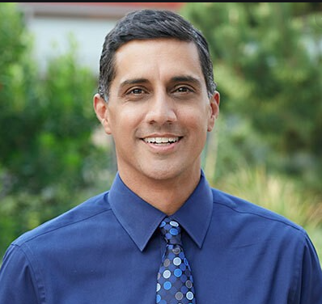
GME Town Hall
Niraj Seghal, MD
Chief Medical Officer, Senior Associate Dean, Clinical Affairs

Slide 7
Current COVID Numbers
74 COVID patients in-house
22 ICU patients (9 on vents)

Slide 8
HCW COVID Testing Info
Color Testing
Required by university staff to utilize university buildings
available to residents/fellows on Jan 4: more to follow

Slide 9
Housing Resources
Discounted COVID Lodging
https://wellmd.stanford.edu/COVID-19/discounted-lodging.html

Slide 10
Vaccine Plan
Health stream invite sent yesterday (12/14) to sign up for the vaccine
11,000 responses
84% said “yes”
You will be emailed to set up a date/time (coordinate with your Program)
Goal: residents/fellows in wave one and wave two!!
More information:
FAQs
https://shcconnect.stanfordmed.org/shcnews/COVID-19/Documents/COVID-19%20Vaccine%20Allocation%20and%20Information--FAQs.pdf
https://www.nytimes.com/2020/12/14/well/live/covid-vaccine-questions.html

Slide 11
Surge Planning
COVID inpatient ward
ED management
Medical ICU Surge Planning

Slide 12
Surge Planning for Ward COVID Cases
Dedicated ward for COVID patients
Transfer Center
Ward Coverage
IM Residents
DOM Faculty
Depending on degree of surge coverage needs, may need to request further coverage

Slide 13
Surge Planning for MICU COVID
Team 1 Activated last week
Triggers
Team 2 Activated when there are 16 COVID positive
Team 2 Activated yesterday
Team 3 Activated when there are 30 positive
Team 4 Activated when there are 46 positive
Teams composed of faculty, 3 residents (fellows)
2 day, 1 night
Medicine to cover 50% of teams
Anesthesia/Emergency Medicine
Other services as needed for team activation
Surgery, Neurology
Reduction in elective surgical cases

Slide 14
GME is virtual
We are working from home but office hours are available by appointment.
Still processing loan forms (mhaddad@stanfordhealthcare.org)
Main phone line 650 723 5948 still answered
For urgent issues call Ann on her cell phone 650.799.1504

Slide 15
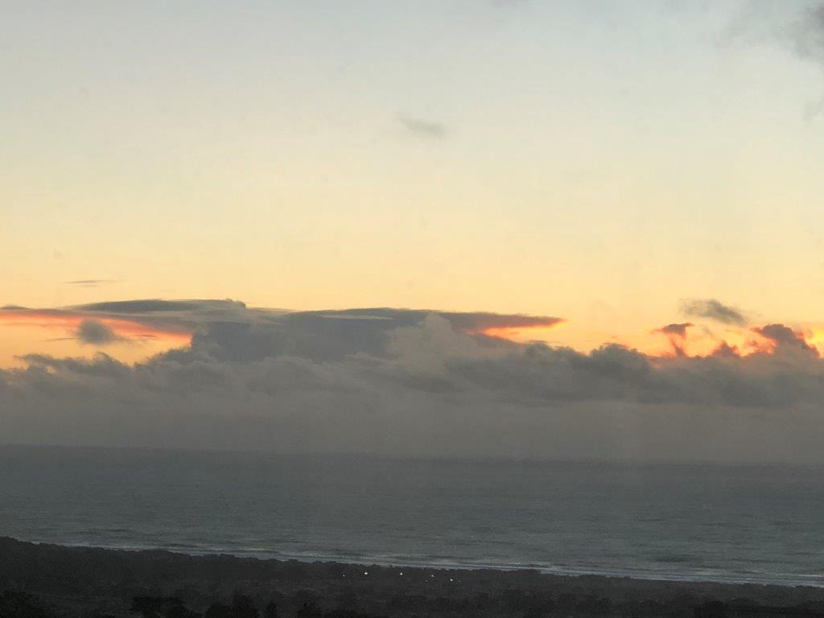
Questions?
Stay safe

